Slide 1
Integrating New Advances into the Care of Patients with Cancer A Multitumor Symposium in Partnership with the American Oncology Network
CME/MOC, NCPD and ACPE Accredited
Saturday, November 8, 2025 10:00 AM – 3:00 PM CT

Slide 2
Agenda
Module 1 — Lung Cancer: Drs Gainor, Langer and Shields
Module 2 — Chronic Lymphocytic Leukemia: Dr Rogers
Module 3 — Ovarian Cancer: Dr Konecny
Module 4 — Gastroesophageal Cancers: Dr Shah

Slide 3
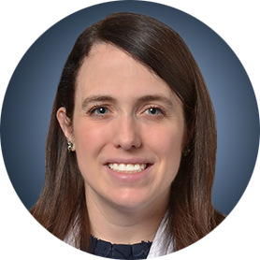

Chronic Lymphocytic Leukemia Faculty
Kerry A Rogers, MD
Associate Professor
Division of Hematology
The Ohio State University
Columbus, Ohio
MODERATOR
Stephen "Fred" Divers, MD
Chief Medical Officer
American Oncology Network
Hot Springs, Arkansas

Slide 4
Dr Rogers — Disclosures
Advisory Committees | Genentech, a member of the Roche Group, Janssen Biotech Inc
Consulting Agreements | AbbVie Inc, Alpine Immune Sciences, AstraZeneca Pharmaceuticals LP, BeOne, Genentech, a member of the Roche Group, Lilly
Contracted Research | AbbVie Inc, AstraZeneca Pharmaceuticals LP, Genentech, a member of the Roche Group, Lilly
Data and Safety Monitoring Boards/Committees | AstraZeneca Pharmaceuticals LP

Slide 5
Dr Divers — Disclosures
Advisory Committees | Daiichi Sankyo Inc

Slide 6
Snapshot of AON Practice Chronic Lymphocytic Leukemia

Slide 7
Snapshot of AON Practice Chronic Lymphocytic Leukemia — Bruton Tyrosine Kinase Inhibitors

Slide 8
Snapshot of AON Practice Chronic Lymphocytic Leukemia — Other Treatments

Slide 9
Chronic Lymphocytic Leukemia
Kerry A Rogers, MD
Associate Professor
Division of Hematology, The Ohio State University
November 8th, 2025

Slide 10
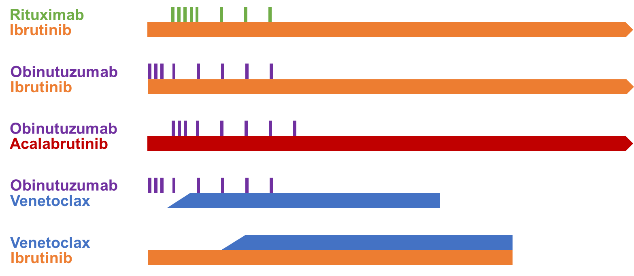
Initial CLL Treatment Regimens
Both continuous and fixed-duration options
Choice depends on CLL features and patient factors
 | Continuous BTKi | Venetoclax + Obinutuzumab | BTKi + Venetoclax +/- Obinutuzumab
Agents/ Regiments | Acalabrutinib +/- O Zanubrutinib Ibrutinib | Venetoclax + Obinutuzumab (VO) | Acalabrutinib + Venetoclax +/- O (AV, AVO)
Schedule | Continuously dosed | Venetoclax C2-12 Obinutuzumab C1-6) | Acalabrutinib C1-14 Venetoclax C3-14 (Obinutuzumab C2-7)
Key Points | Indefinite Best PFS in del(17p) and/or TP53 mutated CLL Easiest to start and take | Fixed-duration Initiation is visit-intensive Infusions are not preferred | Fixed-duration All oral and fewer visits than VO with AV
Major Toxicities | BTKi cardiotoxicities Bleeding risk Ongoing drug costs | TLS risk Cytopenias can be more Infusion reactions | Still has BTKi cardiac toxicities, just less Fewer visits at initiation

Slide 11
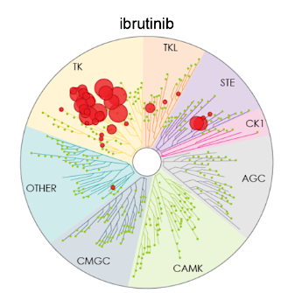
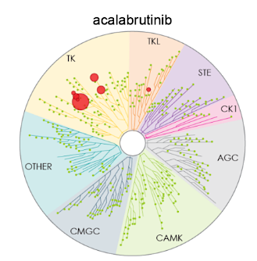
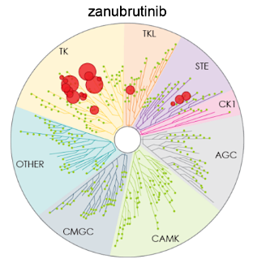
The FDA Approved Covalent BTK Inhibitors
 | Ibrutinib | Acalabrutinib | Zanubrutinib
FDA Approvals | CLL/SLL, WM | CLL/SLL, MCL | CLL/SLL, MCL, WM, MZL, FL
Dosing | 420mg PO daily | 100mg PO BID | 160mg PO BID or 320mg PO daily
FDA approved combinations | Rituximab, Obinutuzumab | Obinutuzumab, + Venetoclax - pending | -
Selectivity
Key Facts | First-in-class Inhibits ITK Highest rates of afib | More selective Less atrial fibrillation Less hypertension | More selective Less atrial fibrillation Most approvals
CLL = Chronic Lymphocytic Leukemia, SLL = Small Lymphocytic Lymphoma, MCL = Mantle Cell Lymphoma, WM = Waldenstrom’s Macroglobulinemia, MZL = Marginal Zone Lymphoma, FL = Follicular Lymphoma

Slide 12
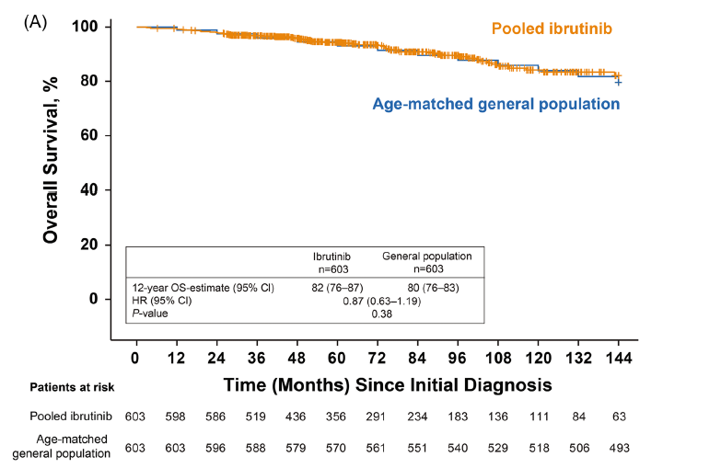
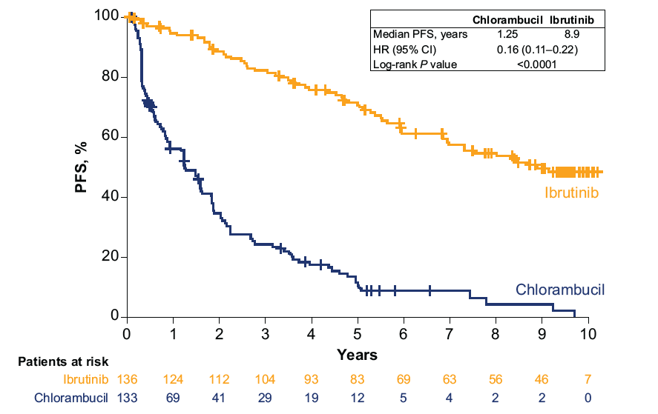
Efficacy of BTK Inhibitors – Ibrutinib (1st in Class)
Progression-free and overall survival advantage over chemotherapy
Most patients can expect normal survival
OS from CLL Diagnosis in Patients
in Firstline Ibrutinib Studies
PFS with Ibrutinib (RESONATE-2)
Median PFS
8.9 years
HR 0.87 (95% CI: 0.63-1.19)
Burger et al., EHA 2024; Ghia et al., Hematologica 2024

Slide 13
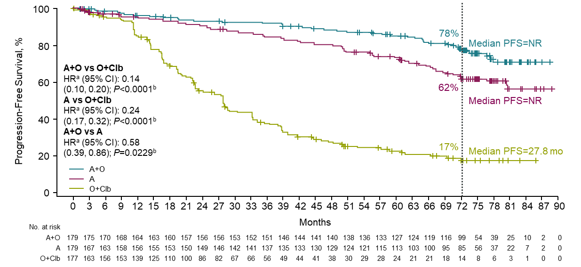
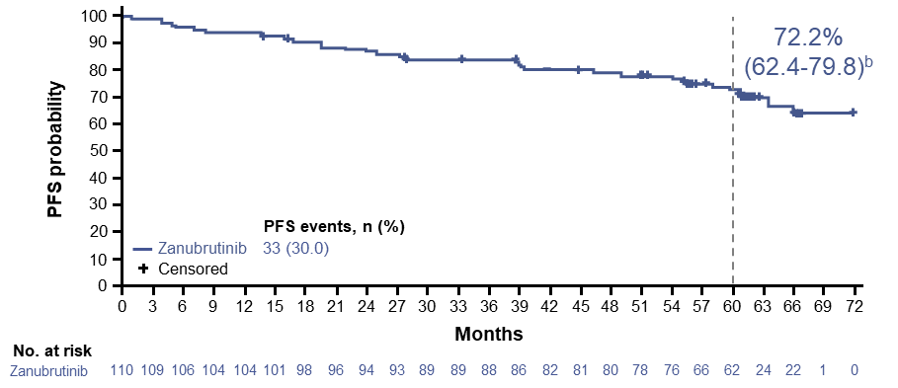
Acalabrutinib and Zanubrutinib Are Highly Effective
Outstanding PFS with other covalent BTKi
PFS similar in patients with or without del(17p) CLL
Obinutuzumab can improve the PFS when added to acalabrutinib in patients without del(17p) CLL
Acalabrutinib 6-year Follow Up (PFS)
ELEVATE-TN
Zanubrutinib 5-year Follow Up (PFS)
Sequoia Arm C – del(17p) CLL
Sharman et al., ASH 2023; Tam et al., ASCO 2025 abstract 7011

Slide 14
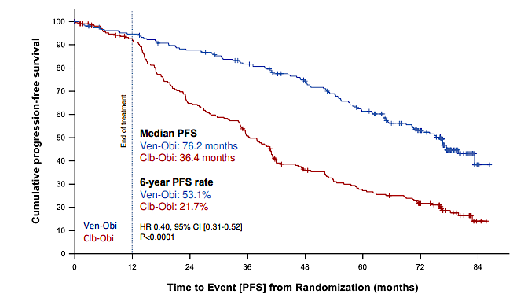
CLL14: Venetoclax + Obinutuzumab for 1 year
Phase 3 study in older patients or those with comorbidities
Clear benefit to venetoclax and obinutuzumab (HR 0.35, p<0.0001)
PFS with Venetoclax/Obinutuzumab
Median PFS
6.35 years
Al-Sawaf O et al. Blood 2024

Slide 15
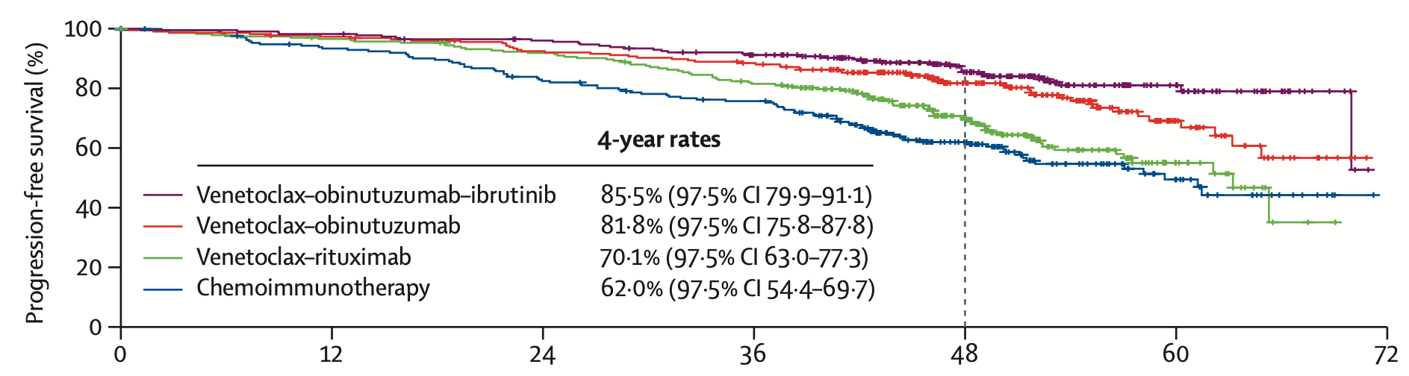
CLL13: Venetoclax Regimens in Fit Patients
Established venetoclax and obinutuzumab in young, fit patients
Obinutuzumab makes a difference over rituximab!
PFS with Venetoclax Combinations vs CIT (FCR vs BR)
Months
Ven/Obin vs Ven/R
HR 0.57, p=0.011
Furstenau et al., Lancet Onc 2024

Slide 16
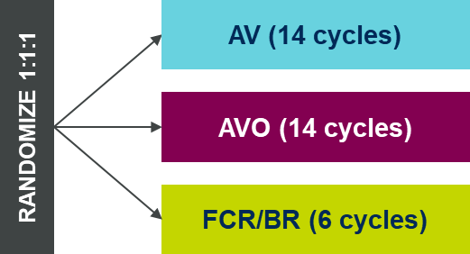
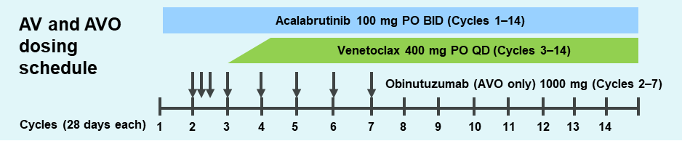
AMPLIFY: AV or AVO vs FCR/BR
Randomized phase 3 study of initial treatment
Fit patients (CIRS-Geriatric >6 excluded)
Excludes del(17p) and/or TP53 mutated CLL
Compares PFS with AV to FCR/BR then AVO to FCR/BR
Randomization
Study Treatment for AV +/-O
Stratified by: age (>65 vs ≤65 years), IGHV mutational status, Rai stage (≥3 vs <3), and geographic region
Brown et al., ASH 2024

Slide 17
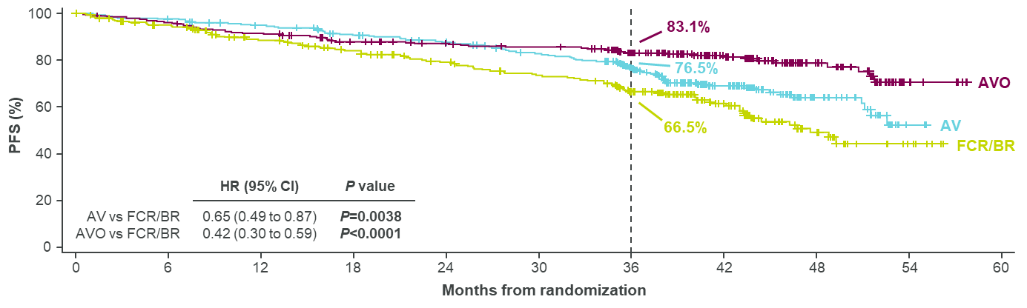
AMPLIFY: Progression-Free Survival
Both AV and AVO had improved PFS compared to FCR/BR
The study was not designed to compare AV to AVO
AMPLIFY Progression-Free Survival
Median NR
Median NR
Median 47.6 months
Brown et al., ASH 2024

Slide 18
AV+/- O Toxicities
Limited treatment duration decreased frequency of hypertension and atrial arrhythmias
Infection remained common, particularly with AVO
 | AV (n=291) |  | AVO (n=284) |  | CIT (n=259)
n (%) | Any Grade | Grade 3+ | Any Grade | Grade 3+ | Any Grade | Grade 3+
Afib/flutter | 2 (0.7) | 5 (1.7) | 34 (12.0) | 7 (2.5) | 9 (3.5) | 2 (1.2)
Hypertension | 12 (4.1) | 8 (2.7) | 11 (3.9%) | 6 (2.1%) | 7 (2.7%) | 2 (0.8%)
Major Hemorrhage | 3 (1.0) | 3 (1.0) | 8 (2.8) | 6 (2.1) | 2 (0.8) | 1 (0.4)
Infection | 148 (50.9) | 36 (12.4) | 153 (53.9) | 67 (23.6) | 82 (31.7) | 26 (10.0)
TLS | 1 (0.3) | 1 (0.3) | 1 (0.4) | 1 (0.4) | 8 (3.1) | 8 (3.1)
Brown et al., NEJM 2025

Slide 19
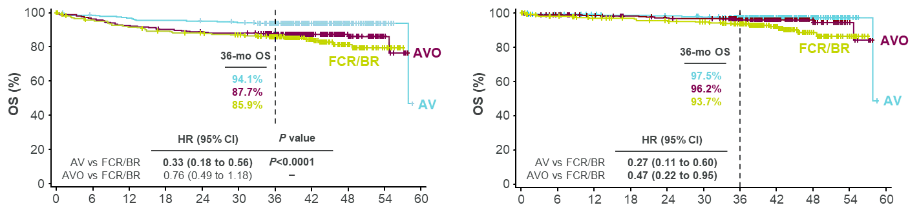
AMPLIFY: Overall Survival and COVID-19 Deaths
There were more deaths from COVID-19 in anti-CD20 antibody containing arms (AVO n=25, FCR/BR n=21, and AV n=10)
This highlights infection risk with obinutuzumab
Overall Survival with
COVID-19 Deaths Censored
Overall Survival
Brown et al., ASH 2024

Slide 20
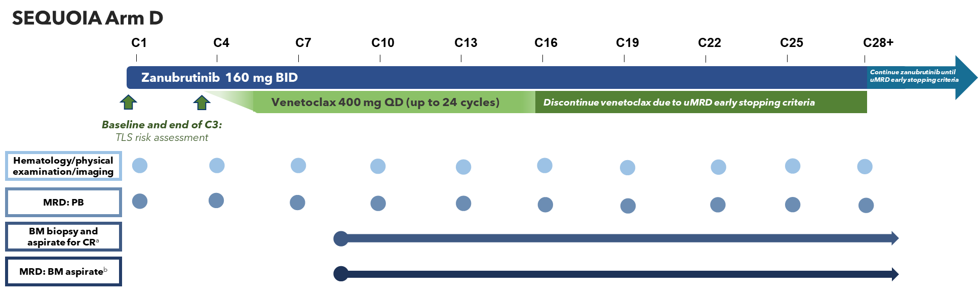
SEQUOIA Arm D: ZV with MRD Guided Duration
Non-randomized arm of a phase 3 study for treatment-naïve CLL
Originally for patients with del(17p) and/or TP53 mutations (n=66)
Amended to include patients without TP53 alteration (n=47)
Complex MRD and response guided stopping rules
uMRD-guided stopping criteria
All conditions must be met:
Response assessed as CR or CRi confirmed by a BM biopsy
uMRD <1×10⁻⁴ (uMRD4) achieved in 2 consecutive peripheral blood MRD tests conducted ≥12 weeks apart
uMRD4 achieved in 2 consecutive BM tests conducted ≥12 weeks apart
Received:
Minimum of 12 cycles of venetoclax (to stop venetoclax early)
Minimum of 27 cycles of zanubrutinib (to stop zanubrutinib early)
Shadman et al., ASCO 2025 abstract 7009

Slide 21
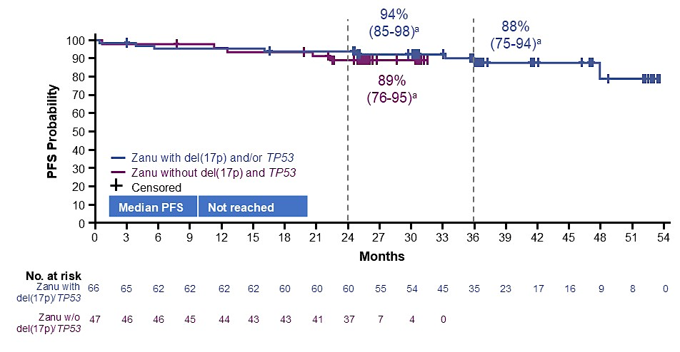
SEQUOIA Arm D: Progression-Free Survival
Median follow-up was 38.7 months for patients with del(17p)/TP53 mutation and 29.6 months for patients without del(17p)/TP53 mutation
11 of 114 (9.6%) met MRD-stopping criteria and discontinued treatment
Shadman et al., ASCO 2025 abstract 7009

Slide 22
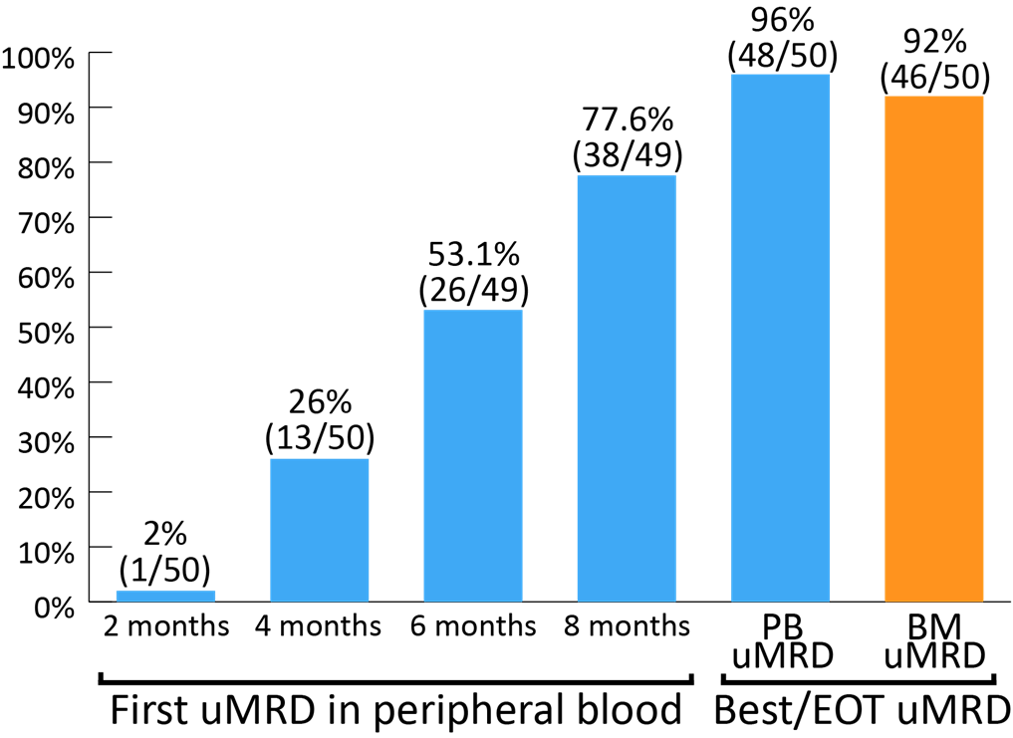
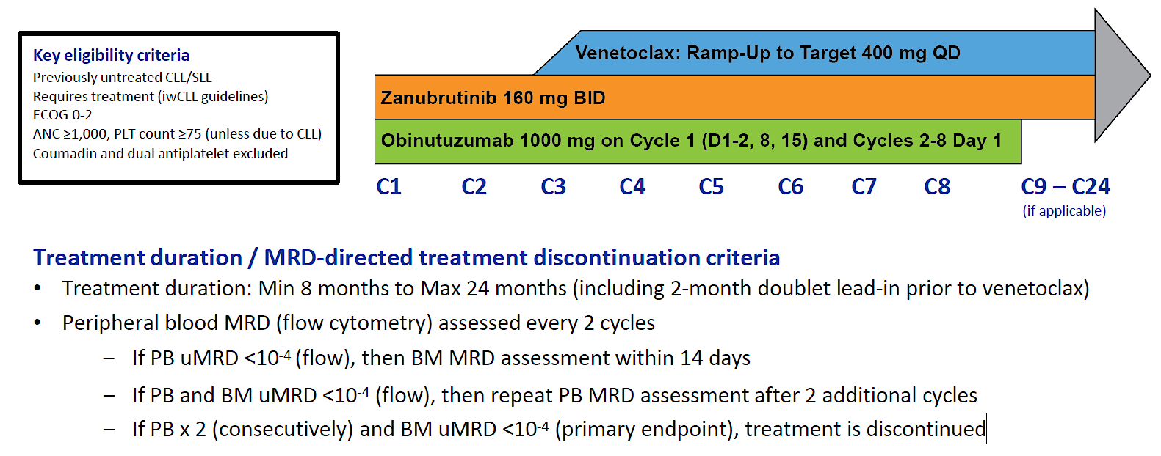
BOVen: Phase 2 Study of ZVO
Treatment-naïve CLL patients with any genetic disease features
Treatment duration is based on achieving uMRD
Study Treatment Schedule
uMRD by Flow Cytometry (1x10⁻⁴)
Soumerai et al., ASH 2024 Abstract 1867

Slide 23
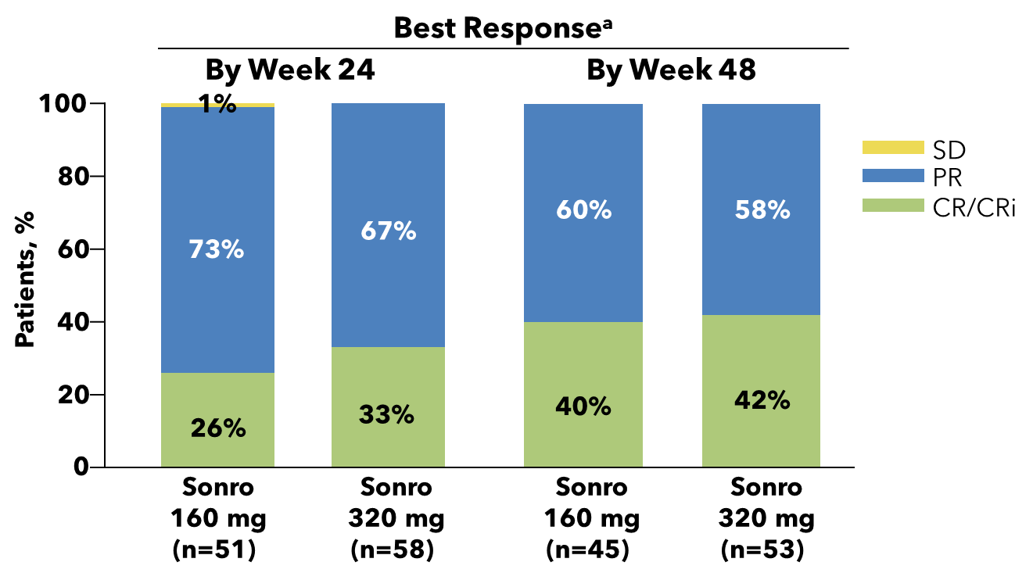
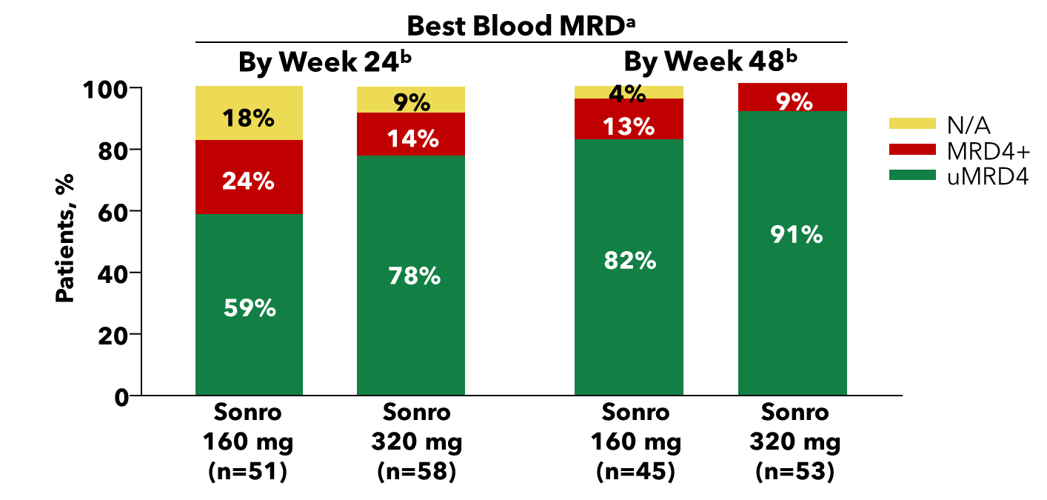
Phase I/Ib Study: Zanubrutinib and Sonrotoclax
Sonrotoclax is a potent and selective BCL2 inhibitor with activity against BCL-xL
It was combined with zanubrutinib 320mg at 2 doses (160mg and 320mg) with favorable safety and high response rates
v
Soumerai et al., ASH 2024 Abstract 1012

Slide 24
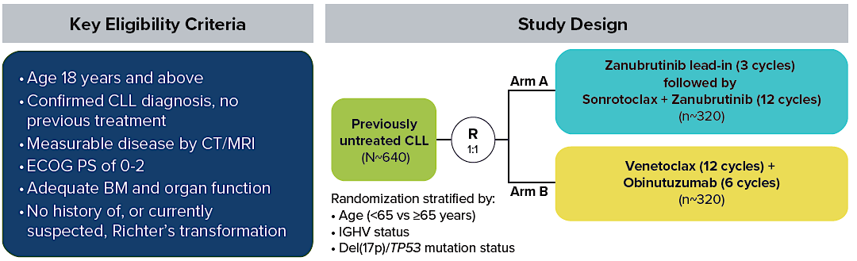
CELESTIAL-TNCLL: VO vs ZS
Phase 3 study of venetoclax/obinutuzumab (VO) vs zanubrutinib/sonrotoclax (ZS) in untreated CLL
Primary endpoint is PFS by ICR
Patten et al., ASH 2024 Abstract 3275.1

Slide 25
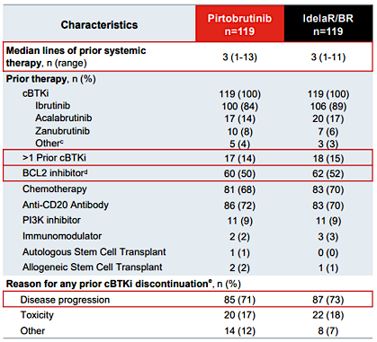
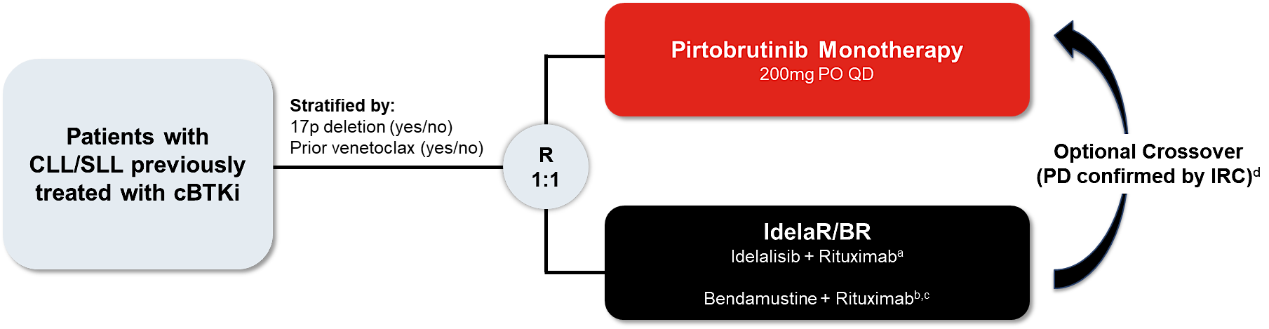
BRUIN CLL-321: Pirtobrutinib vs IdelaR/BR
Study of the non-covalent BTKi, pirtobrutinib, in R/R CLL
Enrolled similar population to prior phase 1/2 study of pirtobrutinib
Study Diagram
Sharman et al., ASH 2024 Abstract 886

Slide 26
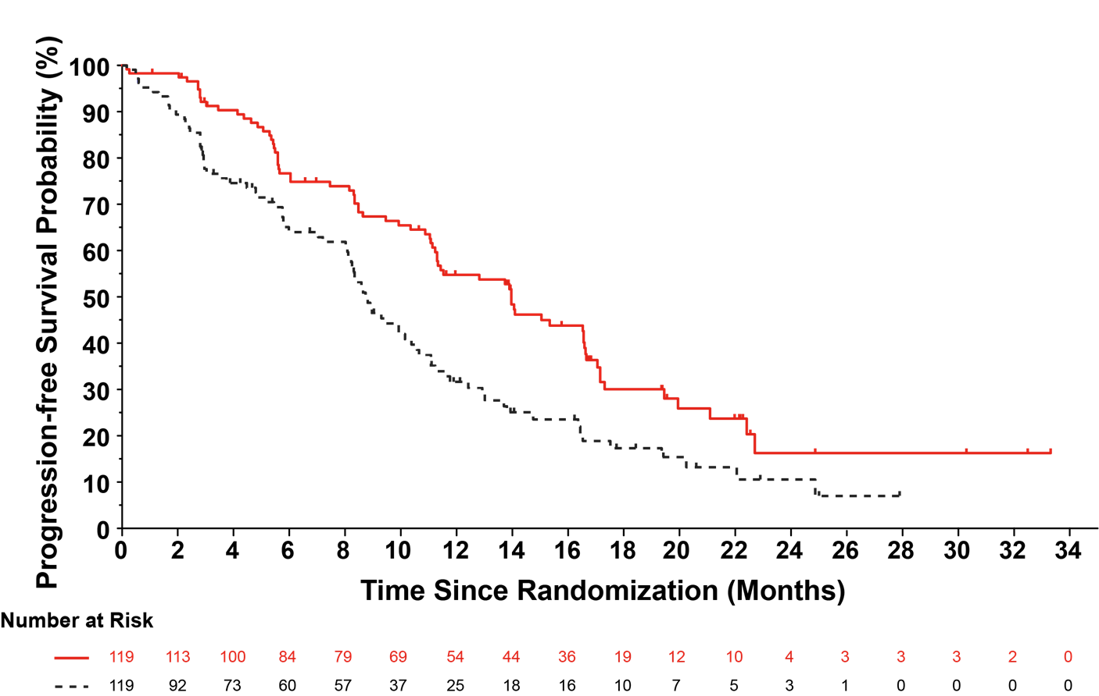
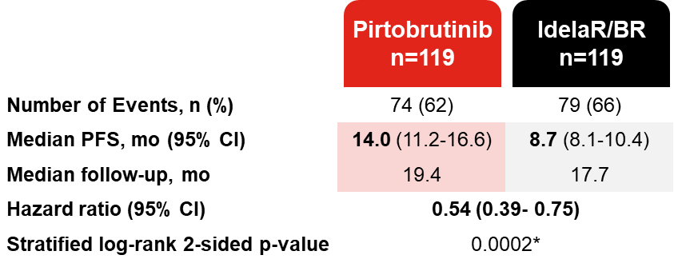
BRUIN CLL-321: PFS
PFS was improved with pirtobrutinib, but was short for CLL
Overall survival was similar between arms
Progression-Free Survival
Sharman et al., ASH 2024 Abstract 886

Slide 27
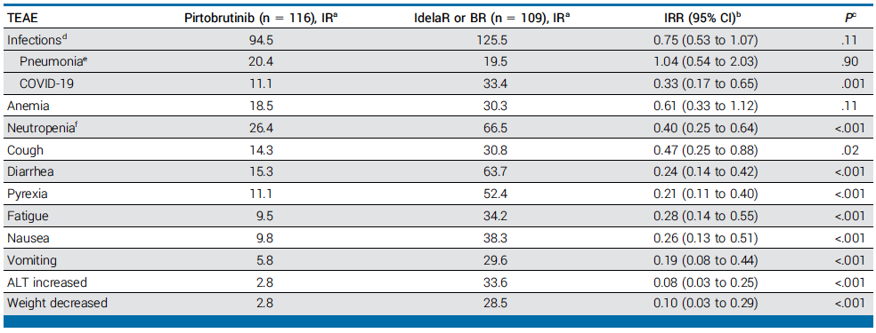
BRUIN CLL-321: Safety Data
Atrial fibrillation: 3 (2.6%) pirtobrutinib, 1 (0.9%) idelaR/BR
Hypertension: 8 (6.9%) pirtobrutinib, 4 (3.7%) idelaR/BR
Sharman JP et al. J Clin Oncol 2025;43:2538-49.

Slide 28
Phase 3 Studies with Pirtobrutinib as Initial Treatment
Pirtobrutinib is being tested as an initial therapy
Compared to bendamustine and rituximab
Compared to ibrutinib (subgroup of treatment-naïve patients)
 | BRUIN CLL-314 | BRUIN CLL-313
Treatment Arms | Pirtobrutinib Ibrutinib | Pirtobrutinib Bendamustine/rituximab (BR)
Prior Treatment(s) | Both untreated and previously treated | Untreated
Primary Endpoint | ORR | PFS
clinicaltrials.gov

Slide 29
BRUIN CLL-314: Pirtobrutinib vs Ibrutinib
662 patients were randomized: 225 TN and 437 R/R
Primary endpoint was ORR and powered for non-inferiority
Pirtobrutinib was non-inferior for ORR in ITT and R/R cohorts
ORR ITT | 18-month PFS ITT | Atrial Fibrillation Hypertension
87.0% | 86.9% | 2.4% 10.6%
78.6% | 82.3% | 13.5% 15.1%
p<0.0001
1:1
Pirtobrutinib
Ibrutinib
Woyach et al., ASH 2025 (abstract)

Slide 30
BRUIN CLL-313: Pirtobrutinib vs BR
Randomized phase 3 in treatment-naïve patients with CLL/SLL without 17p deletions
Positive results announced for the study:
Statistically significant and clinically meaningful improvement in progression-free survival (PFS) compared to chemoimmunotherapy
The overall safety profile of pirtobrutinib was generally consistent with previously reported trials
Data not yet available but expected soon
https://www.prnewswire.com/news-releases/lillys-jaypirca-pirtobrutinib-the-first-and-only-approved-non-covalent-reversible-btk-inhibitor-significantly-improved-progression-free-survival-in-patients-with-treatment-naive-cllsll-302548399.html

Slide 31
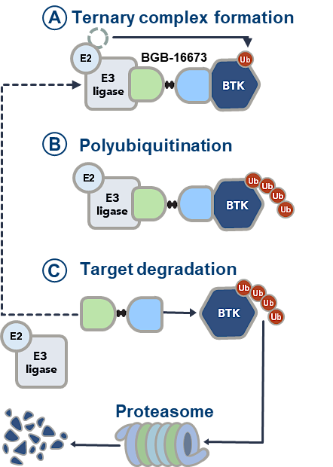
BTK Degraders – Mechanism of Action
Targets BTK for Degradation by the proteosome
In CLL this is effective even with BTK mutations
Mechanism of BTK Degraders
Scarfo et al., EHA 2025 abstract S158

Slide 32
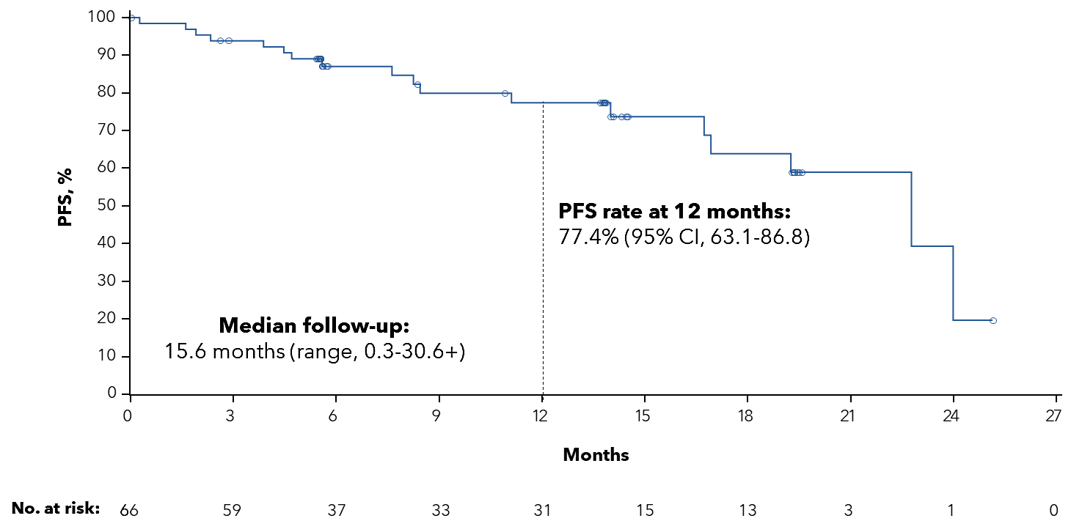
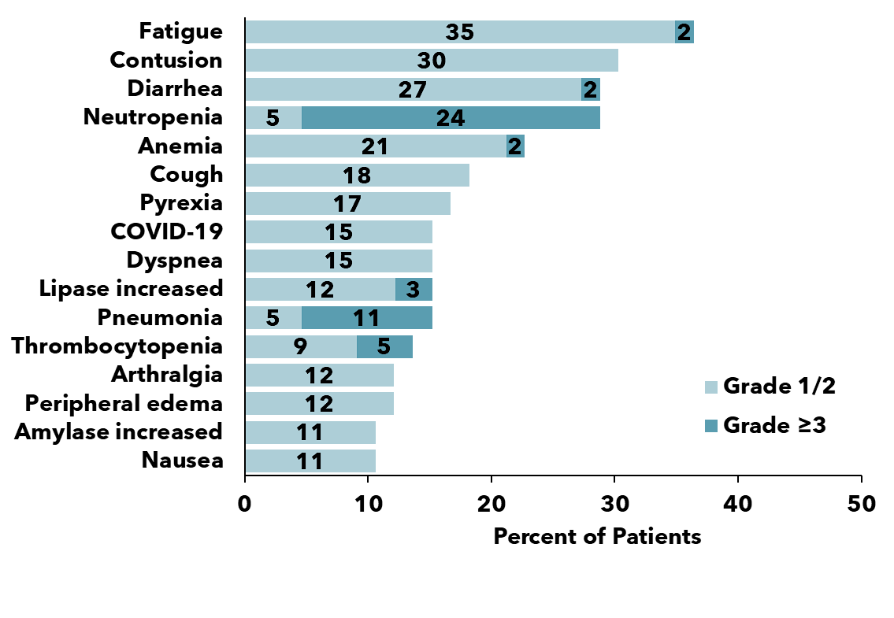
CaDAnCe-101: Phase 1 Study of the BTKI Degrader BGB-16673
66 CLL patients with a median of 4 (range 2-10) prior treatments
BTK mutations were present in 38.1% (24 of 63 tested)
PFS with BGB-16673
Adverse Events ≥10% of Patients
Scarfo et al., EHA 2025 abstract S158

Slide 33

Case Presentation: 75-year-old man with CLL and PMH of atrial fibrillation
Dr Zanetta Lamar (Naples, Florida)

Slide 34
QUESTIONS FOR THE FACULTY
In general, what is your preferred initial treatment for an otherwise healthy patient with IGHV-mutated CLL with no del(17p) or TP53 mutation? How, if at all, does age influence the decision?
For a patient with CLL for whom you are going to initiate treatment with a BTK inhibitor, which do you prefer? How do various comorbidities influence your selection?

Slide 35
QUESTIONS FOR THE FACULTY
If a patient with CLL who is receiving first-line zanubrutinib develops issues with bruising or bleeding, would switching to pirtobrutinib be a reasonable option assuming it was accessible?
Would you consider using MRD, in addition to routine scans, to determine whether discontinuation of a BTK inhibitor might be feasible?

Slide 36

Case Presentation: 82-year-old fit man with IGHV-unmutated, TP53-mutant symptomatic CLL
Dr Brian Mulherin (Indianapolis, Indiana)

Slide 37
QUESTIONS FOR THE FACULTY
In general, what is your preferred initial treatment for an otherwise healthy patient with IGHV-unmutated CLL with no del(17p) or TP53 mutation? How, if at all, does age influence the decision?
In general, what is your preferred initial treatment for an otherwise healthy patient with CLL and a del(17p) or TP53 mutation? How, if at all, does age influence the decision? What about IGHV status?

Slide 38
QUESTIONS FOR THE FACULTY
For a patient with CLL who is interested in time-limited treatment, how will you decide between venetoclax/obinutuzumab and acalabrutinib/venetoclax +/- obinutuzumab assuming the latter becomes available?
Would you be comfortable using zanubrutinib instead of acalabrutinib in combination with venetoclax?

Slide 39
QUESTIONS FOR THE FACULTY
Based on the emerging results from BRUIN CLL-313 and BRUIN CLL-314, are there situations in which you will consider employing pirtobrutinib as first-line treatment?

Slide 40
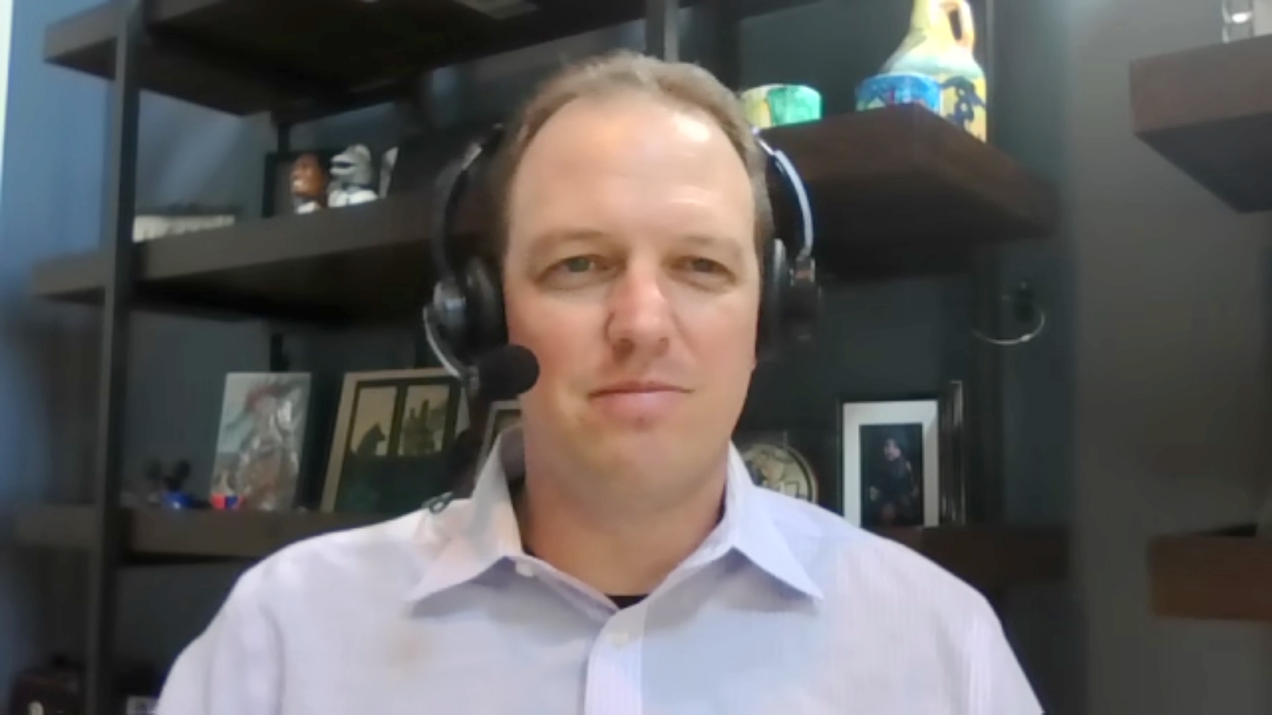
Case Presentation: 84-year-old woman with IGHV-mutated recurrent CLL who receives pirtobrutinib
Dr Sean Warsch (Asheville, North Carolina)

Slide 41
QUESTIONS FOR THE FACULTY
In general, for a patient with CLL with disease progression after 6 years on a covalent BTK inhibitor who then receives venetoclax/obinutuzumab with further progression after 2 years, what would be your preferred next treatment? What if the covalent BTK inhibitor was discontinued after 1 year due to intolerance?

Slide 42
QUESTIONS FOR THE FACULTY
For a patient who receives pirtobrutinib for double-refractory CLL, in general what treatment would you recommend on disease progression?
What do we know about response to covalent BTK inhibitors after progression on pirtobrutinib? Is there reason to believe this strategy would or would not be effective?

Slide 43
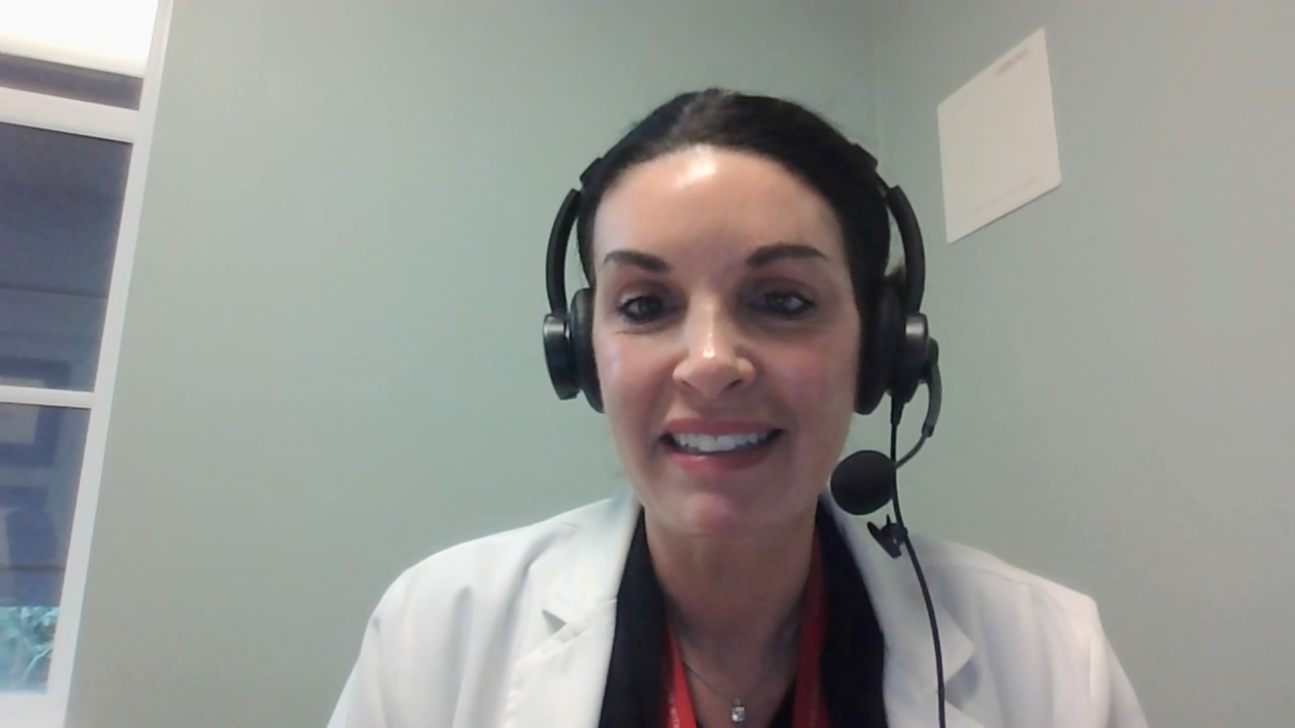
Case Presentation: 78-year-old woman with recurrent del(17p) CLL who receives venetoclax/obinutuzumab
Dr Jennifer Yannucci (Savannah, Georgia)

Slide 44
QUESTIONS FOR THE FACULTY
In general, what is the minimum duration of remission after discontinuation of venetoclax/obinutuzumab before you will consider re-treatment? Does this differ in the front-line versus the relapsed setting?
Based on available data and your personal clinical experience, how would you compare the novel Bcl-2 inhibitor sonrotoclax to venetoclax in terms of efficacy and tolerability?

Slide 45
QUESTIONS FOR THE FACULTY
How do BTK degraders differ from BTK inhibitors? Have you observed definitive clinical benefit from these agents? Where do you think they may fit into current treatment algorithms? What role, if any, do you see for this agent in R/R CLL?

Slide 46
Integrating New Advances into the Care of Patients with Cancer A Multitumor Symposium in Partnership with the American Oncology Network
CME/MOC, NCPD and ACPE Accredited
Saturday, November 8, 2025 10:00 AM – 3:00 PM CT

Slide 47
Up Next … Dr Gottfried E Konecny discusses the management of ovarian cancer

