Slide 1
Cancer Q&A: Addressing Common Questions Posed by
Patients with Relapsed/Refractory Multiple Myeloma
A CME/MOC-Accredited Webinar Developed in Partnership with CancerCare®
Thursday, August 7, 2025
5:00 PM – 6:00 PM ET
Faculty
Natalie S Callander, MD
Sagar Lonial, MD, FACP
Moderator
Neil Love, MD

Slide 2
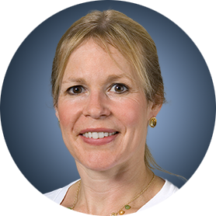
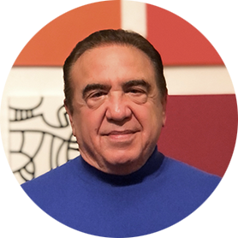
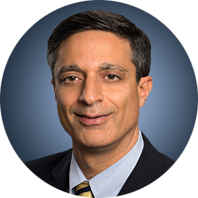
Faculty
Natalie S Callander, MD
Director, Myeloma Clinical Program
University of Wisconsin Carbone Cancer Center
Madison, Wisconsin
MODERATOR
Neil Love, MD
Research To Practice
Miami, Florida
Sagar Lonial, MD, FACP
Chair and Professor
Department of Hematology and Medical Oncology
Chief Medical Officer
Winship Cancer Institute
Emory University School of Medicine
Atlanta, Georgia

Slide 3
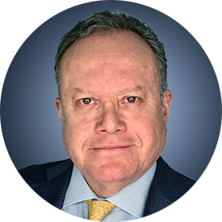
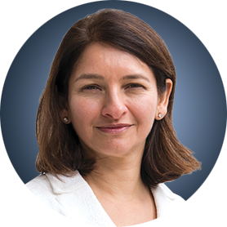
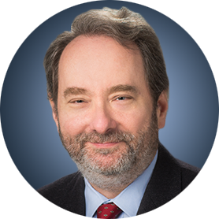
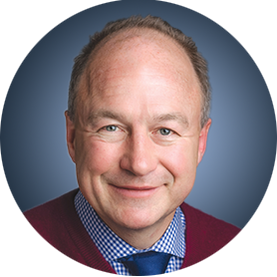
Survey Participants
Rafael Fonseca, MD
Chief Innovation Officer
Getz Family Professor of Cancer
Distinguished Mayo Investigator
Mayo Clinic in Arizona
Phoenix, Arizona
Noopur Raje, MD
Director, Center for Multiple Myeloma
Rita Kelley Chair in Oncology
Massachusetts General Hospital Cancer Center
Professor of Medicine
Harvard Medical School
Boston, Massachusetts
Robert Z Orlowski, MD, PhD
Florence Maude Thomas Cancer Research Professor
Department of Lymphoma and Myeloma
Professor, Department of Experimental Therapeutics
Vice Chair, Myeloma Translational Research
Division of Cancer Medicine
The University of Texas MD Anderson Cancer Center
Houston, Texas
Paul G Richardson, MD
Clinical Program Leader and Director of Clinical Research
Jerome Lipper Multiple Myeloma Center
Dana-Farber Cancer Institute
RJ Corman Professor of Medicine
Harvard Medical School
Boston, Massachusetts

Slide 4
Commercial Support
This activity is supported by an educational grant from GSK.

Slide 5
Dr Love — Disclosures
Dr Love is president and CEO of Research To Practice. Research To Practice receives funds in the form of educational grants to develop CME activities from the following companies: Aadi Bioscience, AbbVie Inc, ADC Therapeutics, Alexion Pharmaceuticals, Amgen Inc, Array BioPharma Inc, a subsidiary of Pfizer Inc, Arvinas, Astellas, AstraZeneca Pharmaceuticals LP, Aveo Pharmaceuticals, Bayer HealthCare Pharmaceuticals, BeOne, Black Diamond Therapeutics Inc, Blueprint Medicines, Boehringer Ingelheim Pharmaceuticals Inc, Bristol Myers Squibb, Clovis Oncology, Coherus BioSciences, CTI BioPharma, a Sobi Company, Daiichi Sankyo Inc, Eisai Inc, Elevation Oncology Inc, Exact Sciences Corporation, Exelixis Inc, Genentech, a member of the Roche Group, Genmab US Inc, Geron Corporation, Gilead Sciences Inc, GSK, Hologic Inc, ImmunoGen Inc, Incyte Corporation, Ipsen Biopharmaceuticals Inc, Jazz Pharmaceuticals Inc, Johnson & Johnson, Karyopharm Therapeutics, Kite, A Gilead Company, Kura Oncology, Legend Biotech, Lilly, MEI Pharma Inc, Merck, Mersana Therapeutics Inc, Mirati Therapeutics Inc, Mural Oncology Inc, Natera Inc, Novartis, Novartis Pharmaceuticals Corporation on behalf of Advanced Accelerator Applications, Novocure Inc, Nuvalent, Pfizer Inc, Pharmacyclics LLC, an AbbVie Company, Puma Biotechnology Inc, Regeneron Pharmaceuticals Inc, Rigel Pharmaceuticals Inc, R-Pharm US, Sanofi, Seagen Inc, Servier Pharmaceuticals LLC, SpringWorks Therapeutics Inc, Stemline Therapeutics Inc, Syndax Pharmaceuticals, Taiho Oncology Inc, Takeda Pharmaceuticals USA Inc, TerSera Therapeutics LLC, and Tesaro, A GSK Company.

Slide 6
Research To Practice CME Planning Committee Members,
Staff and Reviewers
Planners, scientific staff and independent reviewers for Research To Practice have no relevant conflicts of interest to disclose.

Slide 7
Dr Callander — Disclosures
No relevant conflicts of interest to disclose.

Slide 8
Dr Lonial — Disclosures
Advisory Committees and Consulting Agreements | AbbVie Inc, Amgen Inc, Bristol Myers Squibb, Genentech, a member of the Roche Group, GSK, Janssen Biotech Inc, Novartis, Pfizer Inc, Regeneron Pharmaceuticals Inc, Takeda Pharmaceuticals USA Inc
Boards of Directors | TG Therapeutics Inc
Contracted Research | Bristol Myers Squibb, Janssen Biotech Inc, Novartis, Takeda Pharmaceuticals USA Inc
Stock Options/Stock — Public Companies | TG Therapeutics Inc

Slide 9
Dr Fonseca — Disclosures
Survey Participant
Boards of Directors | Antengene
Consulting Agreements | AbbVie Inc, Adaptive Biotechnologies Corporation, Amgen Inc, Apple, Bristol Myers Squibb, Celgene Corporation, GSK, Janssen Biotech Inc, Karyopharm Therapeutics, Pfizer Inc, RA Capital Management, Regeneron Pharmaceuticals Inc, Sanofi
Data and Safety Monitoring Boards/Committees | Bristol Myers Squibb
Patents (Through Institution) | Abbott
Scientific Advisory Boards | Caris Life Sciences
Stock Options/Stock — Public Companies | Antengene, Caris Life Sciences

Slide 10
Dr Orlowski — Disclosures
Survey Participant
Advisory Committees and Consulting Agreements | AbbVie Inc, Adaptive Biotechnologies Corporation, Asylia Therapeutics Inc, Biotheryx, Bristol Myers Squibb, CellCentric, DEM BioPharma, IASO Bio, Karyopharm Therapeutics, Lytica Therapeutics, Meridian Therapeutics, Monte Rosa Therapeutics, MYELOMA360, Neoleukin Therapeutics Inc, Oncopeptides, Pfizer Inc, Regeneron Pharmaceuticals Inc, Sanofi, Takeda Pharmaceuticals USA Inc
Stock Options — Private Companies | Asylia Therapeutics Inc

Slide 11
Dr Raje — Disclosures
Survey Participant
Advisory Committees | Advisor to AstraZeneca Pharmaceuticals LP, Bristol Myers Squibb, Genentech, a member of the Roche Group, GSK, Johnson & Johnson, Pfizer Inc, Sanofi

Slide 12
Dr Richardson — Disclosures
Survey Participant
Consulting Agreements | Bristol Myers Squibb, Celgene Corporation, GSK, Karyopharm Therapeutics, Oncopeptides, Regeneron Pharmaceuticals Inc, Sanofi
Contracted Research | Oncopeptides

Slide 13
This educational activity contains discussion of
non-FDA-approved uses of agents and regimens. Please refer to official prescribing information for each product for approved indications.

Slide 14
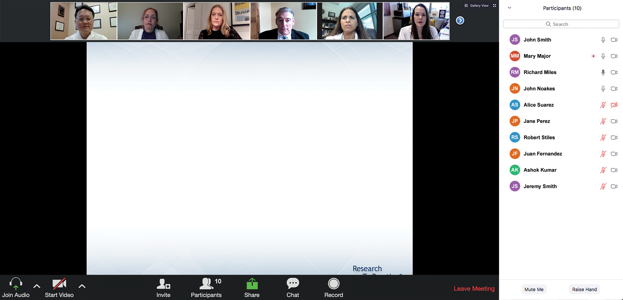
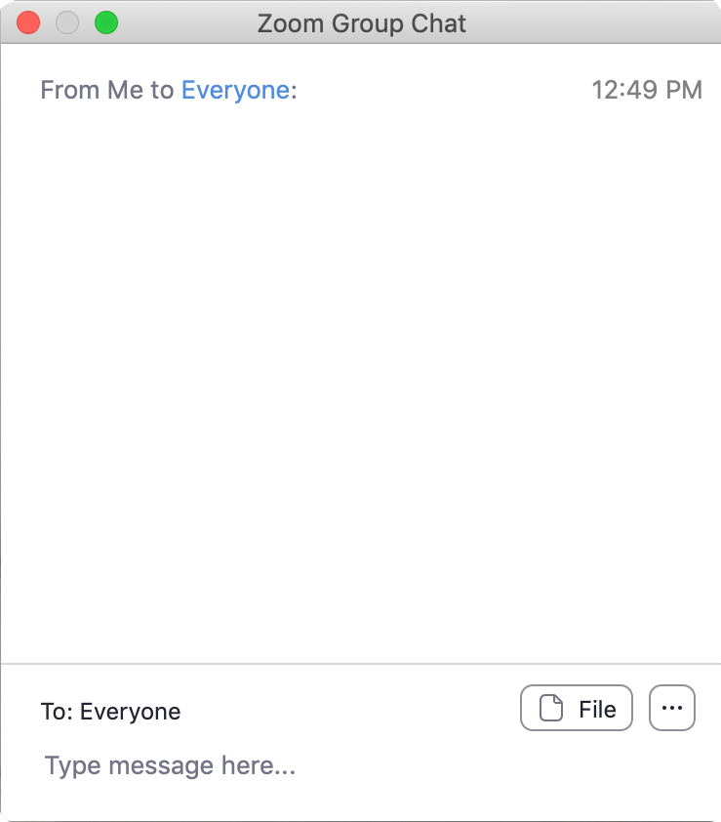
We Encourage Clinicians in Practice to Submit Questions
Feel free to submit questions now before the program begins and throughout the program.

Slide 15
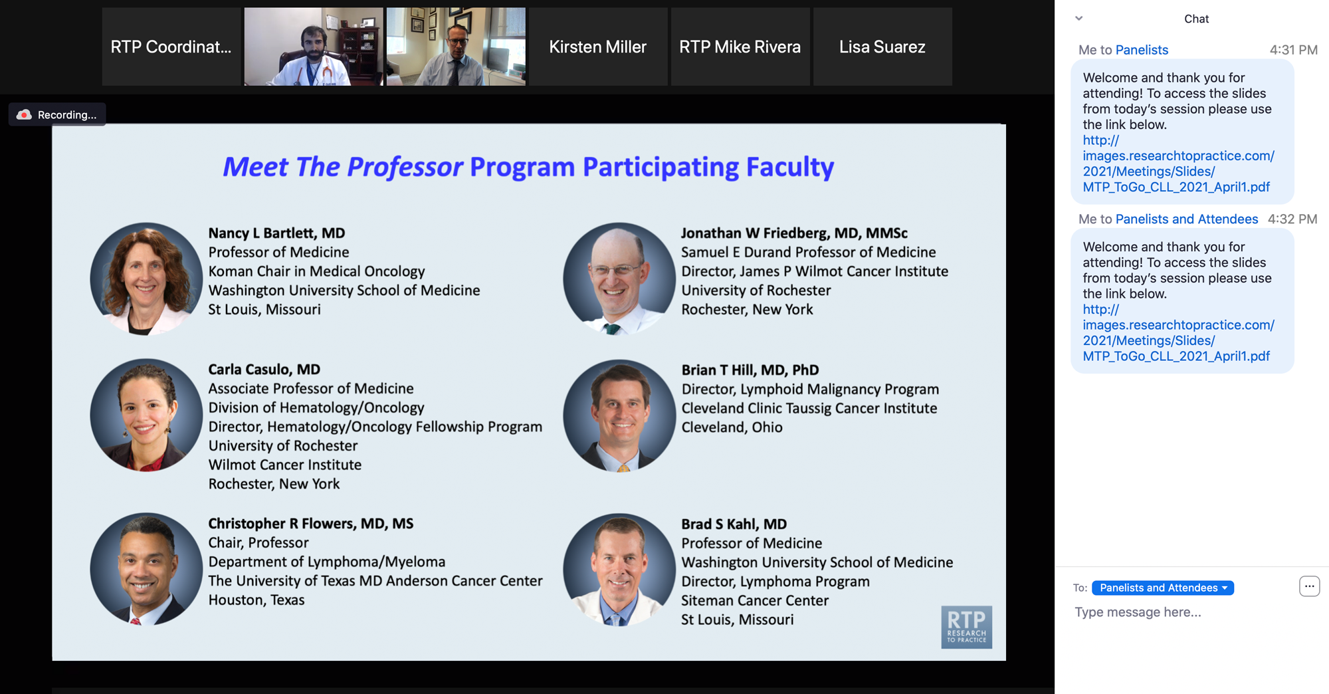
Familiarizing Yourself with the Zoom Interface
Expand chat submission box
Drag the white line above the submission box up to create
more space for your message.

Slide 16
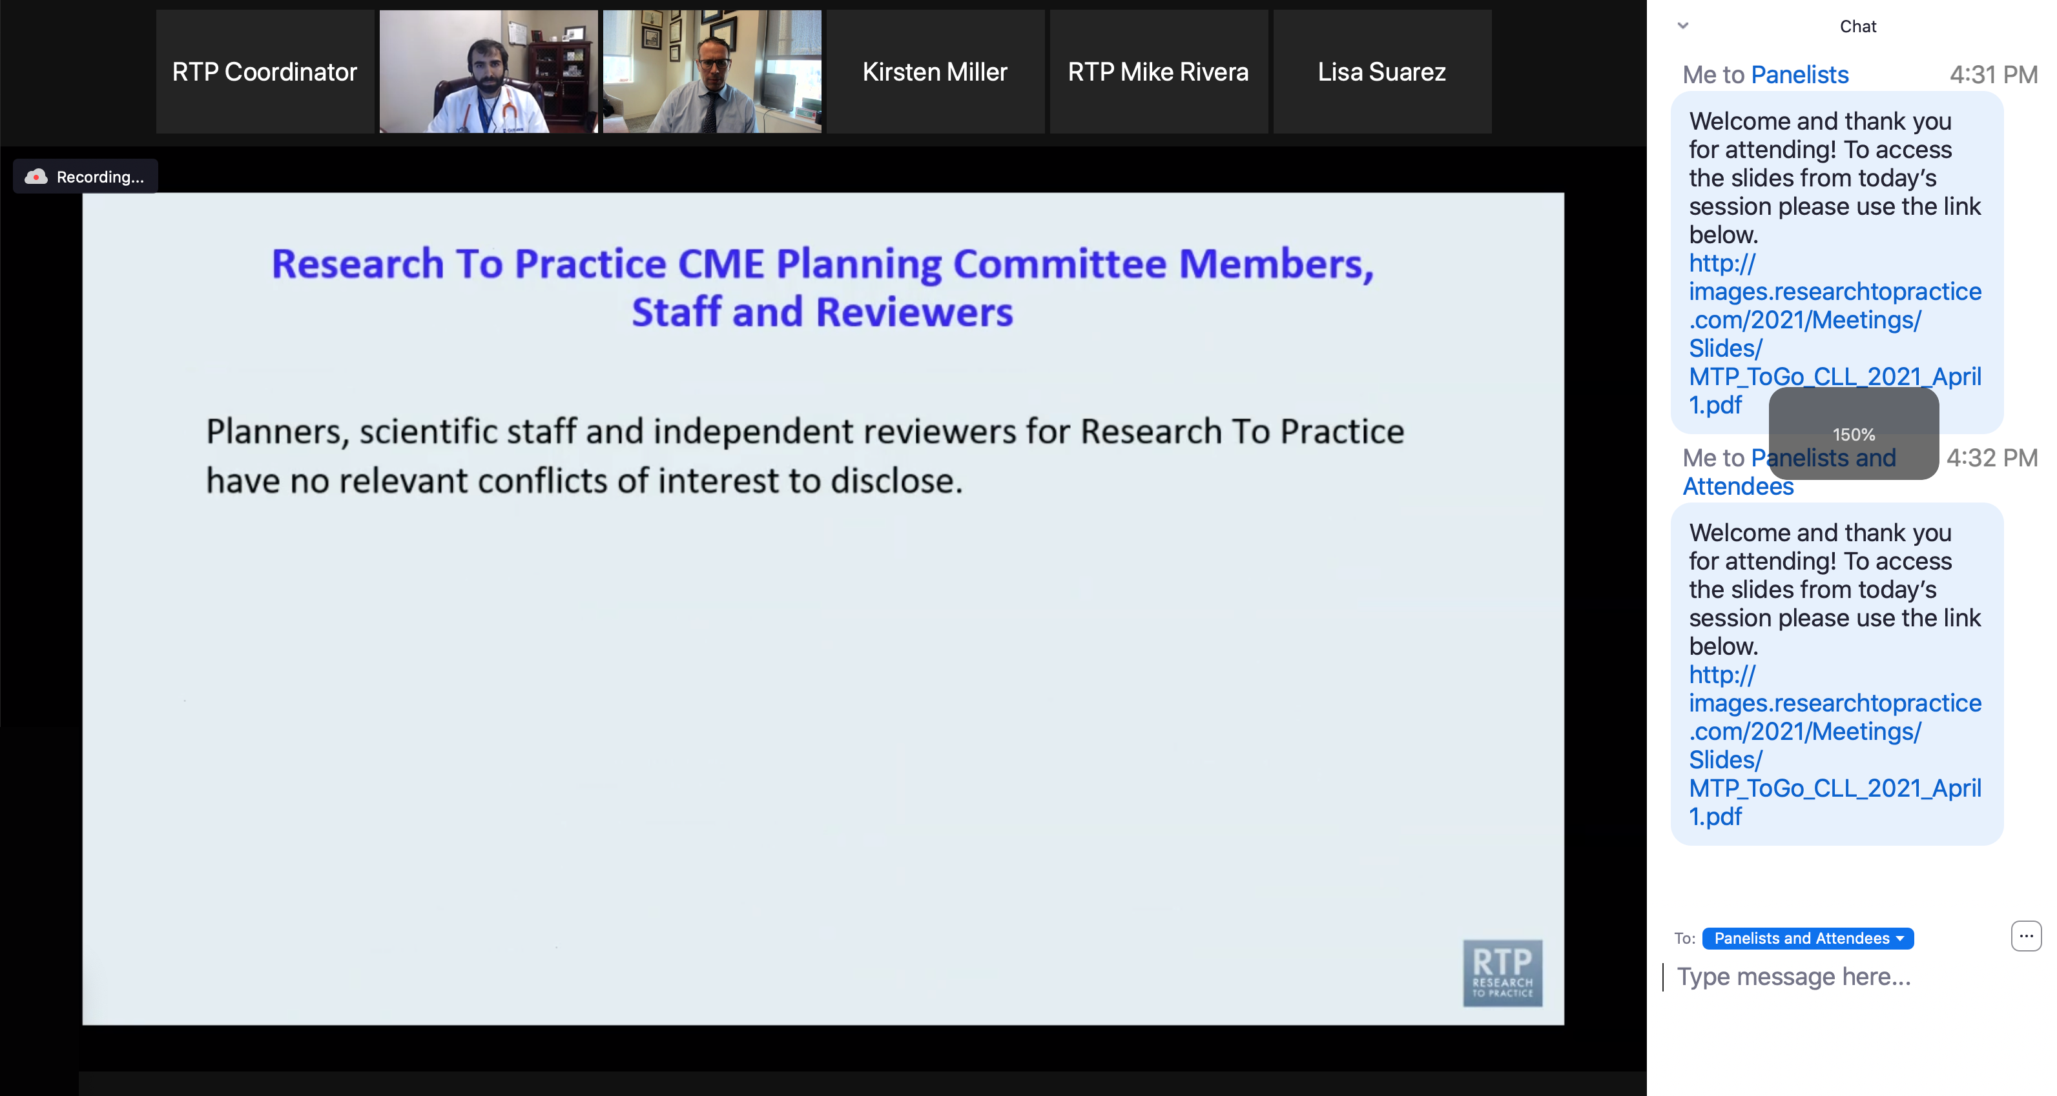
Familiarizing Yourself with the Zoom Interface
Increase chat font size
Press Command (for Mac) or Control (for PC) and the + symbol.
You may do this as many times as you need for readability.

Slide 17
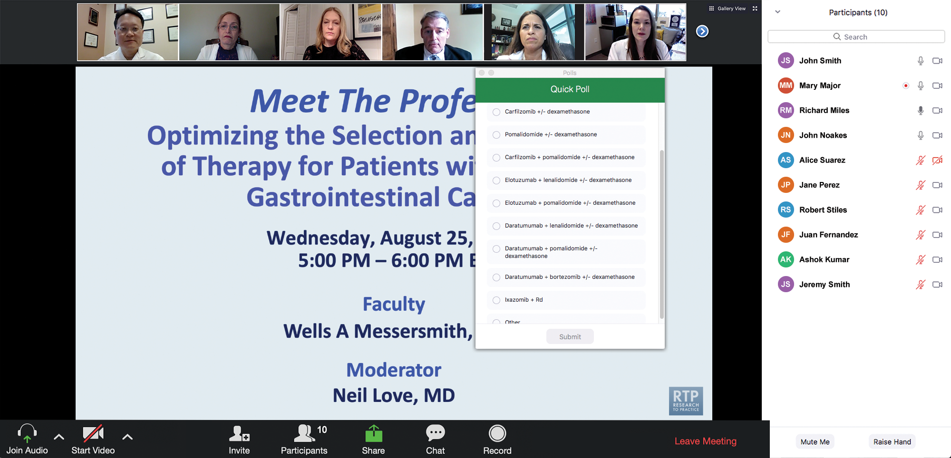
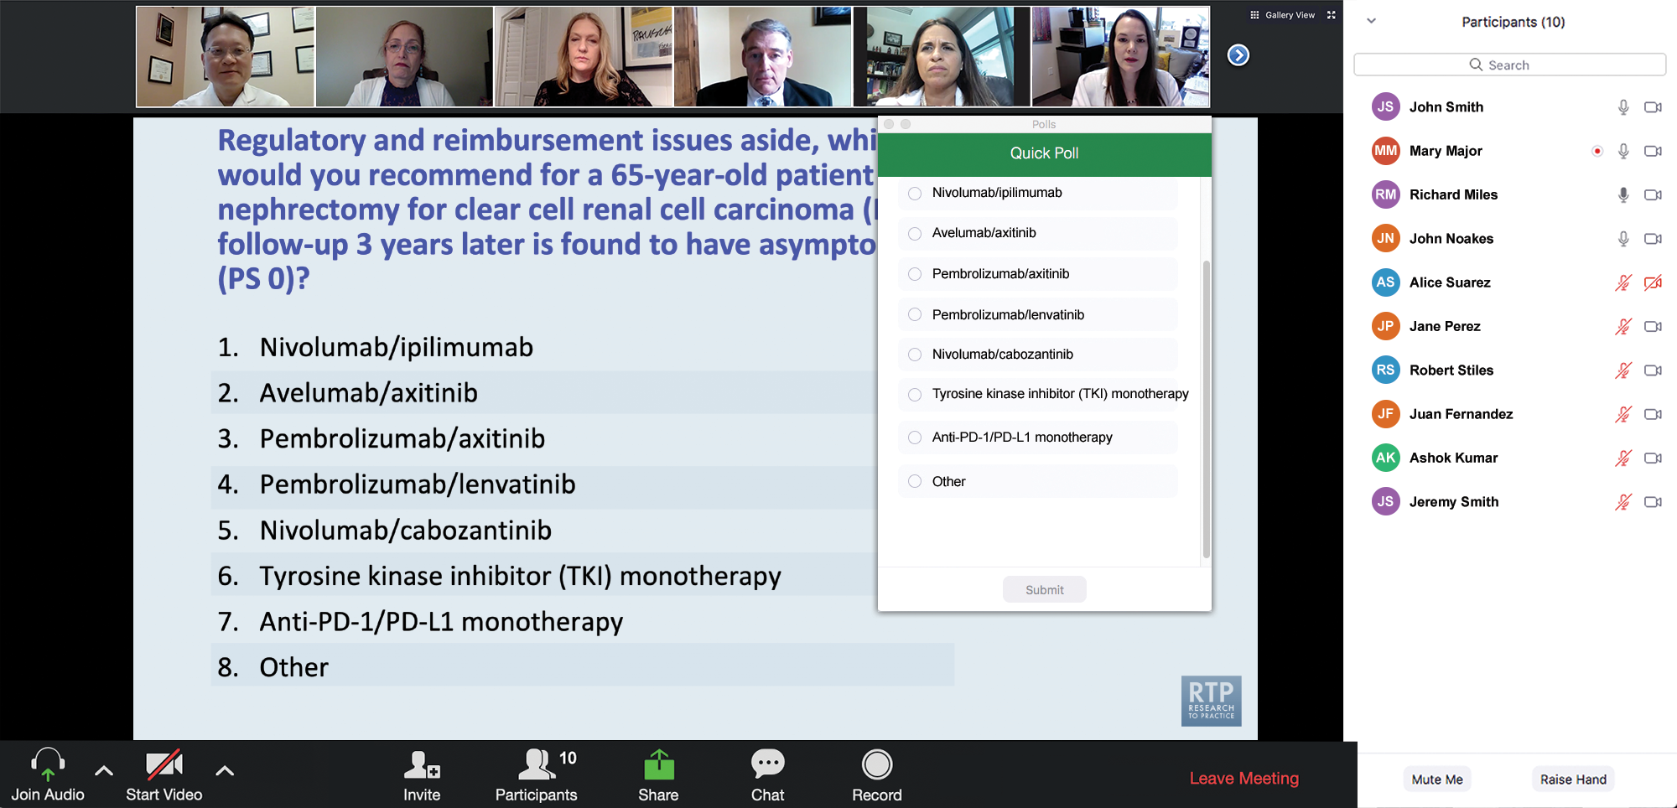
Clinicians in the Audience, Please Complete the Pre- and Postmeeting Surveys
Quick Survey
Quick Poll

Slide 18
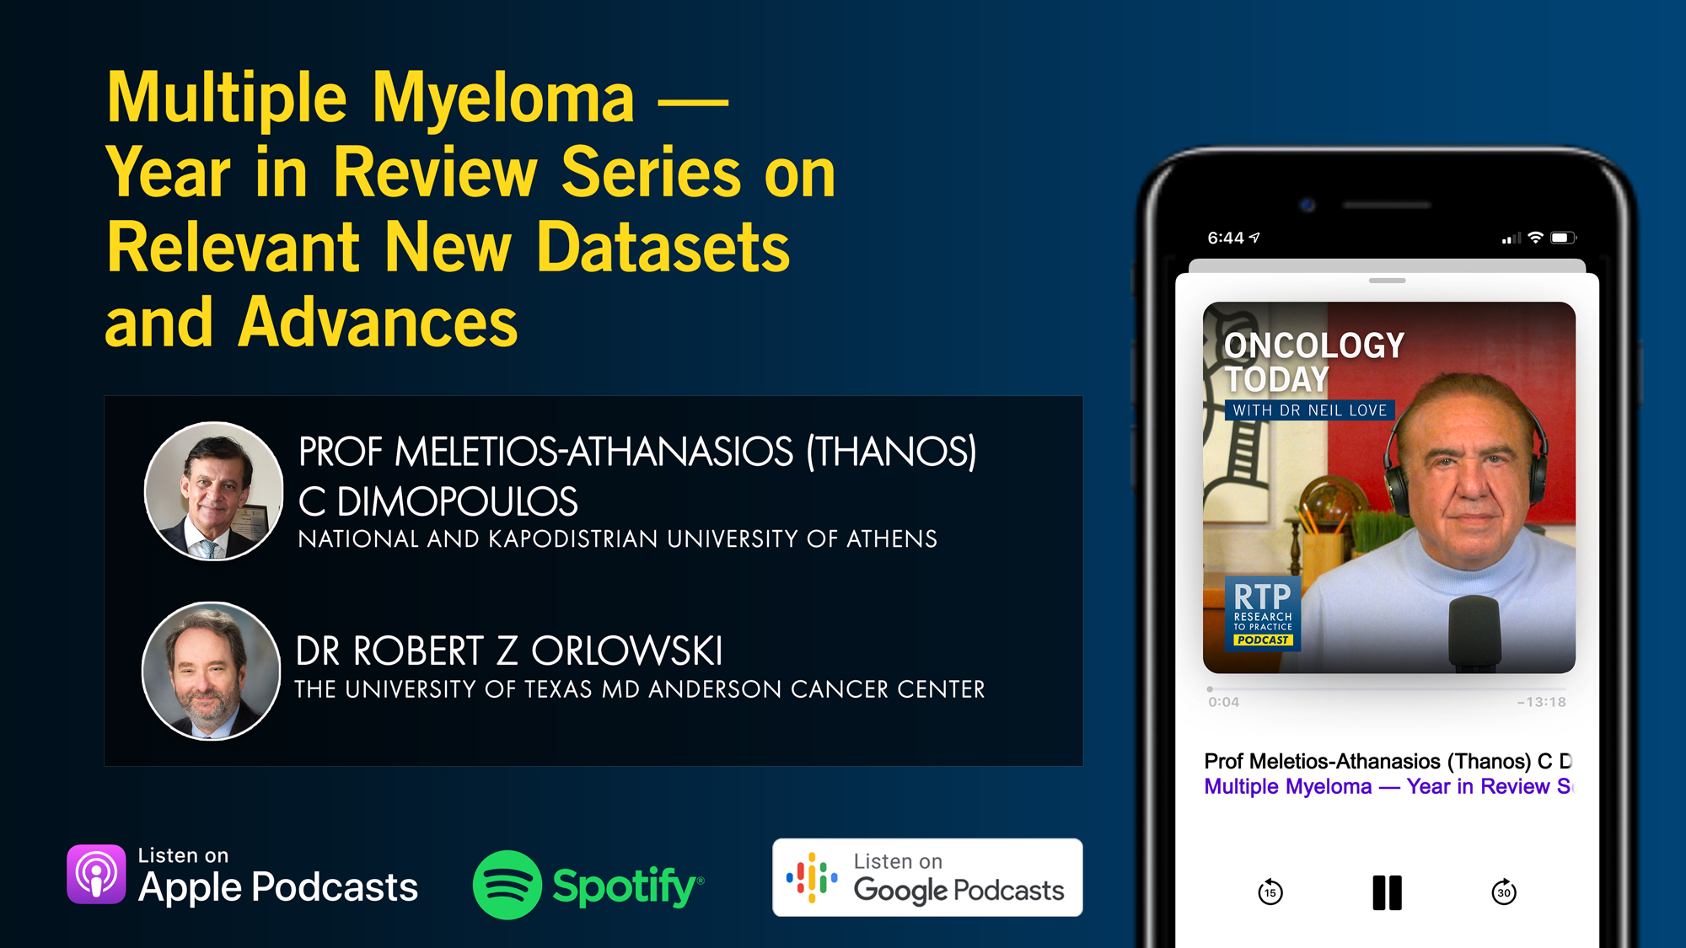

Slide 19
The Implications of Recent Datasets for the Current and
Future Management of Breast Cancer — An ASCO 2025 Review
A CME/MOC-Accredited Live Webinar
Wednesday, August 13, 2025
5:00 PM – 6:00 PM ET
Faculty
Sara A Hurvitz, MD, FACP
Sara M Tolaney, MD, MPH
Moderator
Neil Love, MD

Slide 20
Selection and Sequencing of Therapy for
Metastatic Triple-Negative Breast Cancer
A CME/MOC-Accredited Live Webinar
Thursday, August 28, 2025
5:00 PM – 6:00 PM ET
Faculty
Ana C Garrido-Castro, MD
Professor Peter Schmid, FRCP, MD, PhD
Moderator
Neil Love, MD

Slide 21
Consensus or Controversy? Clinical Investigators Provide Perspectives on the Current and Future Care of Patients with Relapsed/Refractory Multiple Myeloma
Part 1 of a 2-Part CME/MOC-, NCPD- and ACPE-Accredited Satellite Symposium Series During the Society of Hematologic Oncology 2025 Annual Meeting
Thursday, September 4, 2025
6:42 PM – 7:42 PM CT
Faculty
Meletios-Athanasios (Thanos) C Dimopoulos, MD
Hans Lee, MD
Noopur Raje, MD
Moderator
Joseph Mikhael, MD, MEd

Slide 22
Consensus or Controversy? Clinical Investigators
Provide Perspectives on the Current and Future Care of Patients with Follicular Lymphoma
Part 2 of a 2-Part CME/MOC-, NCPD- and ACPE-Accredited Satellite Symposium Series During the Society of Hematologic Oncology 2025 Annual Meeting
Friday, September 5, 2025
11:47 AM – 12:47 PM CT
Faculty
Jennifer Crombie, MD
Laurie H Sehn, MD, MPH
Moderator
Jeremy S Abramson, MD, MMSc

Slide 23
Addressing Current Knowledge and Practice Gaps in the Community — Optimizing the Use of Oral Selective Estrogen
Receptor Degraders for Metastatic Breast Cancer, Part 2
A CME/MOC-Accredited Live Webinar
Wednesday, October 29, 2025
5:00 PM – 6:00 PM ET
Faculty
Rinath M Jeselsohn, MD
Joyce O’Shaughnessy, MD
Moderator
Neil Love, MD

Slide 24
Thank you for joining us! Please take a moment to complete the survey currently up on Zoom.
Your feedback is very important to us.
Information on how to obtain CME and ABIM MOC credit will be provided at the conclusion of the activity in the Zoom chat room. Attendees will also receive an email in 1 to 3 business days with these instructions.

Slide 25
Cancer Q&A: Addressing Common Questions Posed by
Patients with Relapsed/Refractory Multiple Myeloma
A CME/MOC-Accredited Webinar Developed in Partnership with CancerCare®
Thursday, August 7, 2025
5:00 PM – 6:00 PM ET
Faculty
Natalie S Callander, MD
Sagar Lonial, MD, FACP
Moderator
Neil Love, MD

Slide 26
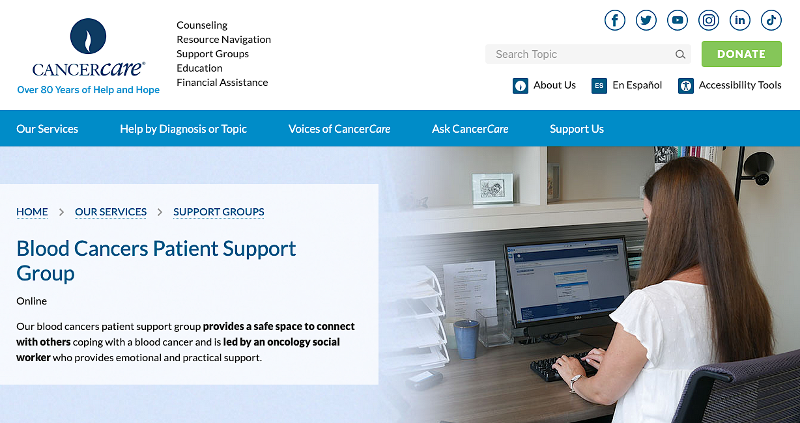

Slide 27
Faculty
Natalie S Callander, MD
Director, Myeloma Clinical Program
University of Wisconsin Carbone Cancer Center
Madison, Wisconsin
MODERATOR
Neil Love, MD
Research To Practice
Miami, Florida
Sagar Lonial, MD, FACP
Chair and Professor
Department of Hematology and Medical Oncology
Chief Medical Officer
Winship Cancer Institute
Emory University School of Medicine
Atlanta, Georgia

Slide 28
Survey Participants
Rafael Fonseca, MD
Chief Innovation Officer
Getz Family Professor of Cancer
Distinguished Mayo Investigator
Mayo Clinic in Arizona
Phoenix, Arizona
Noopur Raje, MD
Director, Center for Multiple Myeloma
Rita Kelley Chair in Oncology
Massachusetts General Hospital Cancer Center
Professor of Medicine
Harvard Medical School
Boston, Massachusetts
Robert Z Orlowski, MD, PhD
Florence Maude Thomas Cancer Research Professor
Department of Lymphoma and Myeloma
Professor, Department of Experimental Therapeutics
Vice Chair, Myeloma Translational Research
Division of Cancer Medicine
The University of Texas MD Anderson Cancer Center
Houston, Texas
Paul G Richardson, MD
Clinical Program Leader and Director of Clinical Research
Jerome Lipper Multiple Myeloma Center
Dana-Farber Cancer Institute
RJ Corman Professor of Medicine
Harvard Medical School
Boston, Massachusetts

Slide 29
We Encourage Clinicians in Practice to Submit Questions
Feel free to submit questions now before the program begins and throughout the program.

Slide 30
Clinicians in the Audience, Please Complete the Pre- and Postmeeting Surveys
Quick Survey
Quick Poll

Slide 32
The Implications of Recent Datasets for the Current and
Future Management of Breast Cancer — An ASCO 2025 Review
A CME/MOC-Accredited Live Webinar
Wednesday, August 13, 2025
5:00 PM – 6:00 PM ET
Faculty
Sara A Hurvitz, MD, FACP
Sara M Tolaney, MD, MPH
Moderator
Neil Love, MD

Slide 33
Selection and Sequencing of Therapy for
Metastatic Triple-Negative Breast Cancer
A CME/MOC-Accredited Live Webinar
Thursday, August 28, 2025
5:00 PM – 6:00 PM ET
Faculty
Ana C Garrido-Castro, MD
Professor Peter Schmid, FRCP, MD, PhD
Moderator
Neil Love, MD

Slide 34
Consensus or Controversy? Clinical Investigators Provide Perspectives on the Current and Future Care of Patients with Relapsed/Refractory Multiple Myeloma
Part 1 of a 2-Part CME/MOC-, NCPD- and ACPE-Accredited Satellite Symposium Series During the Society of Hematologic Oncology 2025 Annual Meeting
Thursday, September 4, 2025
6:42 PM – 7:42 PM CT
Faculty
Meletios-Athanasios (Thanos) C Dimopoulos, MD
Hans Lee, MD
Noopur Raje, MD
Moderator
Joseph Mikhael, MD, MEd

Slide 35
Consensus or Controversy? Clinical Investigators
Provide Perspectives on the Current and Future Care of Patients with Follicular Lymphoma
Part 2 of a 2-Part CME/MOC-, NCPD- and ACPE-Accredited Satellite Symposium Series During the Society of Hematologic Oncology 2025 Annual Meeting
Friday, September 5, 2025
11:47 AM – 12:47 PM CT
Faculty
Jennifer Crombie, MD
Laurie H Sehn, MD, MPH
Moderator
Jeremy S Abramson, MD, MMSc

Slide 36
Addressing Current Knowledge and Practice Gaps in the Community — Optimizing the Use of Oral Selective Estrogen
Receptor Degraders for Metastatic Breast Cancer, Part 2
A CME/MOC-Accredited Live Webinar
Wednesday, October 29, 2025
5:00 PM – 6:00 PM ET
Faculty
Rinath M Jeselsohn, MD
Joyce O’Shaughnessy, MD
Moderator
Neil Love, MD

Slide 37
Cancer Q&A: Addressing Common Questions Posed by
Patients with Relapsed/Refractory Multiple Myeloma
A CME/MOC-Accredited Webinar Developed in Partnership with CancerCare®
Thursday, August 7, 2025
5:00 PM – 6:00 PM ET
Faculty
Natalie S Callander, MD
Sagar Lonial, MD, FACP
Moderator
Neil Love, MD

Slide 38
Dr Callander — Disclosures
No relevant conflicts of interest to disclose.

Slide 39
Dr Lonial — Disclosures
Advisory Committees and Consulting Agreements | AbbVie Inc, Amgen Inc, Bristol Myers Squibb, Genentech, a member of the Roche Group, GSK, Janssen Biotech Inc, Novartis, Pfizer Inc, Regeneron Pharmaceuticals Inc, Takeda Pharmaceuticals USA Inc
Boards of Directors | TG Therapeutics Inc
Contracted Research | Bristol Myers Squibb, Janssen Biotech Inc, Novartis, Takeda Pharmaceuticals USA Inc
Stock Options/Stock — Public Companies | TG Therapeutics Inc

Slide 40
Dr Fonseca — Disclosures
Survey Participant
Boards of Directors | Antengene
Consulting Agreements | AbbVie Inc, Adaptive Biotechnologies Corporation, Amgen Inc, Apple, Bristol Myers Squibb, Celgene Corporation, GSK, Janssen Biotech Inc, Karyopharm Therapeutics, Pfizer Inc, RA Capital Management, Regeneron Pharmaceuticals Inc, Sanofi
Data and Safety Monitoring Boards/Committees | Bristol Myers Squibb
Patents (Through Institution) | Abbott
Scientific Advisory Boards | Caris Life Sciences
Stock Options/Stock — Public Companies | Antengene, Caris Life Sciences

Slide 41
Dr Orlowski — Disclosures
Survey Participant
Advisory Committees and Consulting Agreements | AbbVie Inc, Adaptive Biotechnologies Corporation, Asylia Therapeutics Inc, Biotheryx, Bristol Myers Squibb, CellCentric, DEM BioPharma, IASO Bio, Karyopharm Therapeutics, Lytica Therapeutics, Meridian Therapeutics, Monte Rosa Therapeutics, MYELOMA360, Neoleukin Therapeutics Inc, Oncopeptides, Pfizer Inc, Regeneron Pharmaceuticals Inc, Sanofi, Takeda Pharmaceuticals USA Inc
Stock Options — Private Companies | Asylia Therapeutics Inc

Slide 42
Dr Raje — Disclosures
Survey Participant
Advisory Committees | Advisor to AstraZeneca Pharmaceuticals LP, Bristol Myers Squibb, Genentech, a member of the Roche Group, GSK, Johnson & Johnson, Pfizer Inc, Sanofi

Slide 43
Dr Richardson — Disclosures
Survey Participant
Consulting Agreements | Bristol Myers Squibb, Celgene Corporation, GSK, Karyopharm Therapeutics, Oncopeptides, Regeneron Pharmaceuticals Inc, Sanofi
Contracted Research | Oncopeptides

Slide 44
Dr Love — Disclosures
Dr Love is president and CEO of Research To Practice. Research To Practice receives funds in the form of educational grants to develop CME activities from the following companies: Aadi Bioscience, AbbVie Inc, ADC Therapeutics, Alexion Pharmaceuticals, Amgen Inc, Array BioPharma Inc, a subsidiary of Pfizer Inc, Arvinas, Astellas, AstraZeneca Pharmaceuticals LP, Aveo Pharmaceuticals, Bayer HealthCare Pharmaceuticals, BeOne, Black Diamond Therapeutics Inc, Blueprint Medicines, Boehringer Ingelheim Pharmaceuticals Inc, Bristol Myers Squibb, Clovis Oncology, Coherus BioSciences, CTI BioPharma, a Sobi Company, Daiichi Sankyo Inc, Eisai Inc, Elevation Oncology Inc, Exact Sciences Corporation, Exelixis Inc, Genentech, a member of the Roche Group, Genmab US Inc, Geron Corporation, Gilead Sciences Inc, GSK, Hologic Inc, ImmunoGen Inc, Incyte Corporation, Ipsen Biopharmaceuticals Inc, Jazz Pharmaceuticals Inc, Johnson & Johnson, Karyopharm Therapeutics, Kite, A Gilead Company, Kura Oncology, Legend Biotech, Lilly, MEI Pharma Inc, Merck, Mersana Therapeutics Inc, Mirati Therapeutics Inc, Mural Oncology Inc, Natera Inc, Novartis, Novartis Pharmaceuticals Corporation on behalf of Advanced Accelerator Applications, Novocure Inc, Nuvalent, Pfizer Inc, Pharmacyclics LLC, an AbbVie Company, Puma Biotechnology Inc, Regeneron Pharmaceuticals Inc, Rigel Pharmaceuticals Inc, R-Pharm US, Sanofi, Seagen Inc, Servier Pharmaceuticals LLC, SpringWorks Therapeutics Inc, Stemline Therapeutics Inc, Syndax Pharmaceuticals, Taiho Oncology Inc, Takeda Pharmaceuticals USA Inc, TerSera Therapeutics LLC, and Tesaro, A GSK Company.

Slide 45
Commercial Support
This activity is supported by an educational grant from GSK.
Research To Practice CME Planning Committee Members,
Staff and Reviewers
Planners, scientific staff and independent reviewers for Research To Practice have no relevant conflicts of interest to disclose.

Slide 46
This educational activity contains discussion of
non-FDA-approved uses of agents and regimens. Please refer to official prescribing information for each product for approved indications.

Slide 47
Cancer Q&A: Addressing Common Questions Posed by
Patients with Relapsed/Refractory Multiple Myeloma
A Live Webinar for Patients, Developed in Partnership with CancerCare®
Wednesday, July 23, 2025
6:00 PM – 7:00 PM ET
Faculty
Natalie S Callander, MD
Sagar Lonial, MD, FACP
Moderator
Neil Love, MD

Slide 48
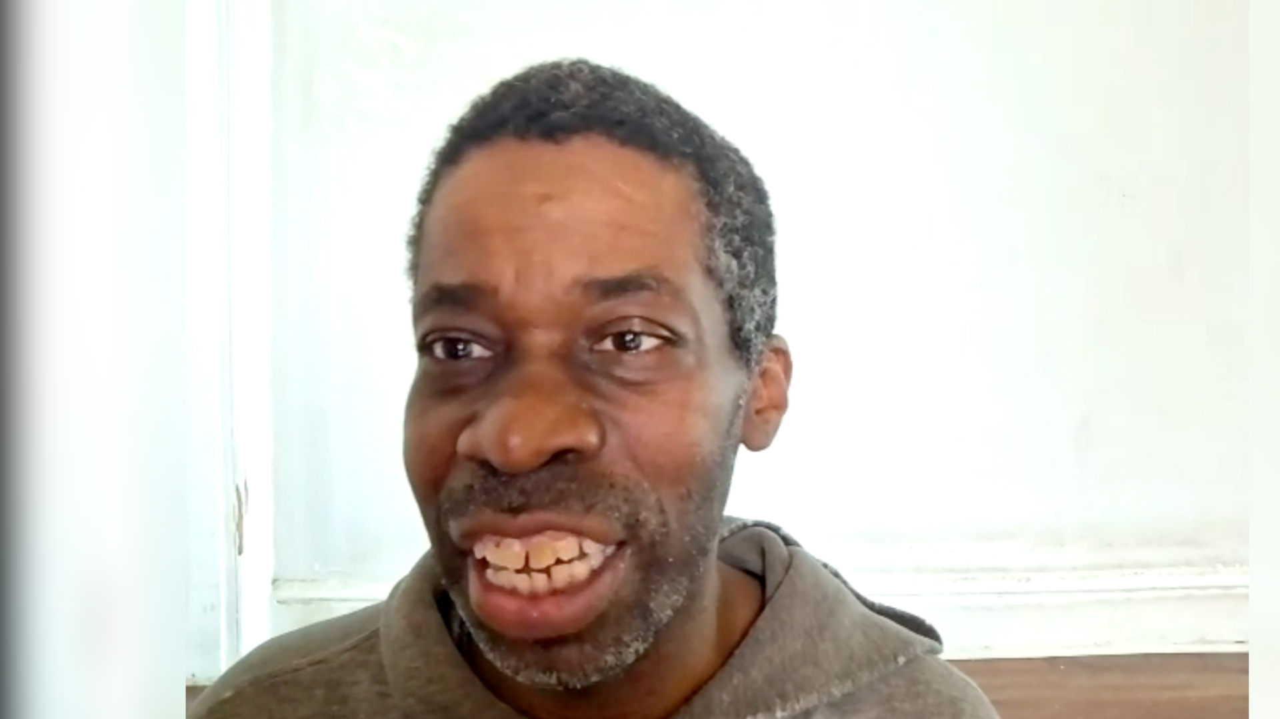
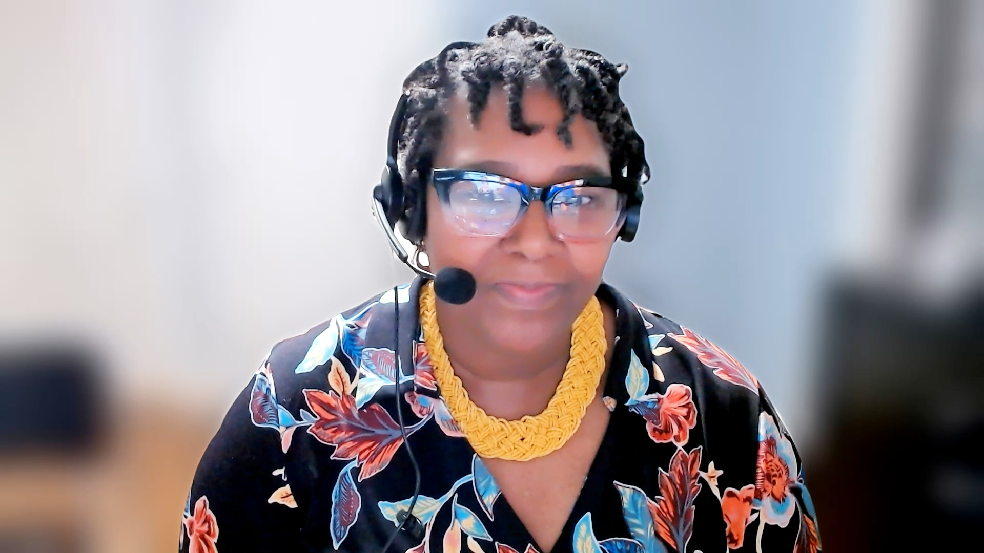
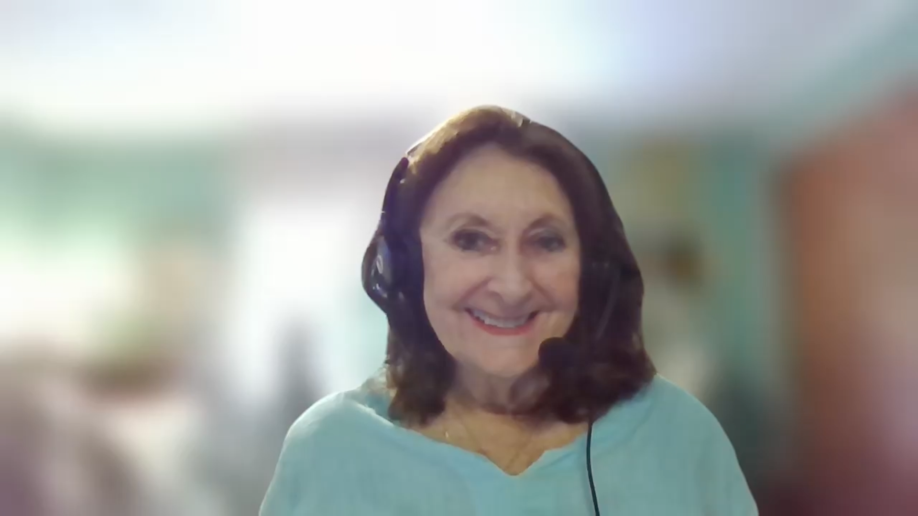
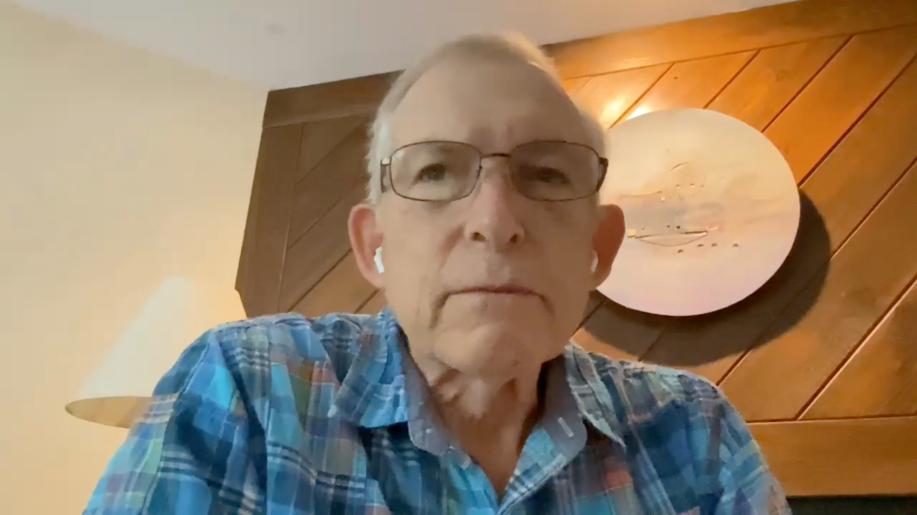
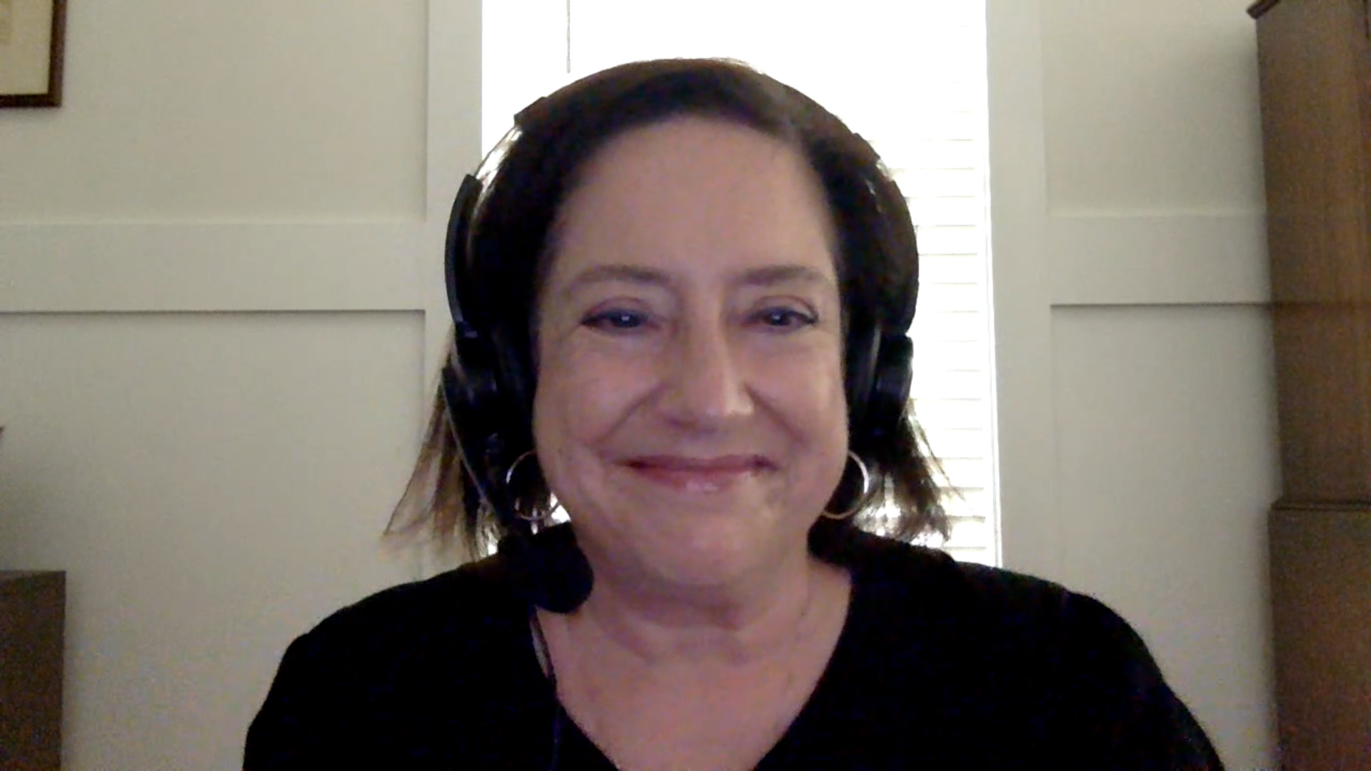
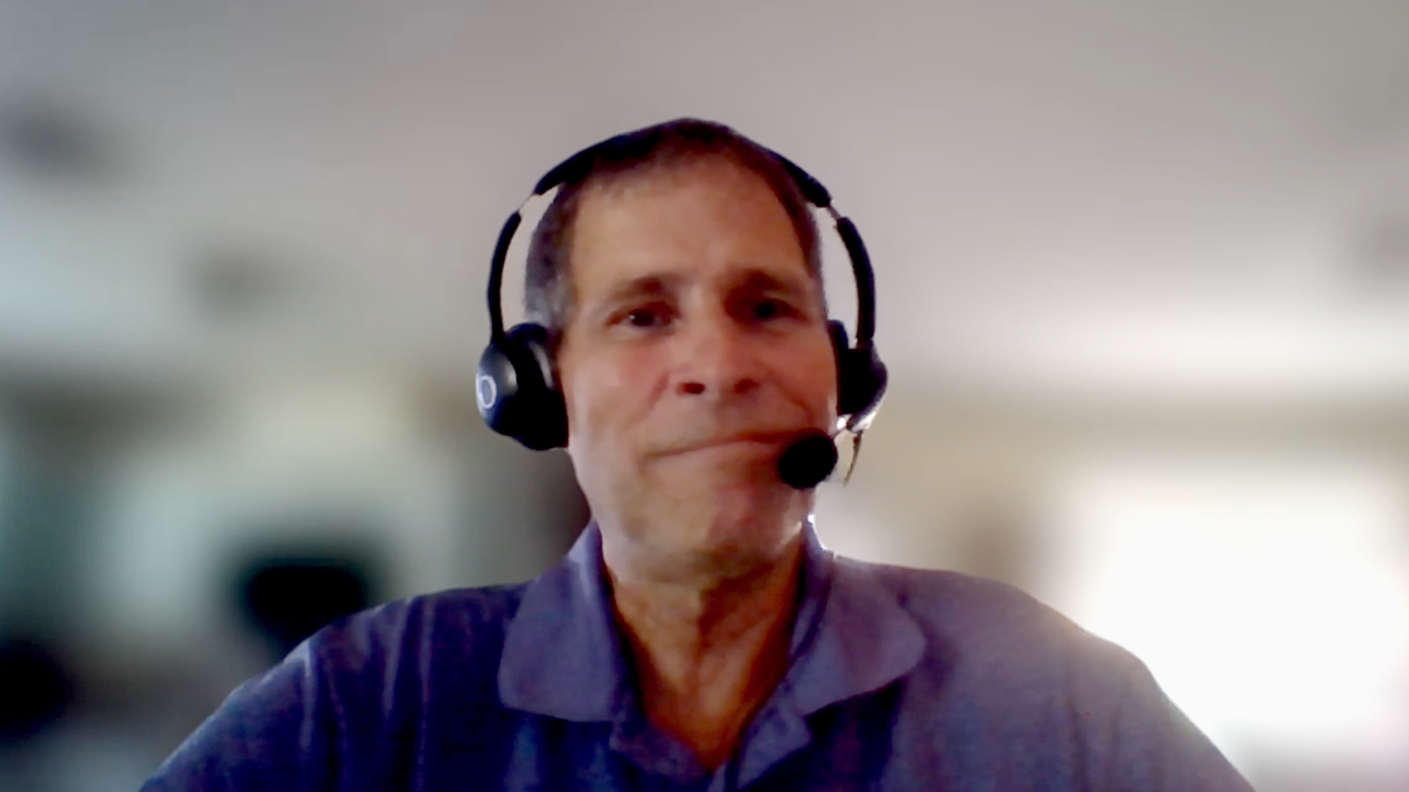
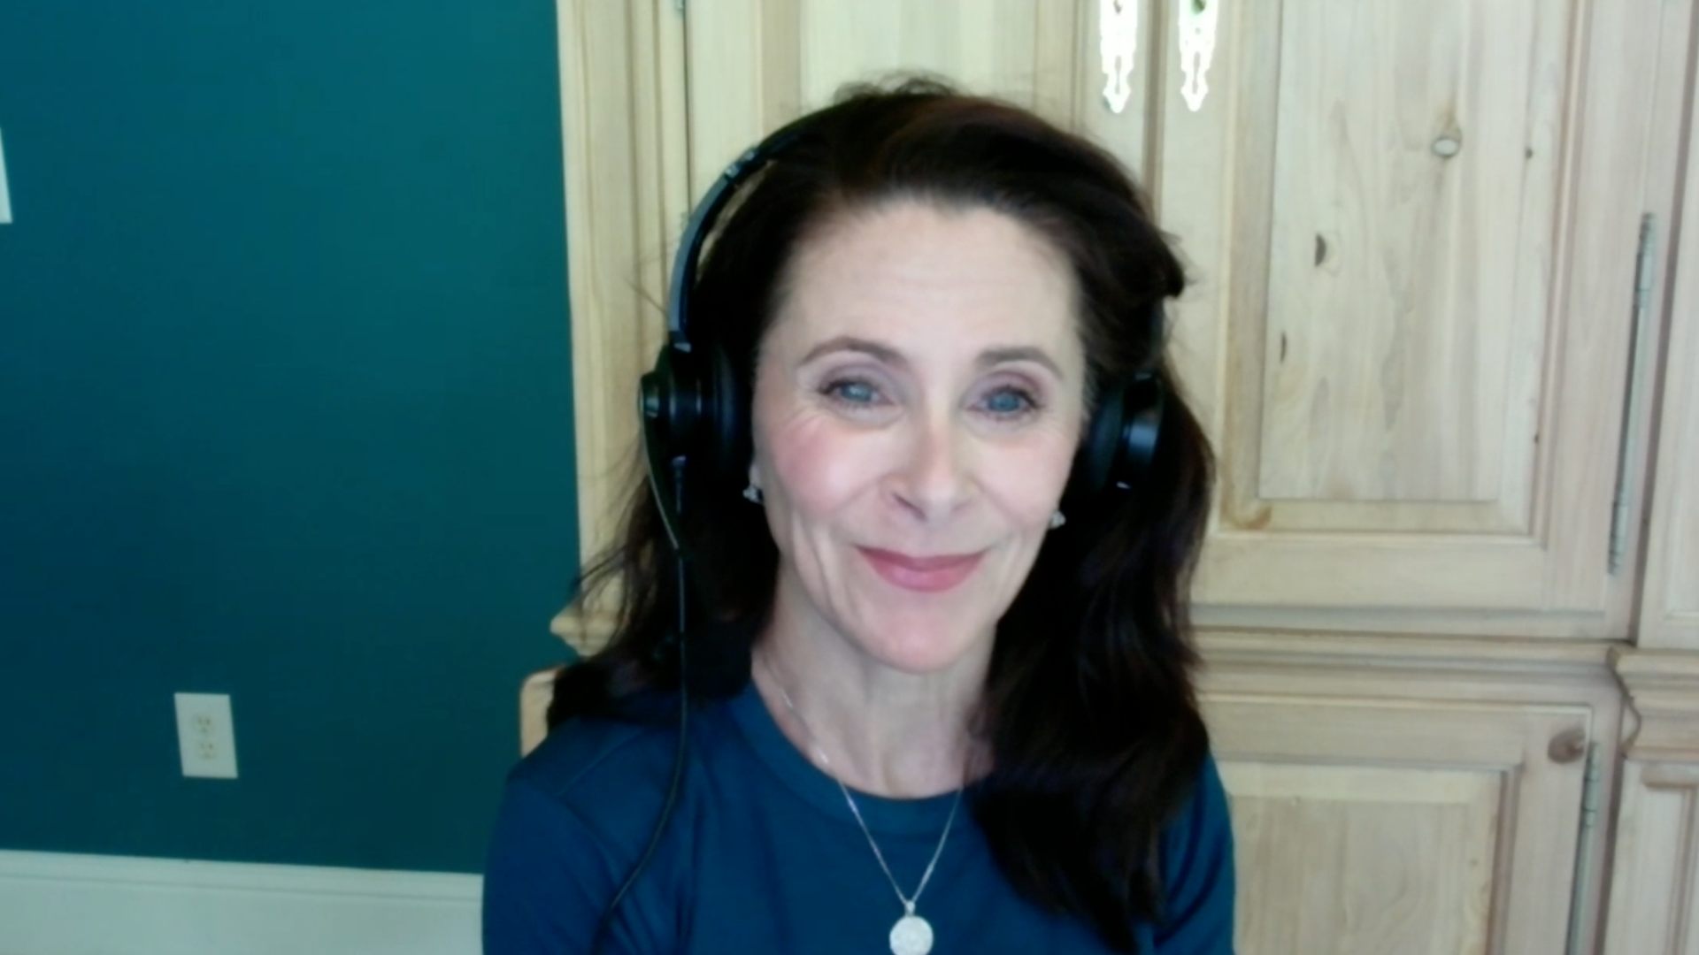
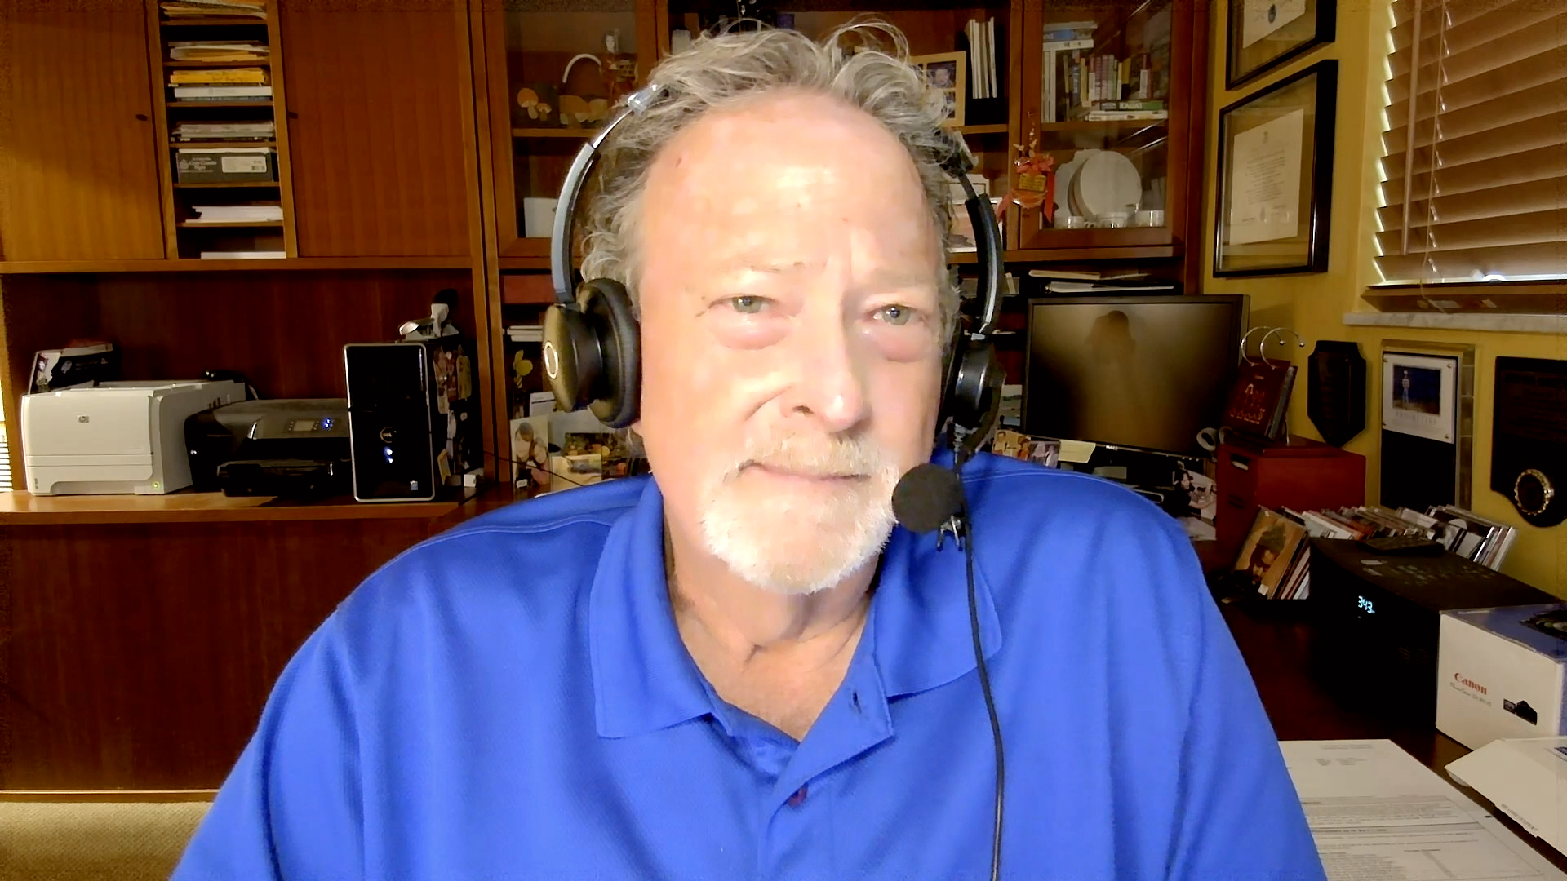
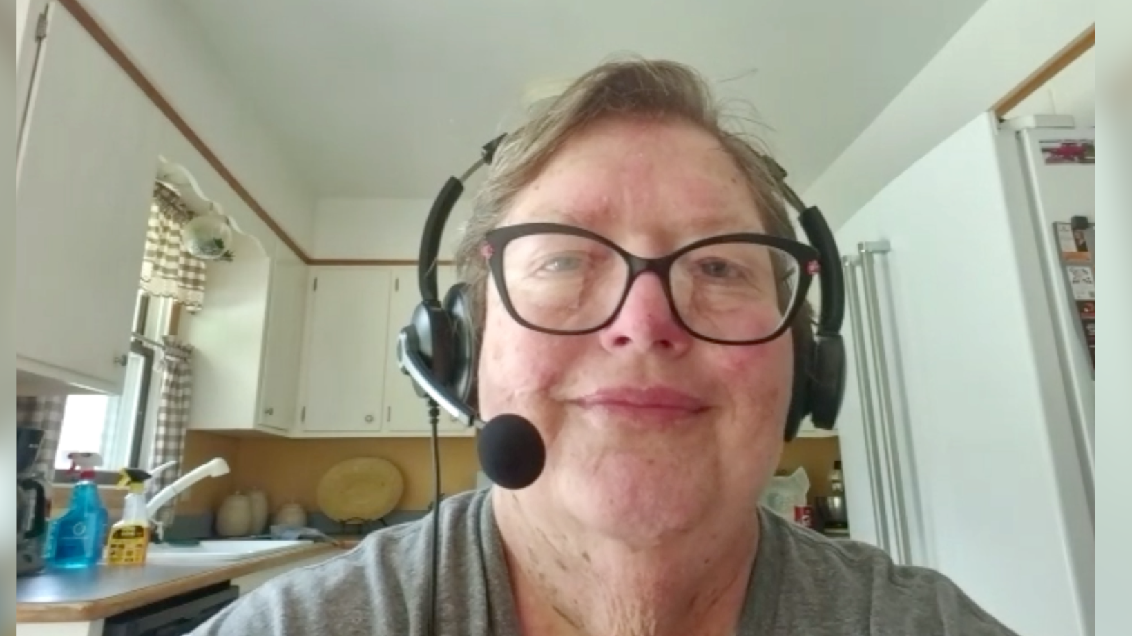

Slide 49
Cancer Q&A
Relapsed/Refractory Multiple Myeloma
Module 1: A farmer with myeloma; is myeloma the new CML?
Module 2: Clinical trials
Module 3: Chimeric antigen receptor (CAR) T-cell therapy
Module 4: Bispecific antibodies
Module 5: Antibody-drug conjugates; a patient on belantamab mafodotin for 3 years
Module 6: Treatment options for relapsed disease
Module 7: Neuropathy
Module 8: Alternative therapies
Module 9: 164 questions

Slide 50
Cancer Q&A
Relapsed/Refractory Multiple Myeloma
Module 1: A farmer with myeloma; is myeloma the new CML?
Module 2: Clinical trials
Module 3: CAR T-cell therapy
Module 4: Bispecific antibodies
Module 5: Antibody-drug conjugates; a patient on belantamab mafodotin for 3 years
Module 6: Treatment options for relapsed disease
Module 7: Neuropathy
Module 8: Alternative therapies
Module 9: 164 questions

Slide 51
A farmer with myeloma; is myeloma the new CML?

Slide 52
Based on available data and your personal clinical experience, do you believe that insecticides or other environmental toxins contribute to the development of MM?
Yes, agree epidemiological data is quite suggestive — Agent Orange- or radiation-exposed, exterminators, 9/11 responders all seem to have an increased risk to develop MM or MGUS
Yes, pesticides, petroleum exposure. We see higher incidence among farmers, gas station attendants, and other factories where workers are exposed to chemical solvents
No. Most myeloma is just an accident in nature.
A bad outcome of our normal immune response
Yes. However, most patients do not have a history of exposure to the extent needed
(ie, in an industrial setting) for this to be an issue
Yes — chemical exposure — not so much in the recent past though
Yes. Agent Orange is the sentinel example, with multiple others since

Slide 53
In general, how would you respond if a 65-year-old transplant-eligible patient with newly diagnosed standard-risk MM asked you to estimate survival with your preferred initial treatment approach?
2005
2025
PFS (months)
OS (months)
PFS (months)
OS (months)
36
60
120
180
40
69
120+
170+
40
60
120
180
~24
~48
~70
~120
72
144
120
240
60
90
96
180
PFS = progession-free survival; OS = overall survival

Slide 54
In general, how would you respond if a 65-year-old transplant-eligible patient with newly diagnosed high-risk MM asked you to estimate survival with your preferred initial treatment approach?
2005
2025
PFS (months)
OS (months)
PFS (months)
OS (months)
24
36
60
90
15
36
65
96
30
40
100
120
~12
~30
~30
~60
24
72
36
84
24
48
48
90

Slide 55
In general, how would you respond if an 80-year-old transplant-ineligible patient with newly diagnosed standard-risk MM asked you to estimate survival with your preferred initial treatment approach?
2005
2025
PFS (months)
OS (months)
PFS (months)
OS (months)
24
48
80
140
18
24-36
60
75
24
36
75
100
~12
~24
~22
~36
48
72
72
120
40
80
80
120

Slide 56
In general, how would you respond if an 80-year-old transplant-ineligible patient with newly diagnosed high-risk MM asked you to estimate survival with your preferred initial treatment approach?
2005
2025
PFS (months)
OS (months)
PFS (months)
OS (months)
12
36
40
80
9
18
36
48
12
24
55
70
~6
~18
~12
~24
24
48
48
120
20
30
40
60

Slide 57
In general, for an 80-year-old patient with newly diagnosed standard-risk MM and typical age-associated comorbidities (eg, hypertension, Type 2 diabetes) but otherwise healthy, how would you respond if the patient asked you about the percent chance of dying due to something other than MM?
80%
75%
70%
80%
70%
60%

Slide 58
In general, for a 90-year-old patient with newly diagnosed standard-risk MM and typical age-associated comorbidities (eg, hypertension, Type 2 diabetes) but otherwise healthy, how would you respond if the patient asked you about the percent chance of dying due to something other than MM?
90%
80%
80%
60%
90%
40%

Slide 59
Cancer Q&A
Relapsed/Refractory Multiple Myeloma
Module 1: A farmer with myeloma; is myeloma the new CML?
Module 2: Clinical trials
Module 3: CAR T-cell therapy
Module 4: Bispecific antibodies
Module 5: Antibody-drug conjugates; a patient on belantamab mafodotin for 3 years
Module 6: Treatment options for relapsed disease
Module 7: Neuropathy
Module 8: Alternative therapies
Module 9: 164 questions

Slide 60
Clinical trials

Slide 61
Based on available data and your personal clinical experience, do you believe it is reasonable to consider minimal residual disease (MRD) assay results in making decisions about starting or continuing maintenance therapy?
No — still think this is a research question. I believe we are getting closer
to figuring out which populations could have treatment shaped by MRD,
but I would like to know that salvage after relapse then remains possible
No — the use of early MRD is an unconfirmed endpoint. I don’t think that early MRD can
be used to de-escalate therapy, but rather to escalate therapy when not MRD-negative
Yes, I use it routinely to decide and do patient guidance and counseling
No, I do not yet feel comfortable stopping maintenance in any high-risk cases, and even
with standard risk the risk of relapse is on the order of 20% even with MRD at 10-6
Yes — for continuing therapy such as lenalidomide maintenance
for patients with standard risk
Yes, but importantly maintenance is a standard of care but MRD
may help dictate intensity of maintenance

Slide 62
Cancer Q&A
Relapsed/Refractory Multiple Myeloma
Module 1: A farmer with myeloma; is myeloma the new CML?
Module 2: Clinical trials
Module 3: CAR T-cell therapy
Module 4: Bispecific antibodies
Module 5: Antibody-drug conjugates; a patient on belantamab mafodotin for 3 years
Module 6: Treatment options for relapsed disease
Module 7: Neuropathy
Module 8: Alternative therapies
Module 9: 164 questions

Slide 63
CAR T-cell therapy

Slide 64
In general, for a patient with relapsed/refractory MM who is eligible to receive both chimeric antigen receptor (CAR) T-cell therapy and a bispecific antibody, which do you administer first and in what line of therapy?
Treatment
Line of therapy
CAR T
Early relapse, high-risk 2nd line
Standard risk — considered at 3rd line or later
Would use ahead of CAR T in frail pts or for relapsed disease
CAR T
2-3
CAR T
First relapse, later
CAR T
2nd line if high risk; 3rd or 4th line
if standard risk
CAR T
After 2-3 LOT
Bispecific
2-3
LOT = lines of therapy

Slide 65
Approximately what is the percent chance that a patient with relapsed/refractory MM who receives idecabtagene vicleucel (ide-cel) will experience either immediate or delayed neurologic symptoms?
1%
<10%
2%
15% (all grades)
<1%
15% to 20%

Slide 66
Approximately what is the percent chance that a patient with relapsed/refractory MM who receives ciltacabtagene autoleucel (cilta-cel) will experience either immediate or delayed neurologic symptoms?
6%
10% to 15%
10%
20% (all grades)
10%
20%

Slide 67
What is the age of the oldest person with relapsed/refractory MM to whom you administered or whom you referred for CAR T-cell therapy, and which agent did you administer?
Age
Agent
84
Cilta-cel
84
Cilta-cel
82
Cilta-cel
82
Ide-cel
84
Ide-cel
77 (He died of TRM)
Cilta-cel
TRM = treatment-related mortality

Slide 68
Cancer Q&A
Relapsed/Refractory Multiple Myeloma
Module 1: A farmer with myeloma; is myeloma the new CML?
Module 2: Clinical trials
Module 3: CAR T-cell therapy
Module 4: Bispecific antibodies
Module 5: Antibody-drug conjugates; a patient on belantamab mafodotin for 3 years
Module 6: Treatment options for relapsed disease
Module 7: Neuropathy
Module 8: Alternative therapies
Module 9: 164 questions

Slide 69
Bispecific antibodies

Slide 70
In general, for a patient with relapsed/refractory MM who is NOT eligible for CAR T-cell therapy but is eligible to receive a bispecific antibody, in which line of therapy would you administer a bispecific antibody?
Limited by labeling but really as soon as possible
and would look for a trial
4+ that is the label
If I could I would use at second line, but often is at fourth
Fourth line as that is the earliest approval (for talquetamab)
3-4
3-4

Slide 71
What is the age of the oldest person with relapsed/refractory MM to whom you administered a bispecific antibody, and which agent did you administer?
Age
Agent
87
Elranatamab
81
Teclistamab
85
Elranatamab
85
Talquetamab
91
Elranatamab
82
Teclistamab was poorly tolerated
and had to be abandoned

Slide 72
In what situations, if any, do you utilize preemptive tocilizumab prior to administering a bispecific antibody to a patient with relapsed/refractory MM?
Typically don’t use
All patients receive preemptive toci
None (yet)
High disease burden or baseline ferritin
High disease burden
Low threshold to use now

Slide 73
Cancer Q&A
Relapsed/Refractory Multiple Myeloma
Module 1: A farmer with myeloma; is myeloma the new CML?
Module 2: Clinical trials
Module 3: CAR T-cell therapy
Module 4: Bispecific antibodies
Module 5: Antibody-drug conjugates; a patient on belantamab mafodotin for 3 years
Module 6: Treatment options for relapsed disease
Module 7: Neuropathy
Module 8: Alternative therapies
Module 9: 164 questions

Slide 74
Antibody-drug conjugates; a patient on belantamab mafodotin for 3 years

Slide 75
If belantamab mafodotin were available, to approximately how many patients currently in your practice would you want to administer it as their next line of treatment?
20 patients
10 to 15 patients
5 patients
20 patients
20%
20% to 30%

Slide 76
If belantamab mafodotin were to become available again, for which patients with relapsed/refractory MM, if any, would you prioritize its use?
I would consider at second line for patients when CAR T is either
not available or would take too long to coordinate
Many patients don’t want the risk and complicated schedule with
a TCE or CAR T. In first relapse the PFS is the same as a CAR T
After CAR T and bispecifics
Frail, older patients who would not be candidates for CAR T or TCE
After CAR T and bispecifics
Early relapse after CD38, also after CAR T or bispecific failure
TCE = bispecific T-cell engager

Slide 77
If belantamab mafodotin were to become available again, what’s the earliest timepoint in the treatment algorithm that you would want to administer it to patients with MM?
I am interested in trials showing benefit in first line,
but certainly second line
First relapse
Likely third line and beyond
Second line
After 3-4 LOT
First relapse

Slide 78
If belantamab mafodotin were to become available again, do you believe that avoiding significant morbidity from ophthalmic toxicity can be achieved by modifying the dose and schedule of administration?
Yes, patients who are receiving every 3-month
dosing rarely have significant eye problems
Yes, I would dose every 8 to 12 weeks as was
functionally done in the trial
Yes, reduced dosing and more prolonged
schedule seem to help with serious toxicity
Yes, I believe some reduction is possible,
though not complete avoidance
Yes, dose reduce and decrease frequency
Yes, ocular toxicity in combination is moderate to mild,
manageable and fully reversible

Slide 79
Cancer Q&A
Relapsed/Refractory Multiple Myeloma
Module 1: A farmer with myeloma; is myeloma the new CML?
Module 2: Clinical trials
Module 3: CAR T-cell therapy
Module 4: Bispecific antibodies
Module 5: Antibody-drug conjugates; a patient on belantamab mafodotin for 3 years
Module 6: Treatment options for relapsed disease
Module 7: Neuropathy
Module 8: Alternative therapies
Module 9: 164 questions

Slide 80
Treatment options for relapsed disease

Slide 81
Cancer Q&A
Relapsed/Refractory Multiple Myeloma
Module 1: A farmer with myeloma; is myeloma the new CML?
Module 2: Clinical trials
Module 3: CAR T-cell therapy
Module 4: Bispecific antibodies
Module 5: Antibody-drug conjugates; a patient on belantamab mafodotin for 3 years
Module 6: Treatment options for relapsed disease
Module 7: Neuropathy
Module 8: Alternative therapies
Module 9: 164 questions

Slide 82
Neuropathy

Slide 83
Based on available data and your personal clinical experience, how effective is gabapentin in the management of MM treatment-associated neuropathy?
(5 = extremely effective; 1 = not effective at all)
3 — Some pt find it helpful, but I would say only about 50%
and usually does not produce complete abatement
3
3
3
3
4

Slide 84
Based on available data and your personal clinical experience, how effective is acupuncture in the management of MM treatment-associated neuropathy?
(5 = extremely effective; 1 = not effective at all)
4 — Helpful but access and expense are issues
4
2
4
4
3

Slide 85
Cancer Q&A
Relapsed/Refractory Multiple Myeloma
Module 1: A farmer with myeloma; is myeloma the new CML?
Module 2: Clinical trials
Module 3: CAR T-cell therapy
Module 4: Bispecific antibodies
Module 5: Antibody-drug conjugates; a patient on belantamab mafodotin for 3 years
Module 6: Treatment options for relapsed disease
Module 7: Neuropathy
Module 8: Alternative therapies
Module 9: 164 questions

Slide 86
Alternative therapies

Slide 87
A patient with MM who is about to begin treatment with daratumumab/RVd informs you that they take daily green tea supplements. How would you counsel the patient?
I would advise them that in vitro studies indicate
that green tea interferes with bortezomib activity
Avoid this as it interacts with bortezomib
Stop taking it
Hold green tea on days of bortezomib
Avoid on days of bortezomib
Not on days of bortezomib

Slide 88
A patient with MM who is about to begin treatment with daratumumab/RVd informs you that they take daily vitamin C supplements. How would you counsel the patient?
I would advise them that high-dose vitamin C
has not proven to improve cancer outcomes
Avoid this as it interacts with bortezomib
Not a concern unless the sFLC is very high (>100 mg/dL)
as changes in urine pH could precipitate cast nephropathy
Hold vitamin C on days of bortezomib
Avoid on days of bortezomib
Not on days of bortezomib
sFLC = serum free light chain

Slide 89
In general, do you proactively ask your patients with MM about their use of dietary supplements or alternative therapies?
Yes but probably not consistently enough
Yes
No
Yes
Sometimes
Yes

Slide 90
Approximately what proportion of your patients with MM do you estimate take dietary supplements or alternative therapies?
30%
75%
25% to 30%
40%
60% to 70%
50%

Slide 91
Cancer Q&A
Relapsed/Refractory Multiple Myeloma
Module 1: A farmer with myeloma; is myeloma the new CML?
Module 2: Clinical trials
Module 3: CAR T-cell therapy
Module 4: Bispecific antibodies
Module 5: Antibody-drug conjugates; a patient on belantamab mafodotin for 3 years
Module 6: Treatment options for relapsed disease
Module 7: Neuropathy
Module 8: Alternative therapies
Module 9: 164 questions

Slide 92
164 Questions

Slide 93
Thank you

Slide 94
The Implications of Recent Datasets for the Current and
Future Management of Breast Cancer — An ASCO 2025 Review
A CME/MOC-Accredited Live Webinar
Wednesday, August 13, 2025
5:00 PM – 6:00 PM ET
Faculty
Sara A Hurvitz, MD, FACP
Sara M Tolaney, MD, MPH
Moderator
Neil Love, MD

Slide 95
Thank you for joining us!
Please take a moment to complete the survey currently up on Zoom. Your feedback is very important to us.
The survey will remain open for
5 minutes after the meeting ends.
Information on how to obtain CME and ABIM
MOC credit is provided in the Zoom chat room.
Attendees will also receive an email in 1 to 3 business days with these instructions.

