Slide 1
Cancer Q&A: Understanding the Role and Reality of CAR (Chimeric Antigen Receptor)
T-Cell Therapy for Non-Hodgkin Lymphoma
A Live Webinar for Patients, Developed in Partnership with CancerCare®
Wednesday, October 22, 2025
6:00 PM – 7:00 PM ET
Faculty
Jeremy S Abramson, MD, MMSc
Manali Kamdar, MD, MBBS
Moderator
Neil Love, MD

Slide 2
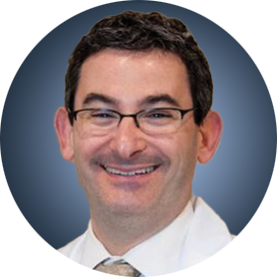
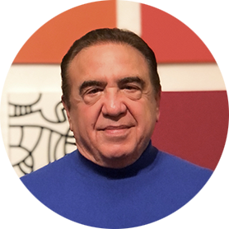
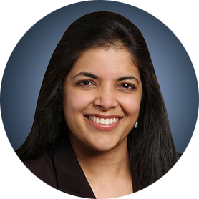
Faculty
Jeremy S Abramson, MD, MMSc
Director, Center for Lymphoma
Massachusetts General Hospital
Professor of Medicine
Harvard Medical School
Boston, Massachusetts
MODERATOR
Neil Love, MD
Research To Practice
Miami, Florida
Manali Kamdar, MD, MBBS
Associate Professor
Clinical Director of Lymphoma Services
Morton and Sandra Saffer Endowed Chair in Hematology Research
Division of Hematology, Hematologic Malignancies
University of Colorado Cancer Center
Aurora, Colorado

Slide 3
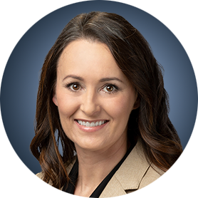
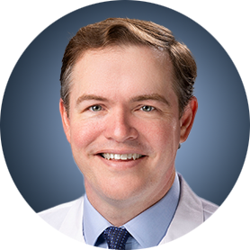
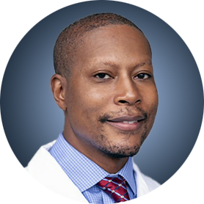
Survey Participants
Loretta J Nastoupil, MD
Oncologist
Southwest Oncology
CommonSpirit Mercy Hospital
Durango, Colorado
Jason Westin, MD, MS
Director, Lymphoma Clinical Research
Section Chief, Aggressive Lymphoma
Professor, Department of Lymphoma and Myeloma
The University of Texas MD Anderson Cancer Center
Houston, Texas
Tycel Phillips, MD, FASCO
Associate Professor, Division of Lymphoma
Department of Hematology and Hematopoietic Cell Transplantation
City of Hope Comprehensive Cancer Center
Duarte, California

Slide 4
Commercial Support
This activity is supported by educational grants from Bristol Myers Squibb and Novartis.

Slide 5
Dr Love — Disclosures
Dr Love is president and CEO of Research To Practice. Research To Practice receives funds in the form of educational grants to develop CME activities from the following companies: Aadi Bioscience, AbbVie Inc, ADC Therapeutics, Agendia Inc, Alexion Pharmaceuticals, Amgen Inc, Array BioPharma Inc, a subsidiary of Pfizer Inc, Arvinas, Astellas, AstraZeneca Pharmaceuticals LP, Aveo Pharmaceuticals, Bayer HealthCare Pharmaceuticals, BeOne, Black Diamond Therapeutics Inc, Blueprint Medicines, Boehringer Ingelheim Pharmaceuticals Inc, Bristol Myers Squibb, Clovis Oncology, Coherus BioSciences, Corcept Therapeutics Inc, CTI BioPharma, a Sobi Company, Daiichi Sankyo Inc, Eisai Inc, Elevation Oncology Inc, Exact Sciences Corporation, Exelixis Inc, Genentech, a member of the Roche Group, Genmab US Inc, Geron Corporation, Gilead Sciences Inc, GSK, Helsinn Therapeutics (US) Inc, Hologic Inc, ImmunoGen Inc, Incyte Corporation, Ipsen Biopharmaceuticals Inc, Jazz Pharmaceuticals Inc, Johnson & Johnson, Karyopharm Therapeutics, Kite, A Gilead Company, Kura Oncology, Legend Biotech, Lilly, MEI Pharma Inc, Merck, Mersana Therapeutics Inc, Mirati Therapeutics Inc, Mural Oncology Inc, Natera Inc, Novartis, Novartis Pharmaceuticals Corporation on behalf of Advanced Accelerator Applications, Novocure Inc, Nuvalent, Pfizer Inc, Pharmacyclics LLC, an AbbVie Company, Puma Biotechnology Inc, Regeneron Pharmaceuticals Inc, Rigel Pharmaceuticals Inc, R-Pharm US, Sanofi, Seagen Inc, Servier Pharmaceuticals LLC, SpringWorks Therapeutics Inc, Stemline Therapeutics Inc, Sumitomo Pharma America, Syndax Pharmaceuticals, Taiho Oncology Inc, Takeda Pharmaceuticals USA Inc, TerSera Therapeutics LLC, and Tesaro, A GSK Company.

Slide 6
Research To Practice CME Planning Committee Members,
Staff and Reviewers
Planners, scientific staff and independent reviewers for Research To Practice have no relevant conflicts of interest to disclose.

Slide 7
Dr Abramson — Disclosures
Faculty
Consulting Agreements | AbbVie Inc, ADC Therapeutics, AstraZeneca Pharmaceuticals LP, BeOne, Bristol Myers Squibb, Celgene Corporation, Foresight Diagnostics, Genentech, a member of the Roche Group, Gilead Sciences Inc, Interius BioTherapeutics, Miltenyi Biotec, Novartis, Roche Laboratories Inc, Seagen Inc
Contracted Research | Bristol Myers Squibb, Celgene Corporation, Cellectis, Genentech, a member of the Roche Group, Merck, Mustang Bio, Regeneron Pharmaceuticals Inc, Seagen Inc, Takeda Pharmaceuticals USA Inc

Slide 8
Dr Kamdar — Disclosures
Faculty
Consulting Agreements | AbbVie Inc, AstraZeneca Pharmaceuticals LP, BeOne, Bristol Myers Squibb, Celgene Corporation, Genentech, a member of the Roche Group
Contracted Research | Novartis
Data and Safety Monitoring Boards/Committees | Celgene Corporation, Genentech, a member of the Roche Group

Slide 9
Dr Nastoupil — Disclosures
Survey Participant
Advisory Committees | AbbVie Inc, AstraZeneca Pharmaceuticals LP, Bristol Myers Squibb, Daiichi Sankyo Inc, Genentech, a member of the Roche Group, Genmab US Inc, Ipsen Biopharmaceuticals Inc, Janssen Biotech Inc, Kite, A Gilead Company, Merck, Novartis, Regeneron Pharmaceuticals Inc, Takeda Pharmaceuticals USA Inc
Consulting Agreements | Genentech, a member of the Roche Group
Contracted Research | BeOne, Bristol Myers Squibb, Daiichi Sankyo Inc, Genentech, a member of the Roche Group, Janssen Biotech Inc, Kite, A Gilead Company, Merck, Novartis, Takeda Pharmaceuticals USA Inc
Data and Safety Monitoring Boards/Committees | Genentech, a member of the Roche Group

Slide 10
Dr Phillips — Disclosures
Survey Participant
Advisory Committees | AbbVie Inc, Genentech, a member of the Roche Group, Genmab US Inc, Merck
Consulting Agreements | AbbVie Inc, ADC Therapeutics, AstraZeneca Pharmaceuticals LP, BeOne, Bristol Myers Squibb, Caribou Biosciences Inc, Genentech, a member of the Roche Group, Genmab US Inc, Gilead Sciences Inc, Ipsen Biopharmaceuticals Inc, Janssen Biotech Inc, Kite, A Gilead Company, Lilly, Merck, Pfizer Inc, Regeneron Pharmaceuticals Inc, Xencor
Contracted Research | AbbVie Inc, Genentech, a member of the Roche Group, Sobi
Nonrelevant Financial Relationships | Leukemia & Lymphoma Society (LLS) Scholar in Clinical Research

Slide 11
Dr Westin — Disclosures
Survey Participant
Advisory Committees | Genentech, a member of the Roche Group, Kite, A Gilead Company, Novartis
Consulting Agreements | AbbVie Inc, ADC Therapeutics, Allogene Therapeutics, AstraZeneca Pharmaceuticals LP, Bristol Myers Squibb, Genentech, a member of the Roche Group, Genmab US Inc, Incyte Corporation, Janssen Biotech Inc, Kite, A Gilead Company, MorphoSys, Novartis, Nurix Therapeutics Inc, Pfizer Inc, Regeneron Pharmaceuticals Inc
Contracted Research | ADC Therapeutics, Allogene Therapeutics, AstraZeneca Pharmaceuticals LP, Bristol Myers Squibb, Genentech, a member of the Roche Group, Incyte Corporation, Janssen Biotech Inc, Kite, A Gilead Company, MorphoSys, Novartis, Nurix Therapeutics Inc, Regeneron Pharmaceuticals Inc

Slide 12
This educational activity contains discussion of
non-FDA-approved uses of agents and regimens. Please refer to official prescribing information for each product for approved indications.

Slide 13
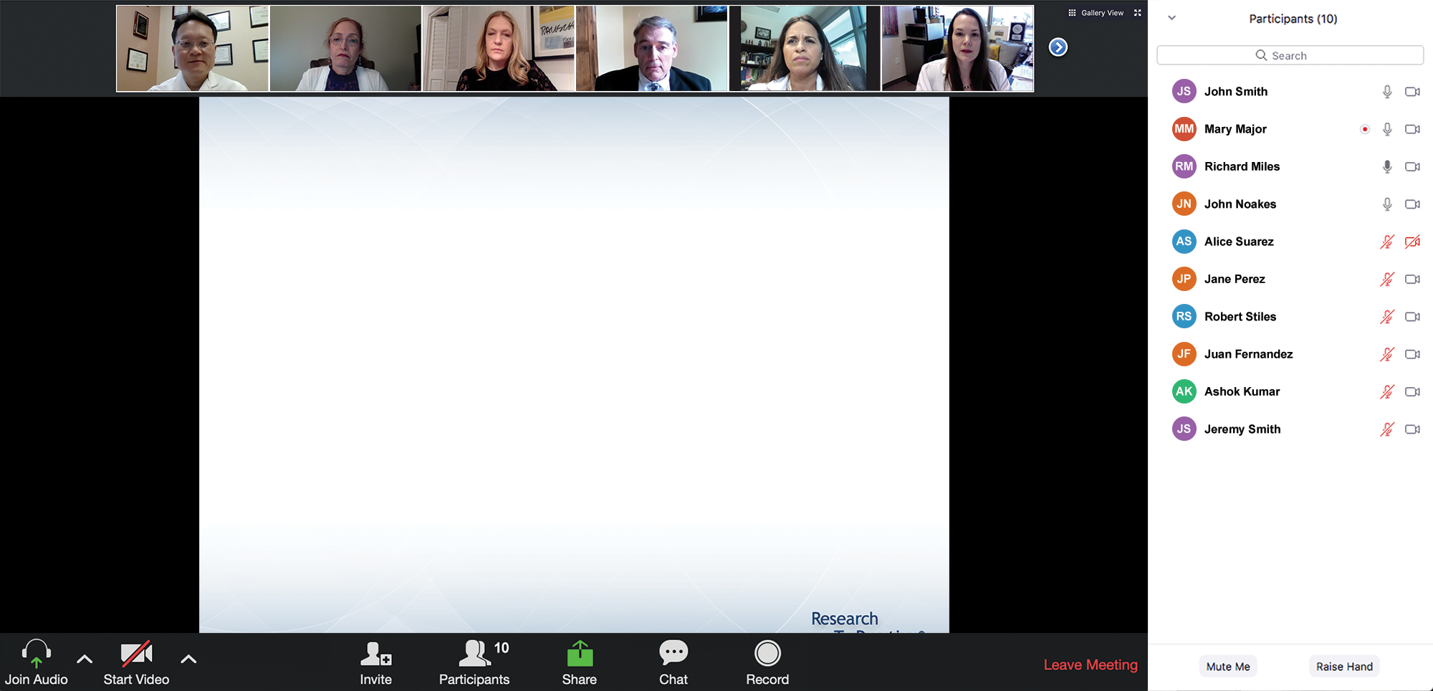
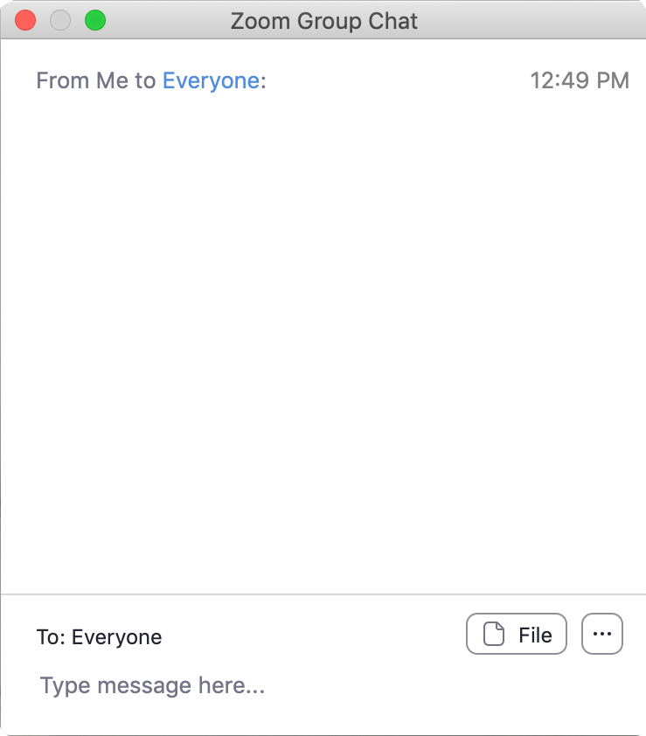
We Encourage Patients to Submit Questions
Feel free to submit questions now before the program begins and throughout the program.

Slide 14
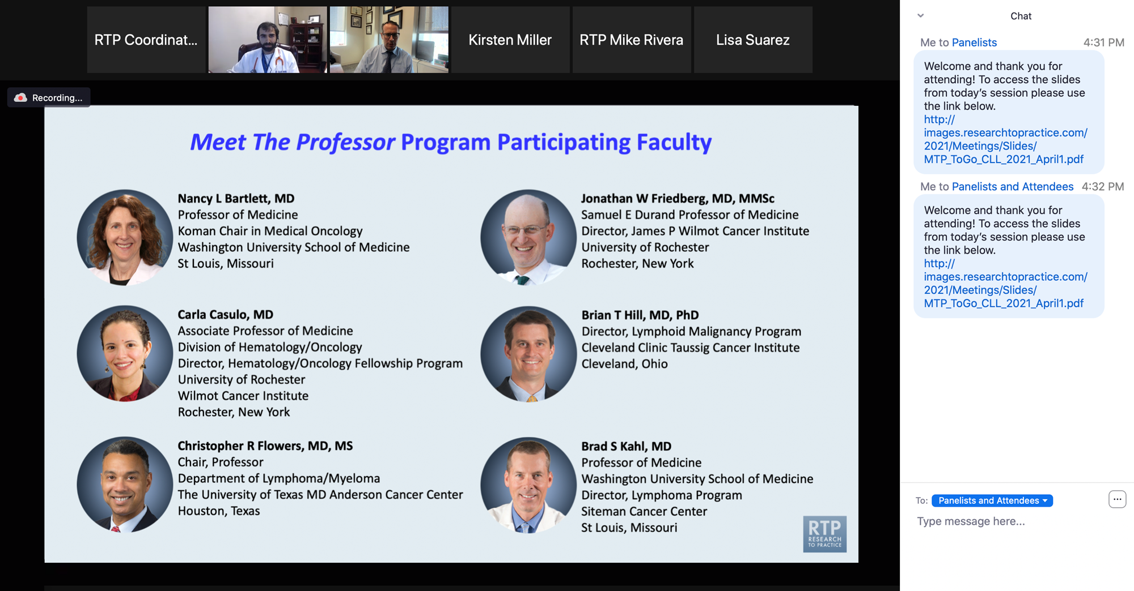
Familiarizing Yourself with the Zoom Interface
Expand chat submission box
Drag the white line above the submission box up to create
more space for your message.

Slide 15
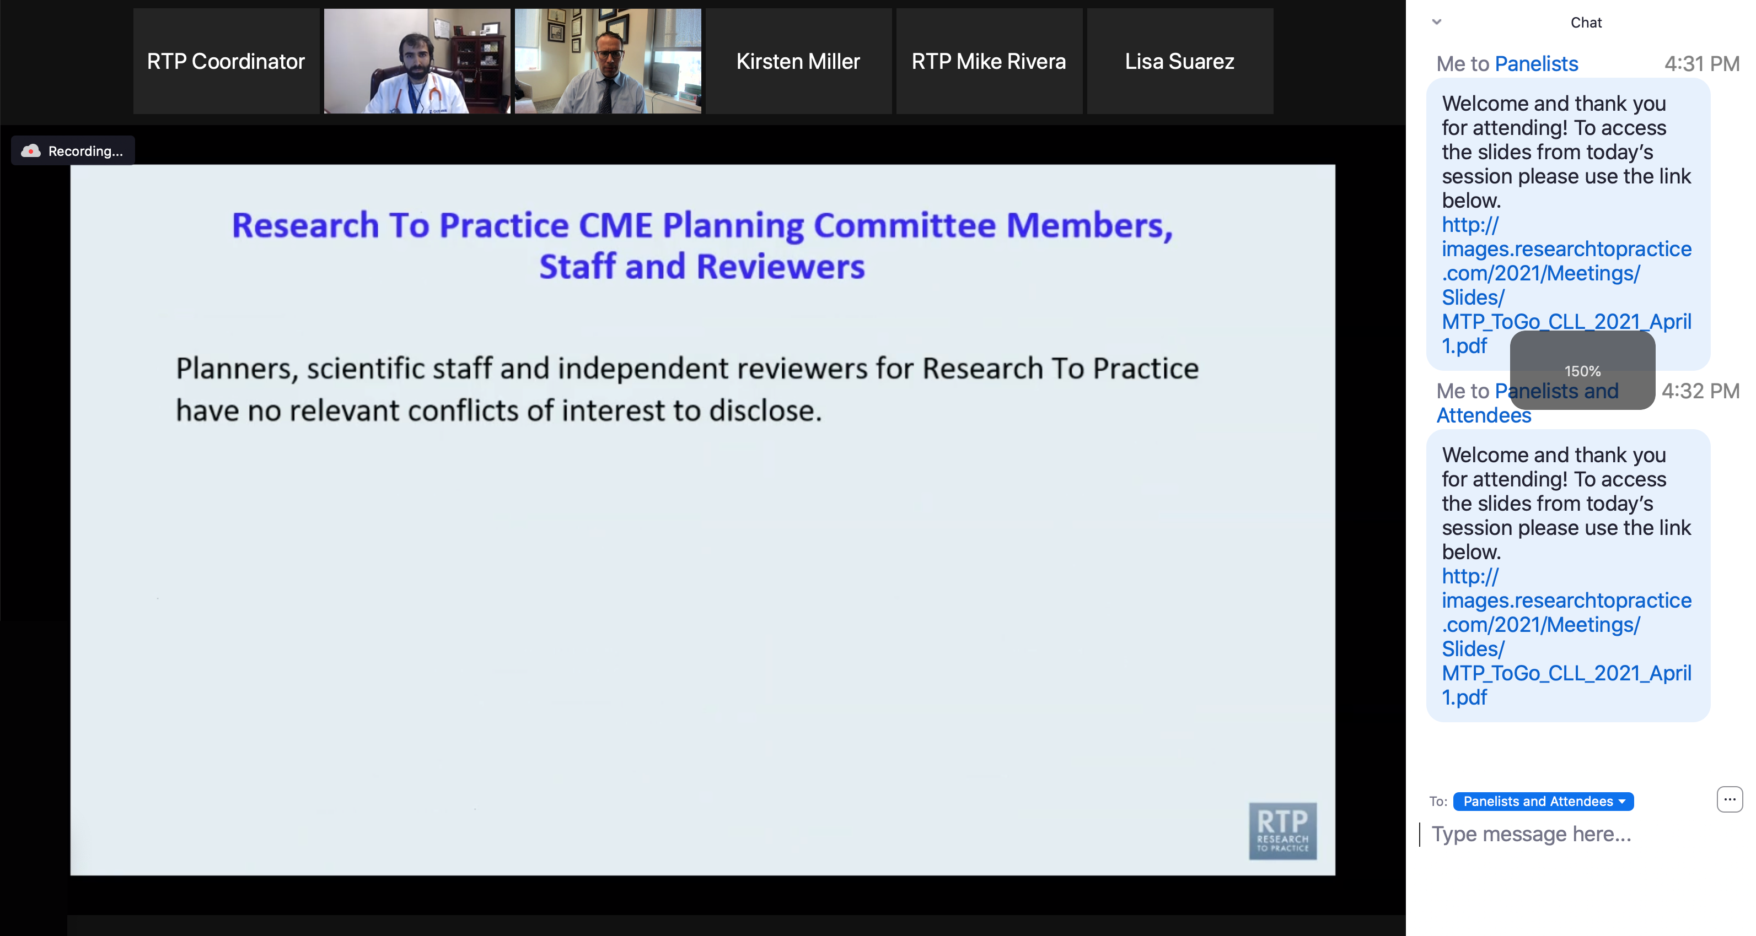
Familiarizing Yourself with the Zoom Interface
Increase chat font size
Press Command (for Mac) or Control (for PC) and the + symbol.
You may do this as many times as you need for readability.

Slide 16
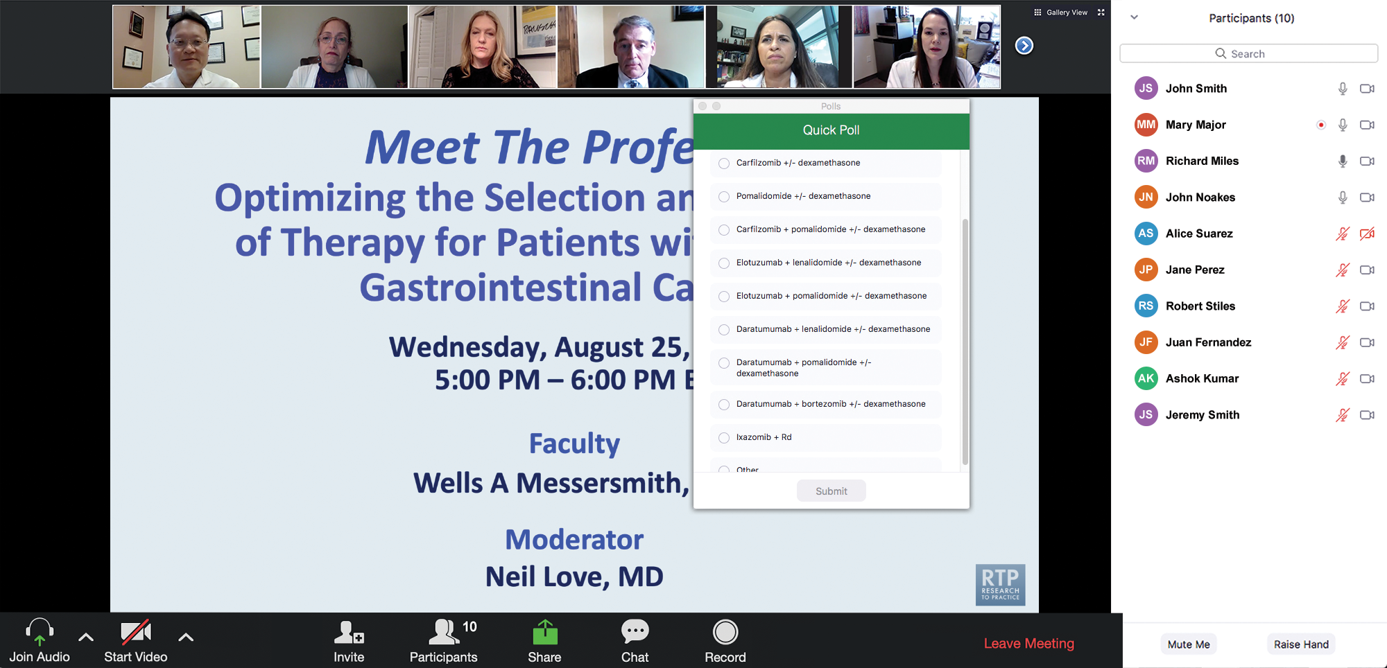
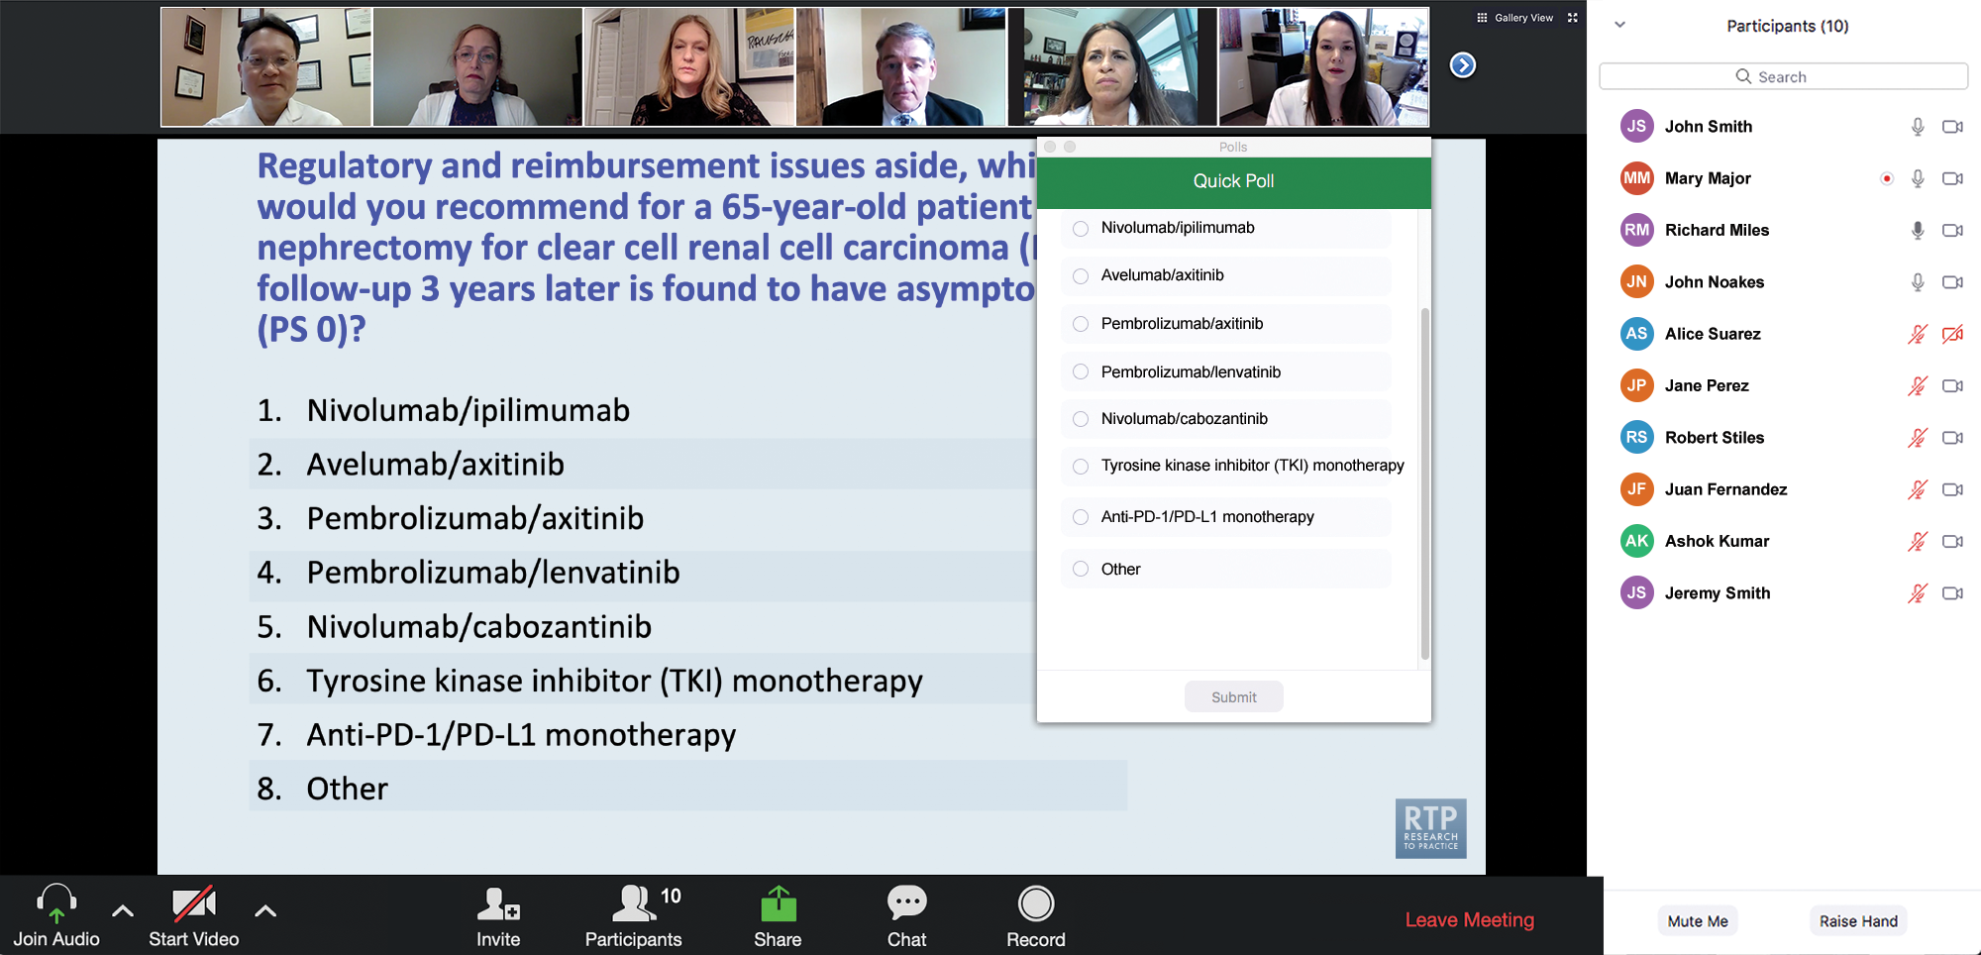
Patients in the Audience, Please Complete the Pre- and Postmeeting Surveys
Quick Survey
Quick Poll

Slide 17
Cancer Q&A: Understanding the Role and Reality of CAR (Chimeric Antigen Receptor)
T-Cell Therapy for Non-Hodgkin Lymphoma
A Live Webinar for Patients, Developed in Partnership with CancerCare®
Wednesday, October 22, 2025
6:00 PM – 7:00 PM ET
Faculty
Jeremy S Abramson, MD, MMSc
Manali Kamdar, MD, MBBS
Moderator
Neil Love, MD

Slide 18
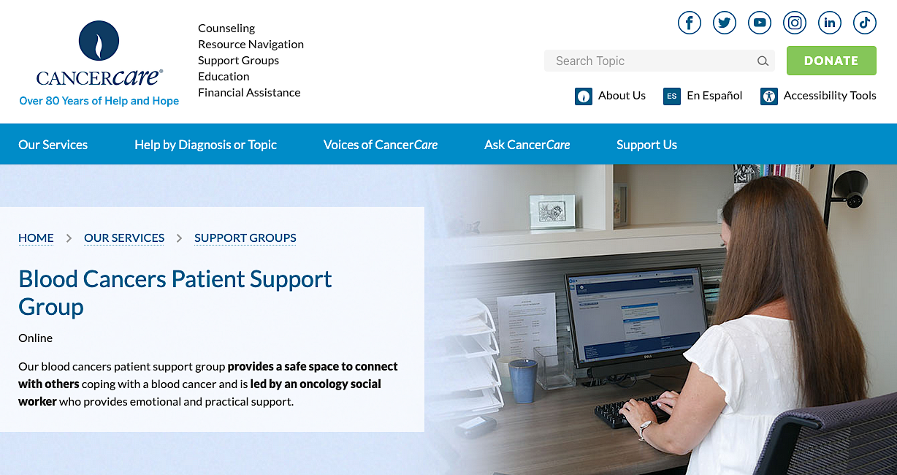

Slide 19
Faculty
Jeremy S Abramson, MD, MMSc
Director, Center for Lymphoma
Massachusetts General Hospital
Professor of Medicine
Harvard Medical School
Boston, Massachusetts
MODERATOR
Neil Love, MD
Research To Practice
Miami, Florida
Manali Kamdar, MD, MBBS
Associate Professor
Clinical Director of Lymphoma Services
Morton and Sandra Saffer Endowed Chair in Hematology Research
Division of Hematology, Hematologic Malignancies
University of Colorado Cancer Center
Aurora, Colorado

Slide 20
Survey Participants
Loretta J Nastoupil, MD
Oncologist
Southwest Oncology
CommonSpirit Mercy Hospital
Durango, Colorado
Jason Westin, MD, MS
Director, Lymphoma Clinical Research
Section Chief, Aggressive Lymphoma
Professor, Department of Lymphoma and Myeloma
The University of Texas MD Anderson Cancer Center
Houston, Texas
Tycel Phillips, MD, FASCO
Associate Professor, Division of Lymphoma
Department of Hematology and Hematopoietic Cell Transplantation
City of Hope Comprehensive Cancer Center
Duarte, California

Slide 21
We Encourage Patients to Submit Questions
Feel free to submit questions now before the program begins and throughout the program.

Slide 22
Patients in the Audience, Please Complete the Pre- and Postmeeting Surveys
Quick Survey
Quick Poll

Slide 23
Cancer Q&A: Understanding the Role and Reality of CAR (Chimeric Antigen Receptor)
T-Cell Therapy for Non-Hodgkin Lymphoma
A Live Webinar for Patients, Developed in Partnership with CancerCare®
Wednesday, October 22, 2025
6:00 PM – 7:00 PM ET
Faculty
Jeremy S Abramson, MD, MMSc
Manali Kamdar, MD, MBBS
Moderator
Neil Love, MD

Slide 24
Dr Abramson — Disclosures
Faculty
Consulting Agreements | AbbVie Inc, ADC Therapeutics, AstraZeneca Pharmaceuticals LP, BeOne, Bristol Myers Squibb, Celgene Corporation, Foresight Diagnostics, Genentech, a member of the Roche Group, Gilead Sciences Inc, Interius BioTherapeutics, Miltenyi Biotec, Novartis, Roche Laboratories Inc, Seagen Inc
Contracted Research | Bristol Myers Squibb, Celgene Corporation, Cellectis, Genentech, a member of the Roche Group, Merck, Mustang Bio, Regeneron Pharmaceuticals Inc, Seagen Inc, Takeda Pharmaceuticals USA Inc

Slide 25
Dr Kamdar — Disclosures
Faculty
Consulting Agreements | AbbVie Inc, AstraZeneca Pharmaceuticals LP, BeOne, Bristol Myers Squibb, Celgene Corporation, Genentech, a member of the Roche Group
Contracted Research | Novartis
Data and Safety Monitoring Boards/Committees | Celgene Corporation, Genentech, a member of the Roche Group

Slide 26
Dr Nastoupil — Disclosures
Survey Participant
Advisory Committees | AbbVie Inc, AstraZeneca Pharmaceuticals LP, Bristol Myers Squibb, Daiichi Sankyo Inc, Genentech, a member of the Roche Group, Genmab US Inc, Ipsen Biopharmaceuticals Inc, Janssen Biotech Inc, Kite, A Gilead Company, Merck, Novartis, Regeneron Pharmaceuticals Inc, Takeda Pharmaceuticals USA Inc
Consulting Agreements | Genentech, a member of the Roche Group
Contracted Research | BeOne, Bristol Myers Squibb, Daiichi Sankyo Inc, Genentech, a member of the Roche Group, Janssen Biotech Inc, Kite, A Gilead Company, Merck, Novartis, Takeda Pharmaceuticals USA Inc
Data and Safety Monitoring Boards/Committees | Genentech, a member of the Roche Group

Slide 27
Dr Phillips — Disclosures
Survey Participant
Advisory Committees | AbbVie Inc, Genentech, a member of the Roche Group, Genmab US Inc, Merck
Consulting Agreements | AbbVie Inc, ADC Therapeutics, AstraZeneca Pharmaceuticals LP, BeOne, Bristol Myers Squibb, Caribou Biosciences Inc, Genentech, a member of the Roche Group, Genmab US Inc, Gilead Sciences Inc, Ipsen Biopharmaceuticals Inc, Janssen Biotech Inc, Kite, A Gilead Company, Lilly, Merck, Pfizer Inc, Regeneron Pharmaceuticals Inc, Xencor
Contracted Research | AbbVie Inc, Genentech, a member of the Roche Group, Sobi
Nonrelevant Financial Relationships | Leukemia & Lymphoma Society (LLS) Scholar in Clinical Research

Slide 28
Dr Westin — Disclosures
Survey Participant
Advisory Committees | Genentech, a member of the Roche Group, Kite, A Gilead Company, Novartis
Consulting Agreements | AbbVie Inc, ADC Therapeutics, Allogene Therapeutics, AstraZeneca Pharmaceuticals LP, Bristol Myers Squibb, Genentech, a member of the Roche Group, Genmab US Inc, Incyte Corporation, Janssen Biotech Inc, Kite, A Gilead Company, MorphoSys, Novartis, Nurix Therapeutics Inc, Pfizer Inc, Regeneron Pharmaceuticals Inc
Contracted Research | ADC Therapeutics, Allogene Therapeutics, AstraZeneca Pharmaceuticals LP, Bristol Myers Squibb, Genentech, a member of the Roche Group, Incyte Corporation, Janssen Biotech Inc, Kite, A Gilead Company, MorphoSys, Novartis, Nurix Therapeutics Inc, Regeneron Pharmaceuticals Inc

Slide 29
Dr Love — Disclosures
Dr Love is president and CEO of Research To Practice. Research To Practice receives funds in the form of educational grants to develop CME activities from the following companies: Aadi Bioscience, AbbVie Inc, ADC Therapeutics, Agendia Inc, Alexion Pharmaceuticals, Amgen Inc, Array BioPharma Inc, a subsidiary of Pfizer Inc, Arvinas, Astellas, AstraZeneca Pharmaceuticals LP, Aveo Pharmaceuticals, Bayer HealthCare Pharmaceuticals, BeOne, Black Diamond Therapeutics Inc, Blueprint Medicines, Boehringer Ingelheim Pharmaceuticals Inc, Bristol Myers Squibb, Clovis Oncology, Coherus BioSciences, Corcept Therapeutics Inc, CTI BioPharma, a Sobi Company, Daiichi Sankyo Inc, Eisai Inc, Elevation Oncology Inc, Exact Sciences Corporation, Exelixis Inc, Genentech, a member of the Roche Group, Genmab US Inc, Geron Corporation, Gilead Sciences Inc, GSK, Helsinn Therapeutics (US) Inc, Hologic Inc, ImmunoGen Inc, Incyte Corporation, Ipsen Biopharmaceuticals Inc, Jazz Pharmaceuticals Inc, Johnson & Johnson, Karyopharm Therapeutics, Kite, A Gilead Company, Kura Oncology, Legend Biotech, Lilly, MEI Pharma Inc, Merck, Mersana Therapeutics Inc, Mirati Therapeutics Inc, Mural Oncology Inc, Natera Inc, Novartis, Novartis Pharmaceuticals Corporation on behalf of Advanced Accelerator Applications, Novocure Inc, Nuvalent, Pfizer Inc, Pharmacyclics LLC, an AbbVie Company, Puma Biotechnology Inc, Regeneron Pharmaceuticals Inc, Rigel Pharmaceuticals Inc, R-Pharm US, Sanofi, Seagen Inc, Servier Pharmaceuticals LLC, SpringWorks Therapeutics Inc, Stemline Therapeutics Inc, Sumitomo Pharma America, Syndax Pharmaceuticals, Taiho Oncology Inc, Takeda Pharmaceuticals USA Inc, TerSera Therapeutics LLC, and Tesaro, A GSK Company.

Slide 30
Commercial Support
This activity is supported by educational grants from Bristol Myers Squibb and Novartis.
Research To Practice CME Planning Committee Members,
Staff and Reviewers
Planners, scientific staff and independent reviewers for Research To Practice have no relevant conflicts of interest to disclose.

Slide 31
This educational activity contains discussion of
non-FDA-approved uses of agents and regimens. Please refer to official prescribing information for each product for approved indications.

Slide 32
Cancer Q&A: Understanding the Role and Reality of CAR (Chimeric Antigen Receptor)
T-Cell Therapy for Non-Hodgkin Lymphoma
A CME/MOC-Accredited Webinar Developed in Partnership with CancerCare®
Wednesday, November 12, 2025
5:00 PM – 6:00 PM ET
Faculty
Jeremy S Abramson, MD, MMSc
Loretta J Nastoupil, MD
Moderator
Neil Love, MD

Slide 33
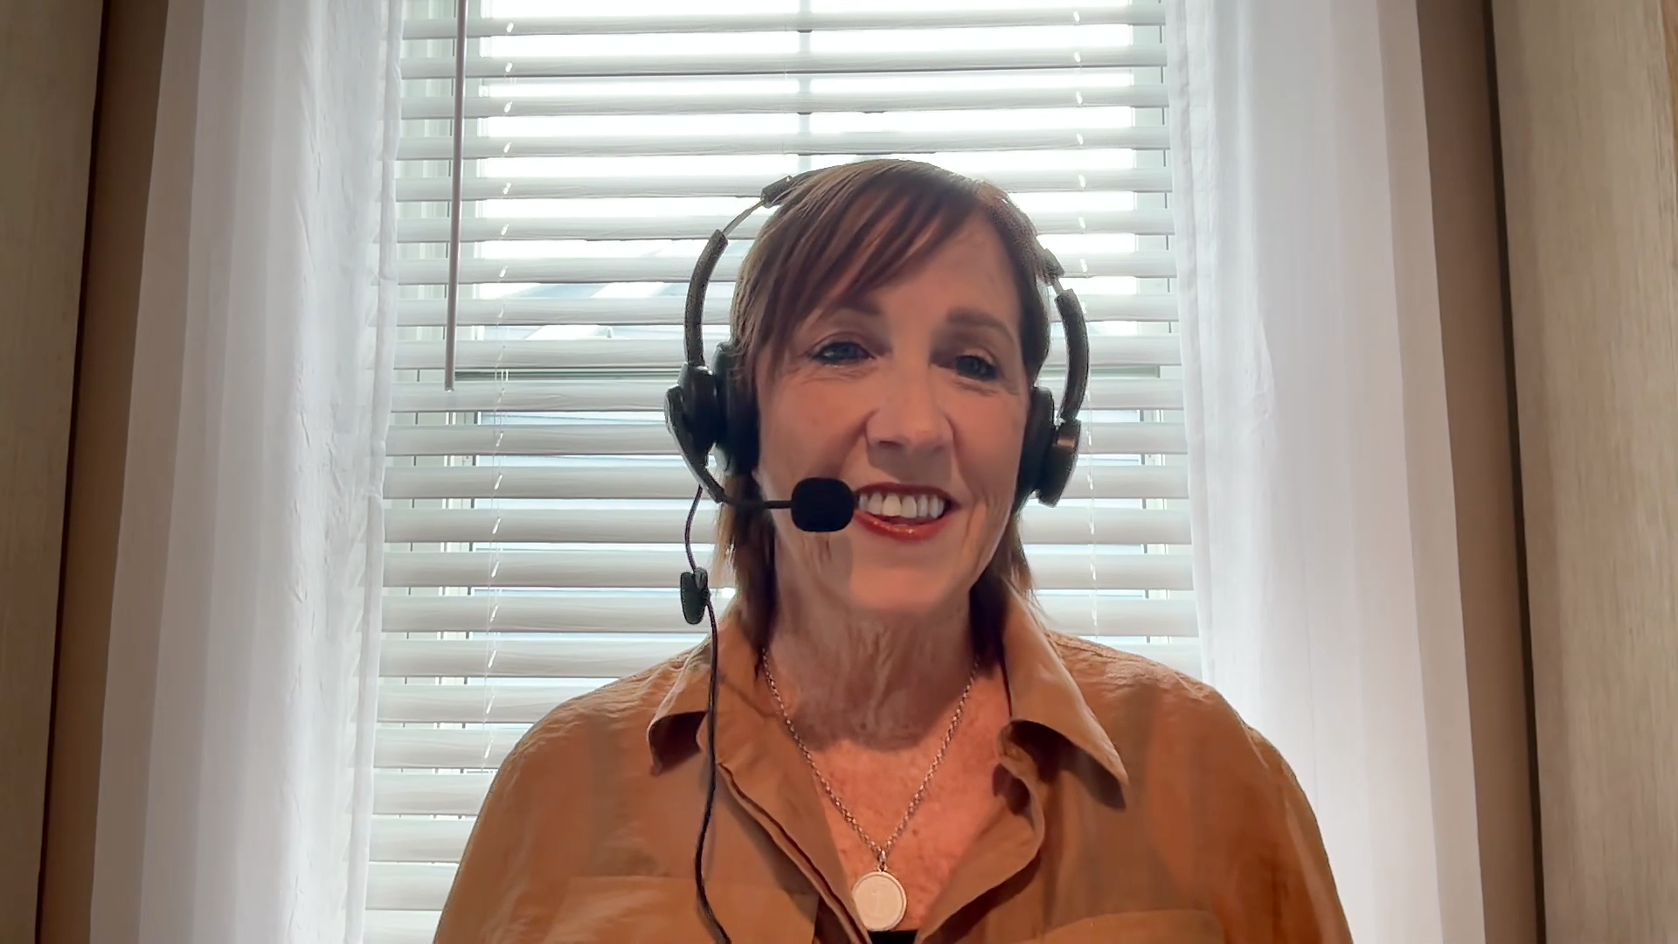
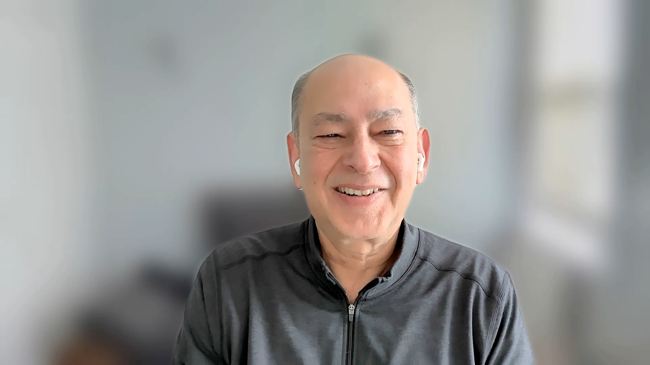
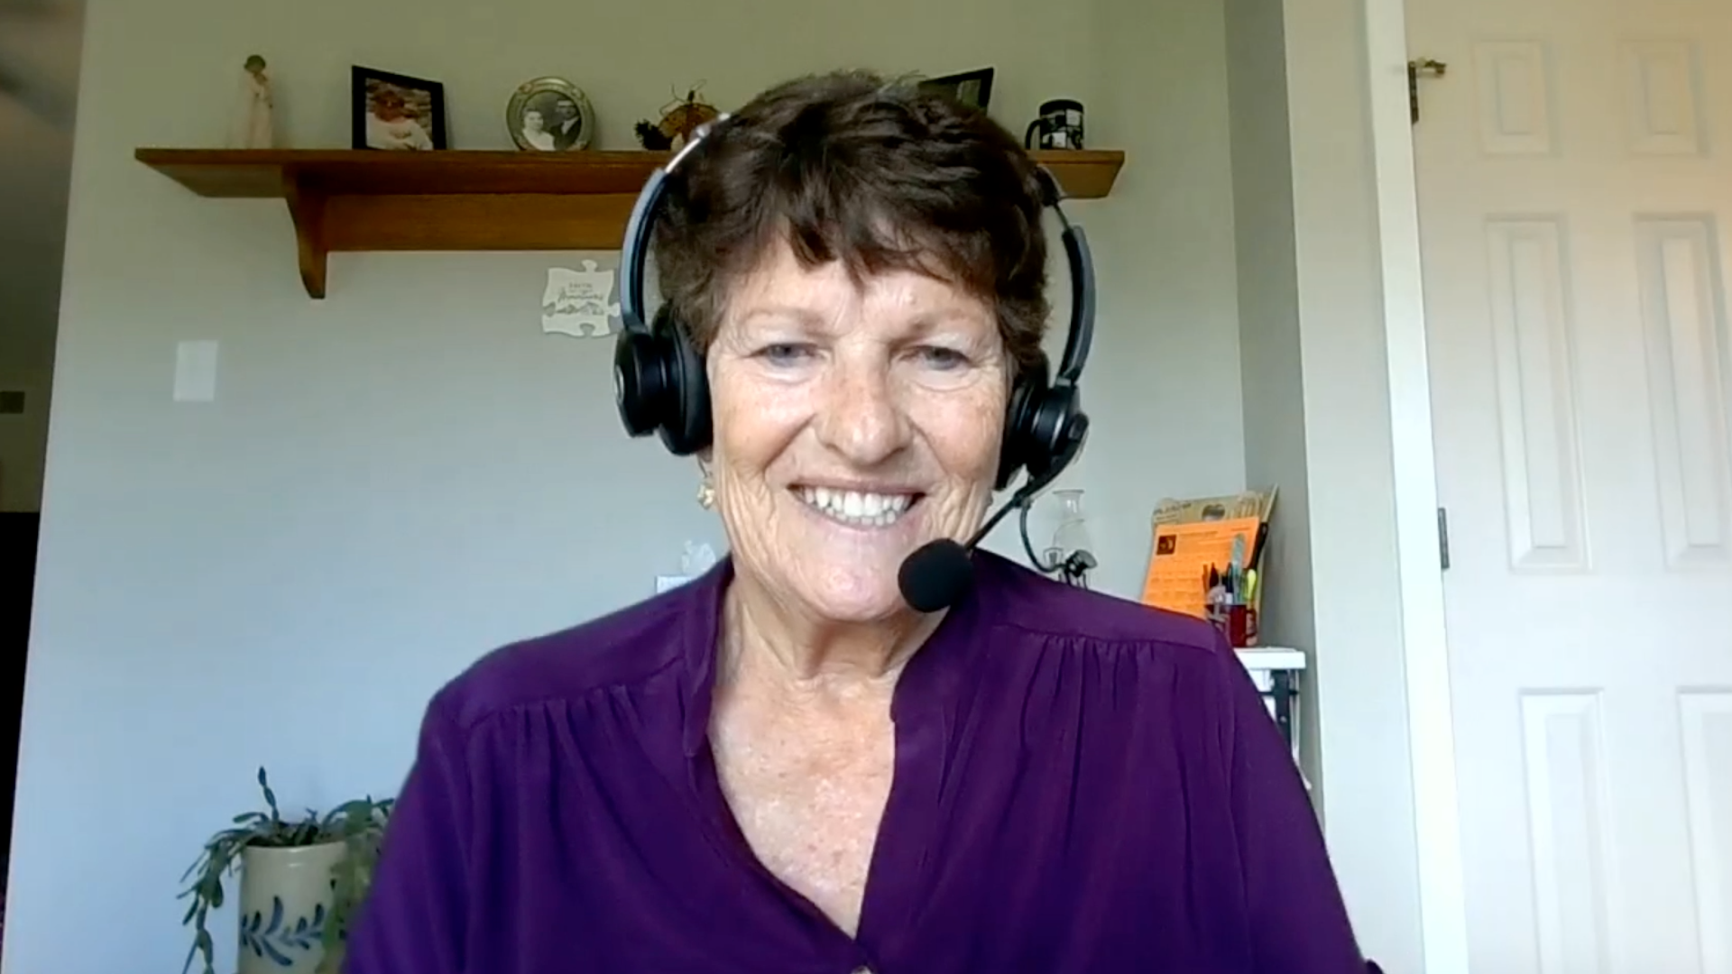
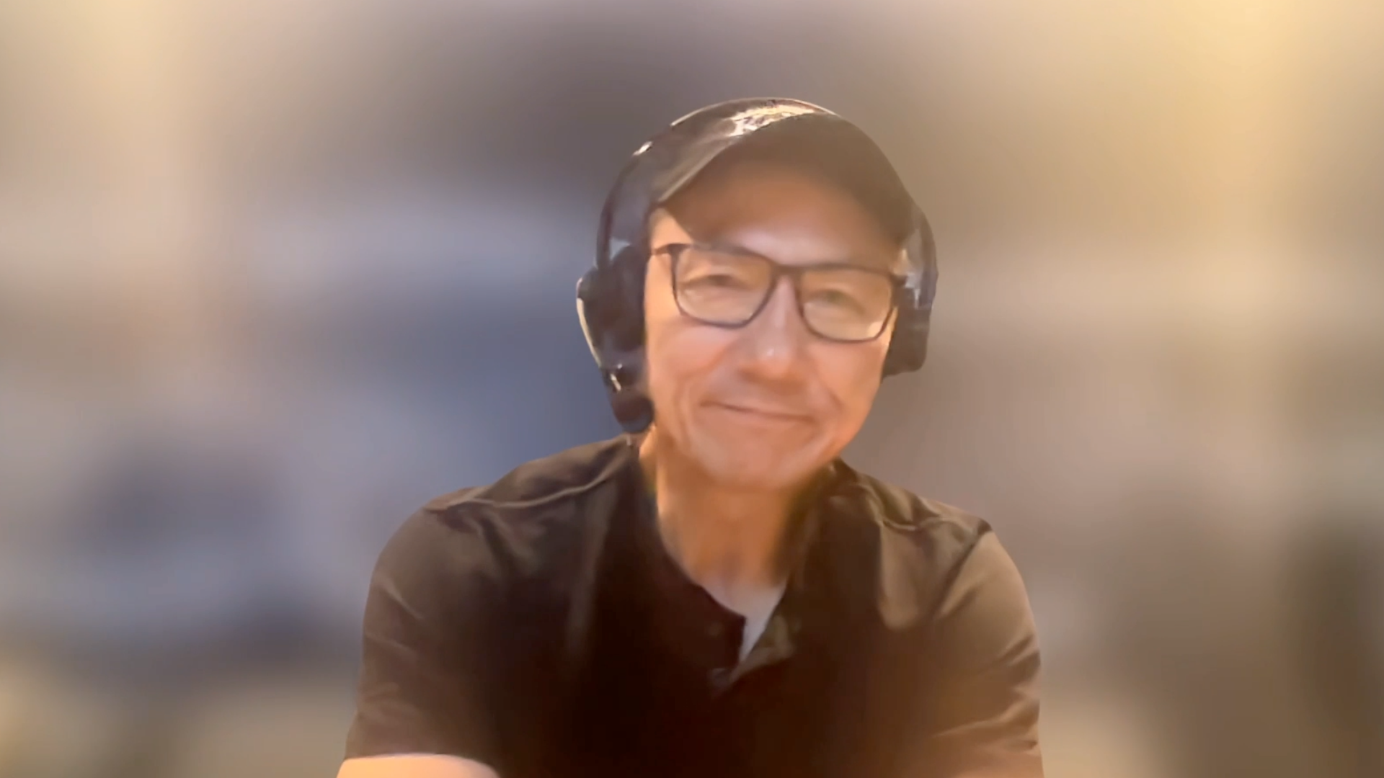
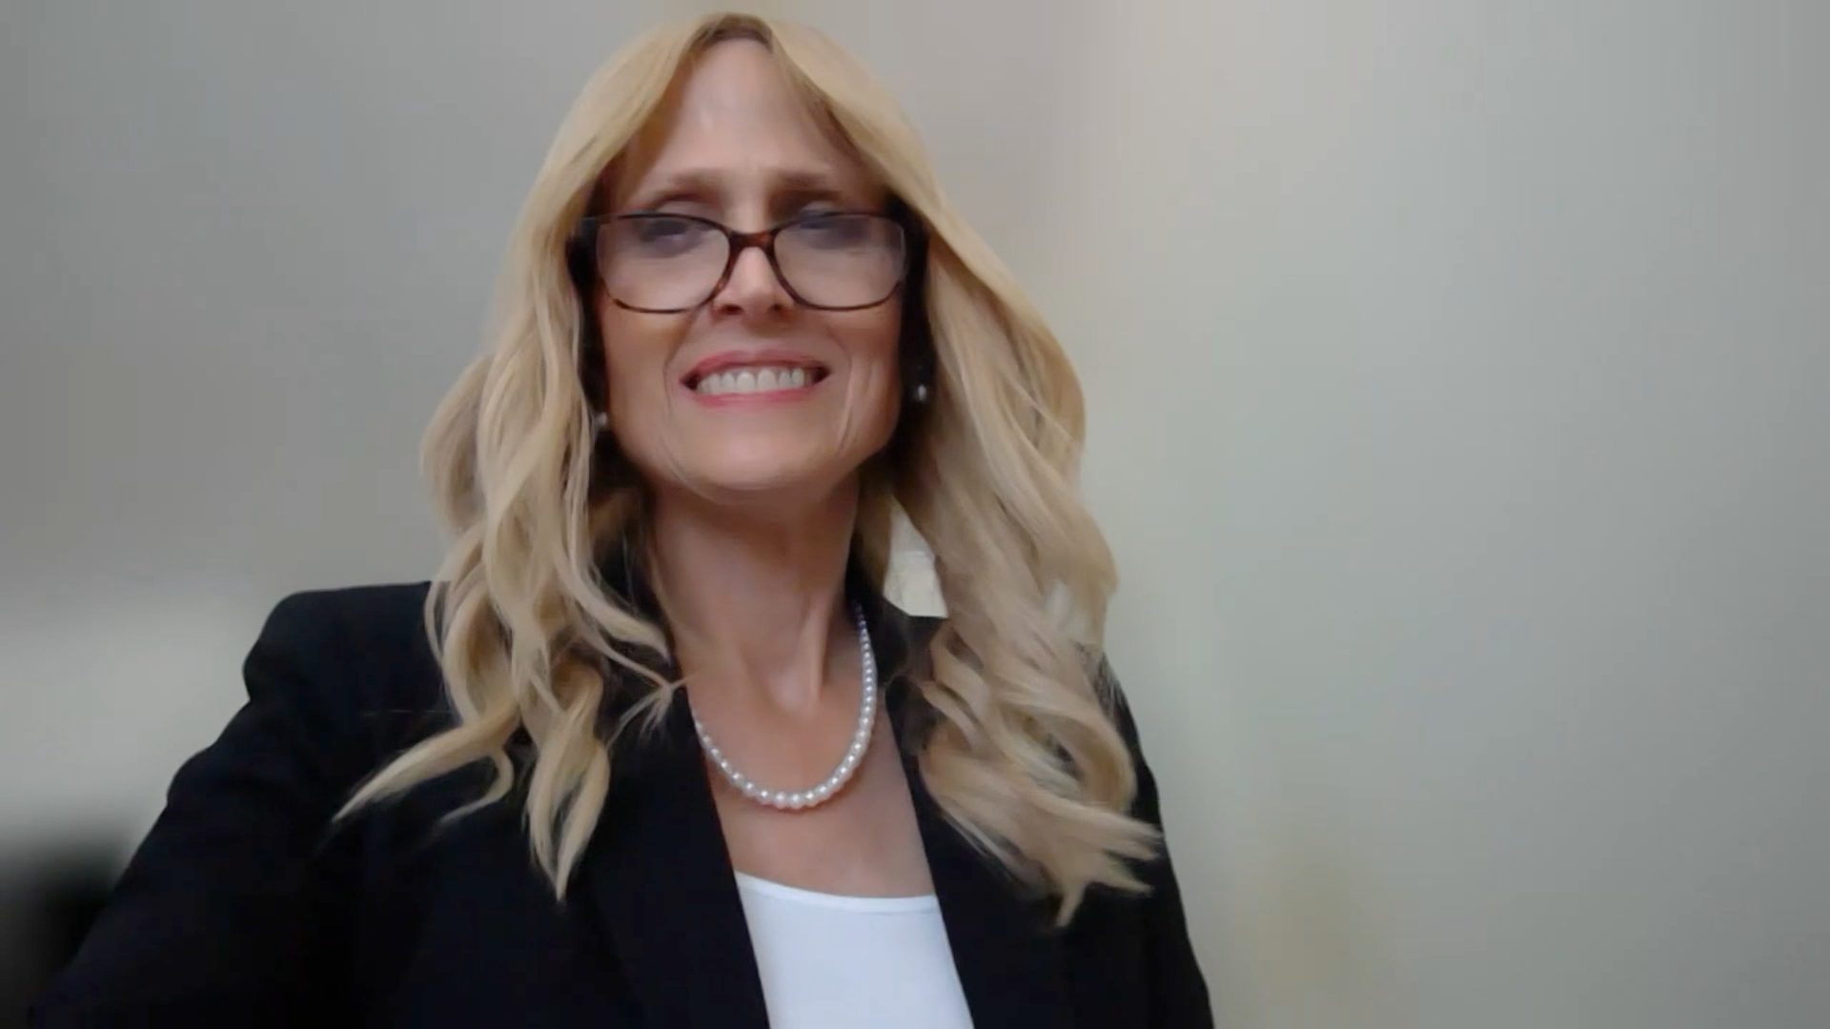
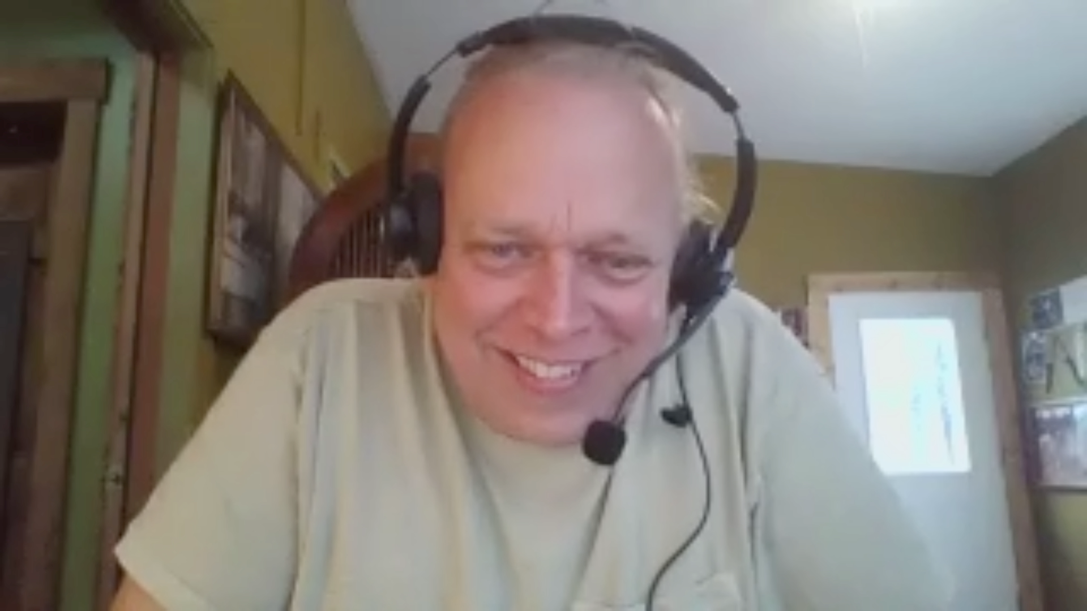
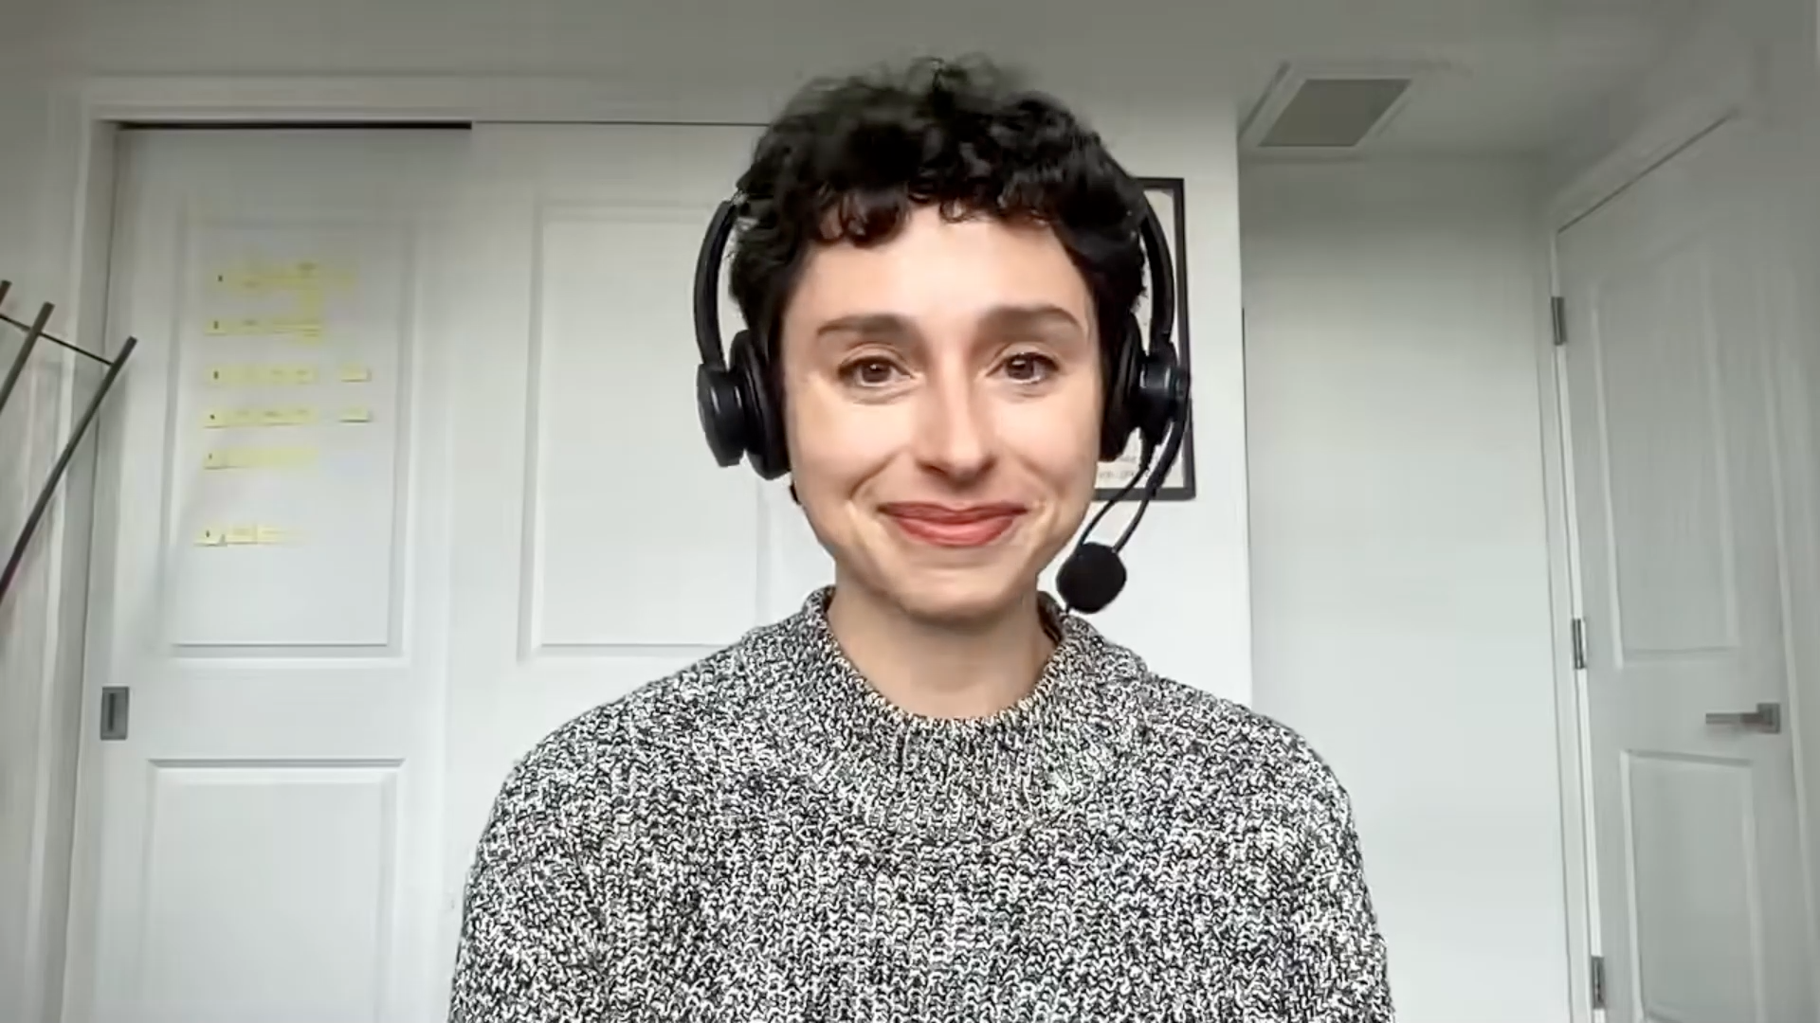
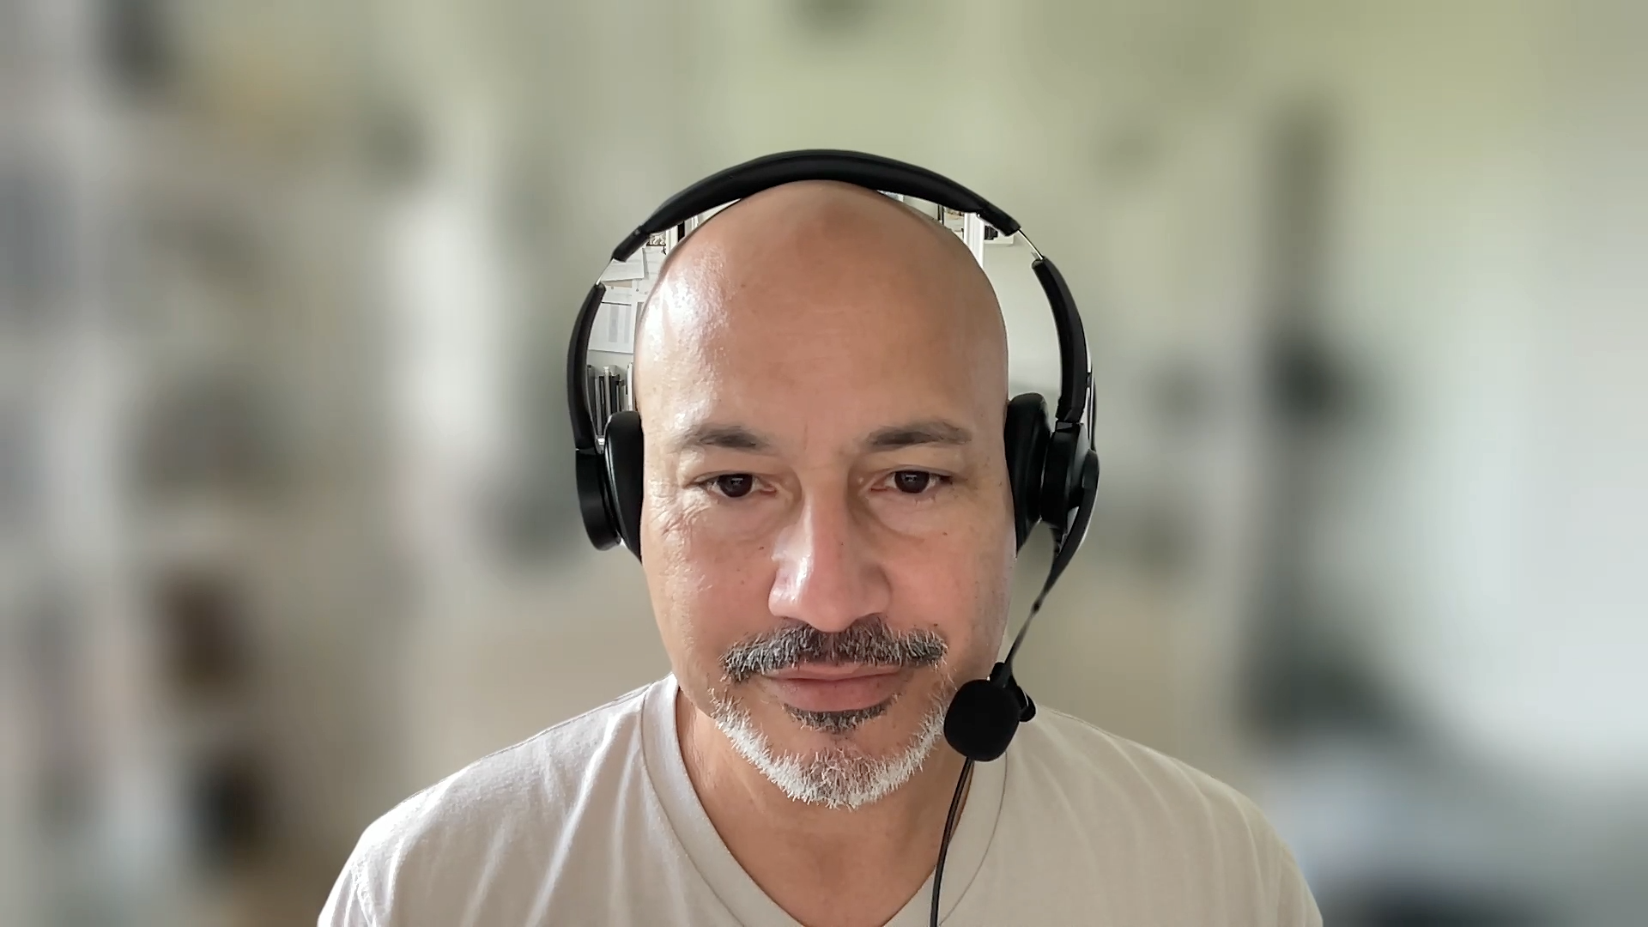

Slide 34
Cancer Q&A
CAR T-Cell Therapy for Non-Hodgkin Lymphoma
Introduction: About This Program
Module 1: Overview of CAR T-Cell Therapy
Module 2: Potential Treatment Benefits of CAR T-Cell Therapy
Module 3: CRS (Cytokine Release Syndrome) and ICANS (Immune Effector Cell-Associated Neurotoxicity Syndrome)
Module 4: Finding Information About CAR T; Clinical Trials
Module 5: Financial Issues; Risk of Infection
Module 6: Coping with Anxiety; Healing and Moving On

Slide 35
Cancer Q&A
CAR T-Cell Therapy for Non-Hodgkin Lymphoma
Introduction: About This Program
Module 1: Overview of CAR T-Cell Therapy
Module 2: Potential Treatment Benefits of CAR T-Cell Therapy
Module 3: CRS (Cytokine Release Syndrome) and ICANS (Immune Effector Cell-Associated Neurotoxicity Syndrome)
Module 4: Finding Information About CAR T; Clinical Trials
Module 5: Financial Issues; Risk of Infection
Module 6: Coping with Anxiety; Healing and Moving On

Slide 36
Cancer Q&A: Addressing Common Questions Posed by
Patients with Relapsed/Refractory Multiple Myeloma
A Live Webinar for Patients, Developed in Partnership with CancerCare®
Wednesday, July 23, 2025
6:00 PM – 7:00 PM ET
Faculty
Natalie S Callander, MD
Sagar Lonial, MD, FACP
Moderator
Neil Love, MD

Slide 37
Cancer Q&A: Addressing Common Questions Posed by
Patients with Relapsed/Refractory Multiple Myeloma
A CME/MOC-Accredited Webinar Developed in Partnership with CancerCare®
Thursday, August 7, 2025
5:00 PM – 6:00 PM ET
Faculty
Natalie S Callander, MD
Sagar Lonial, MD, FACP
Moderator
Neil Love, MD

Slide 38
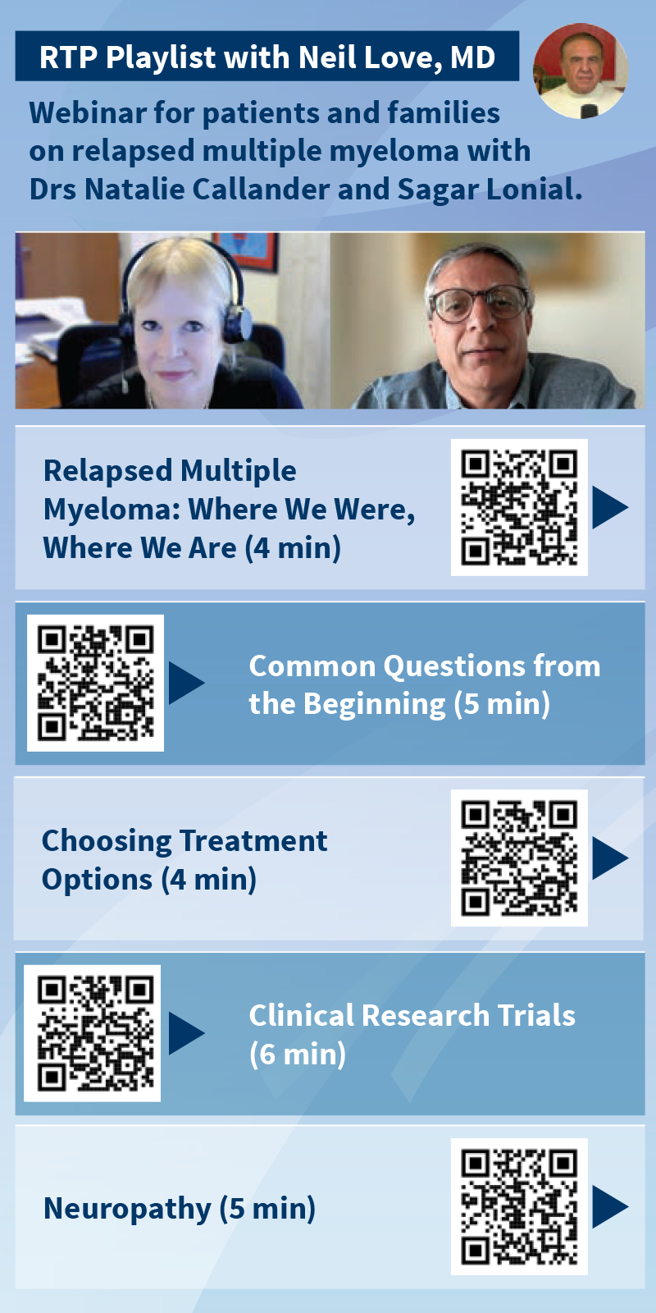
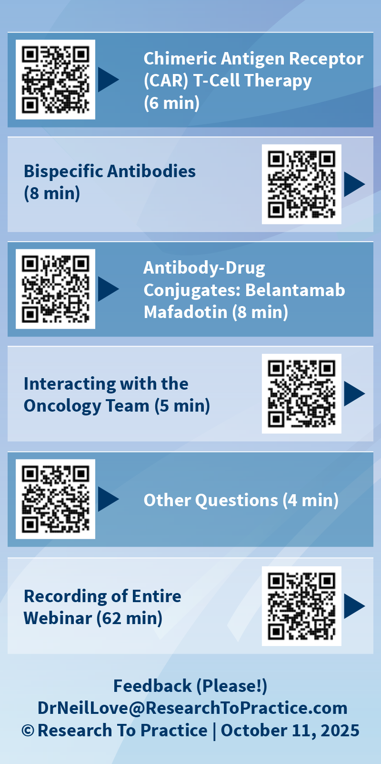

Slide 39
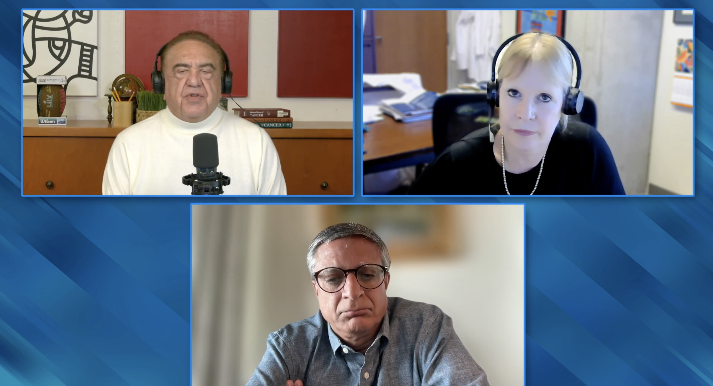
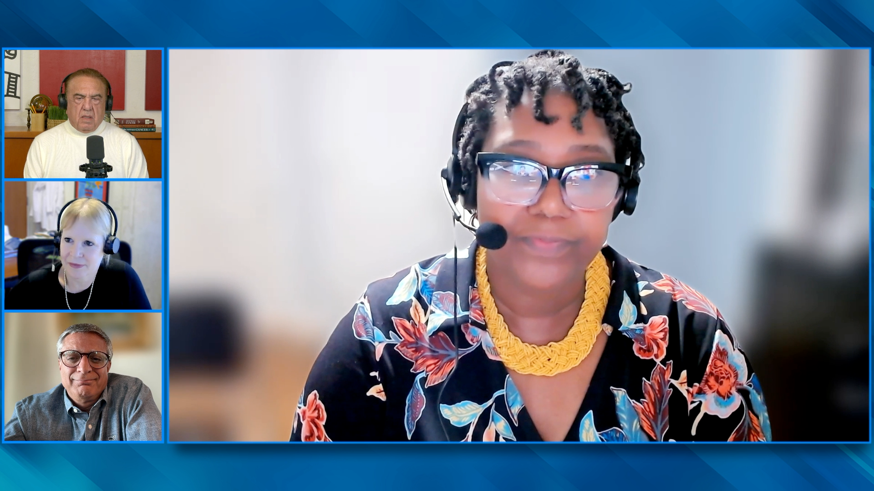
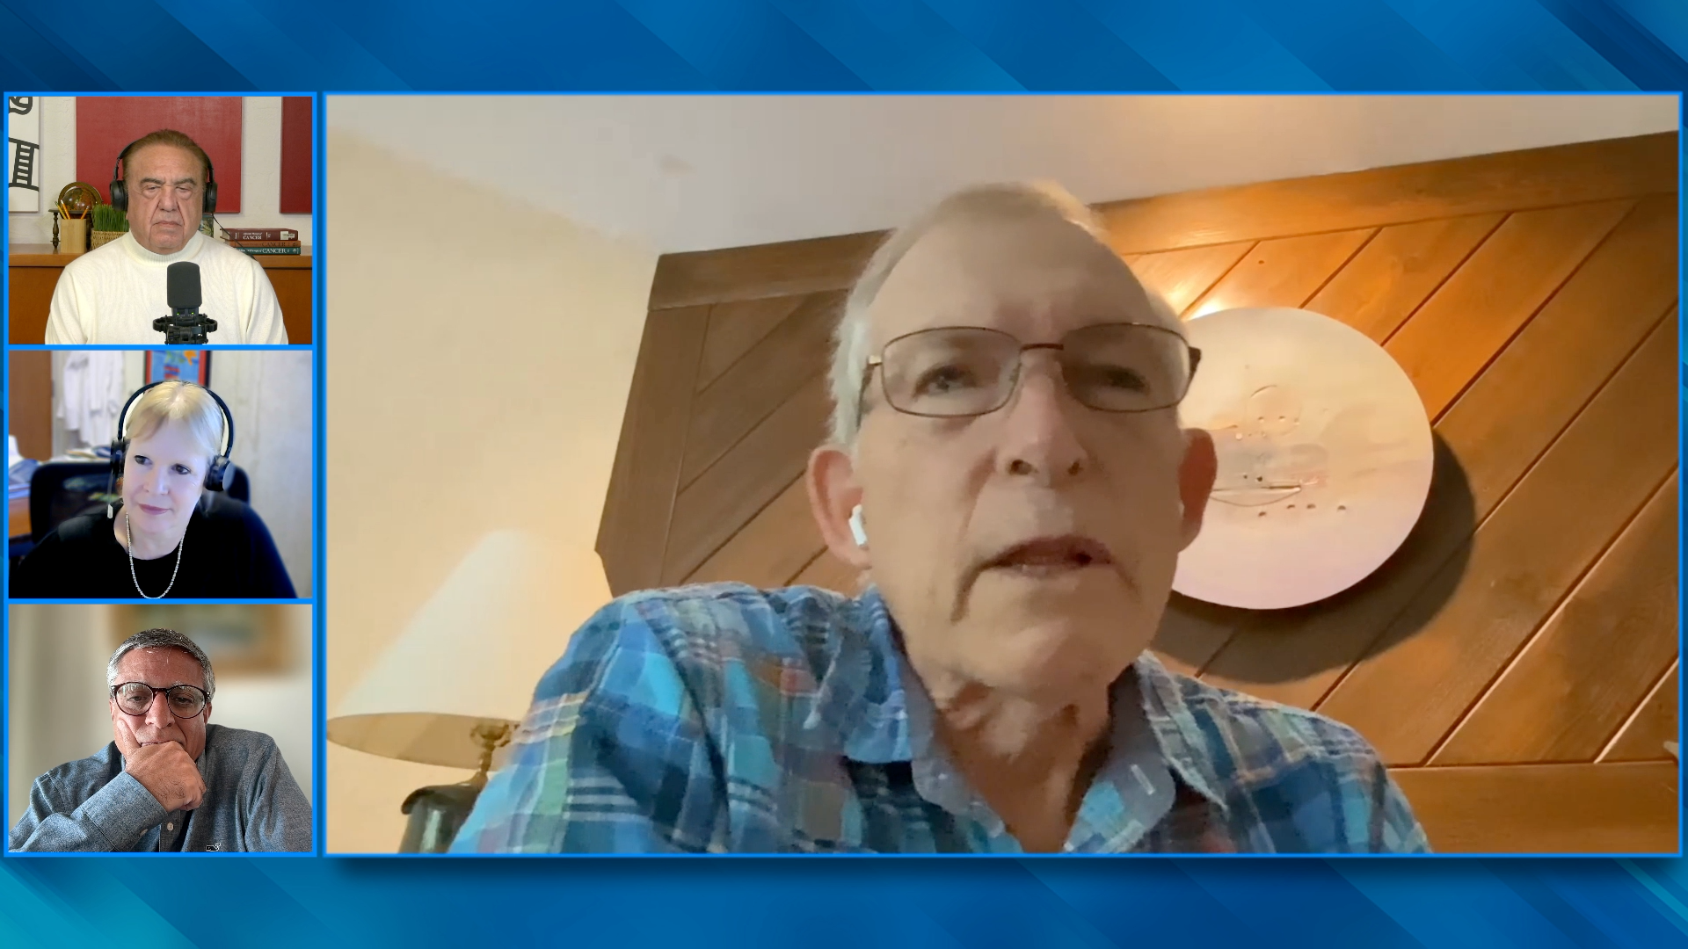
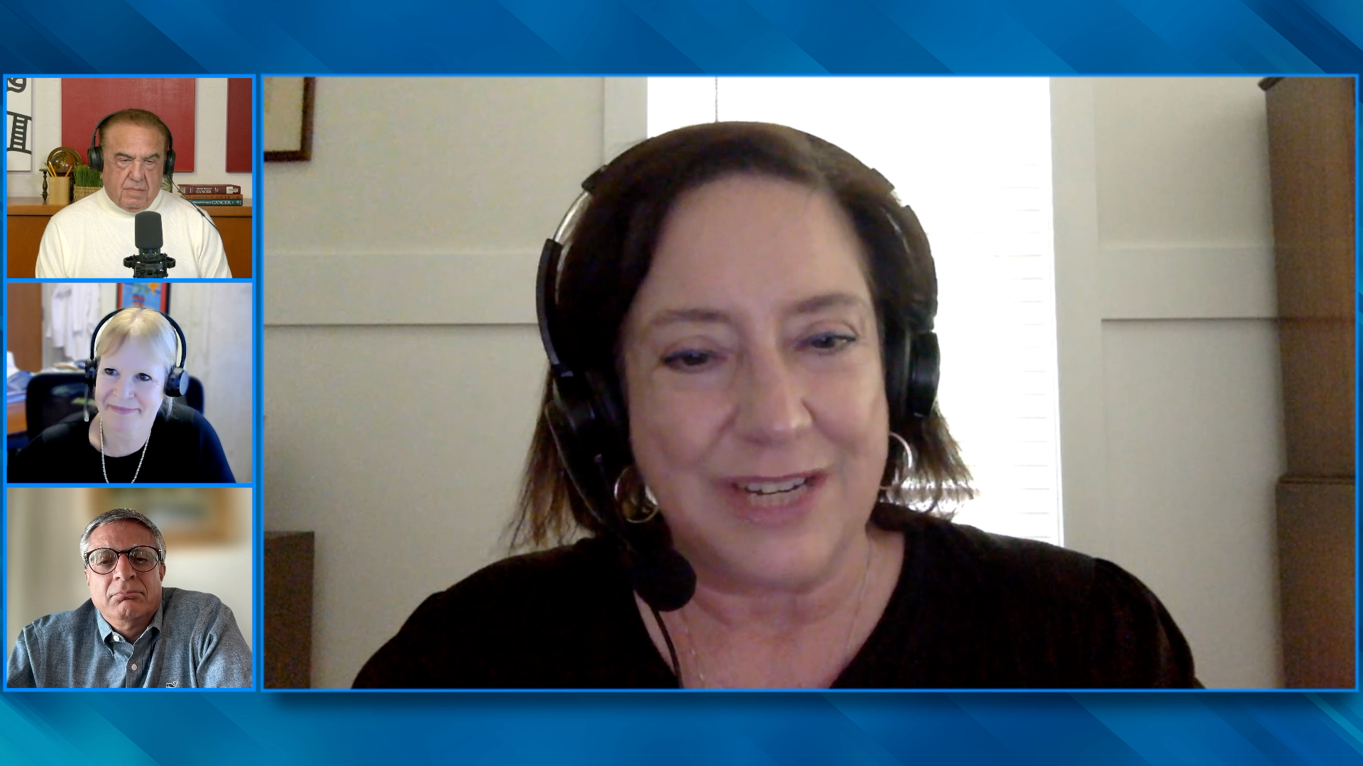

Slide 40
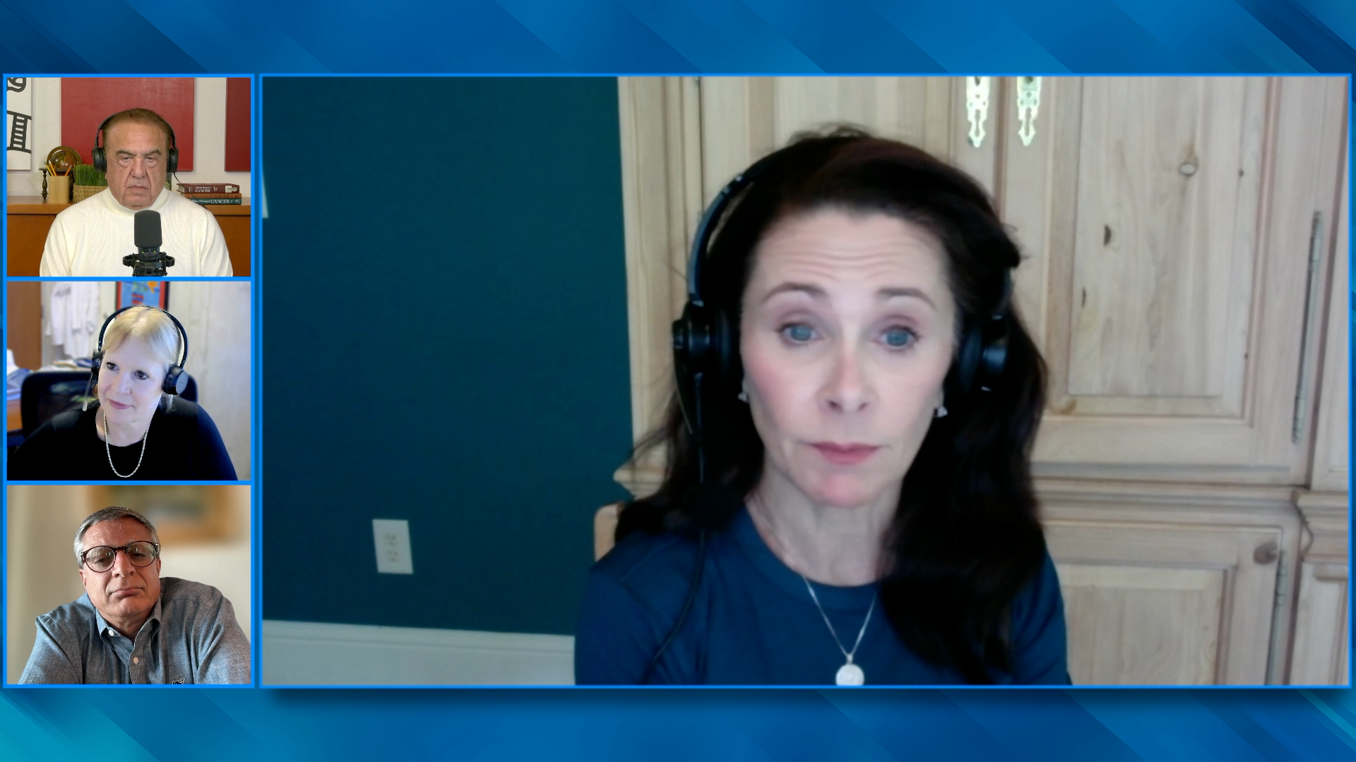
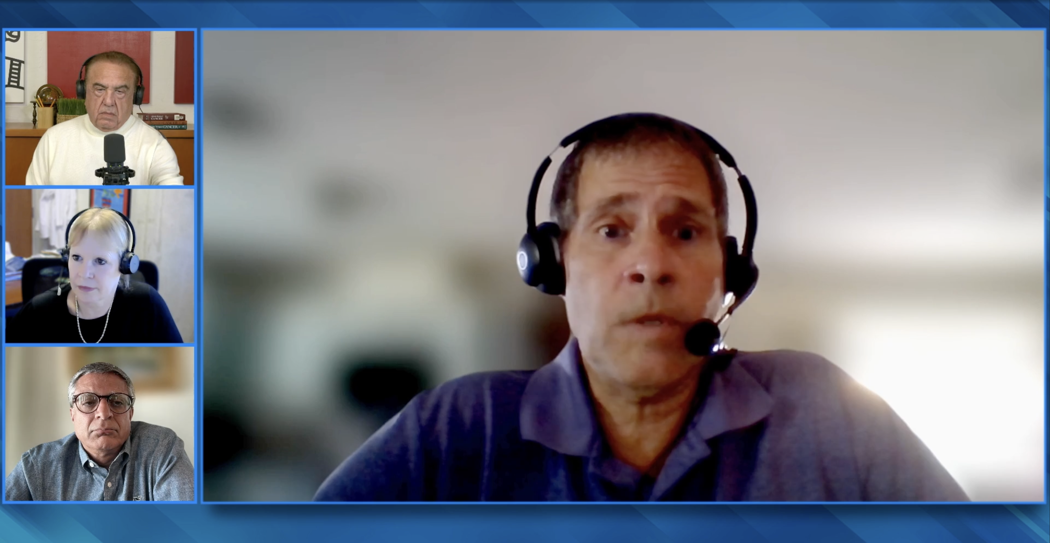
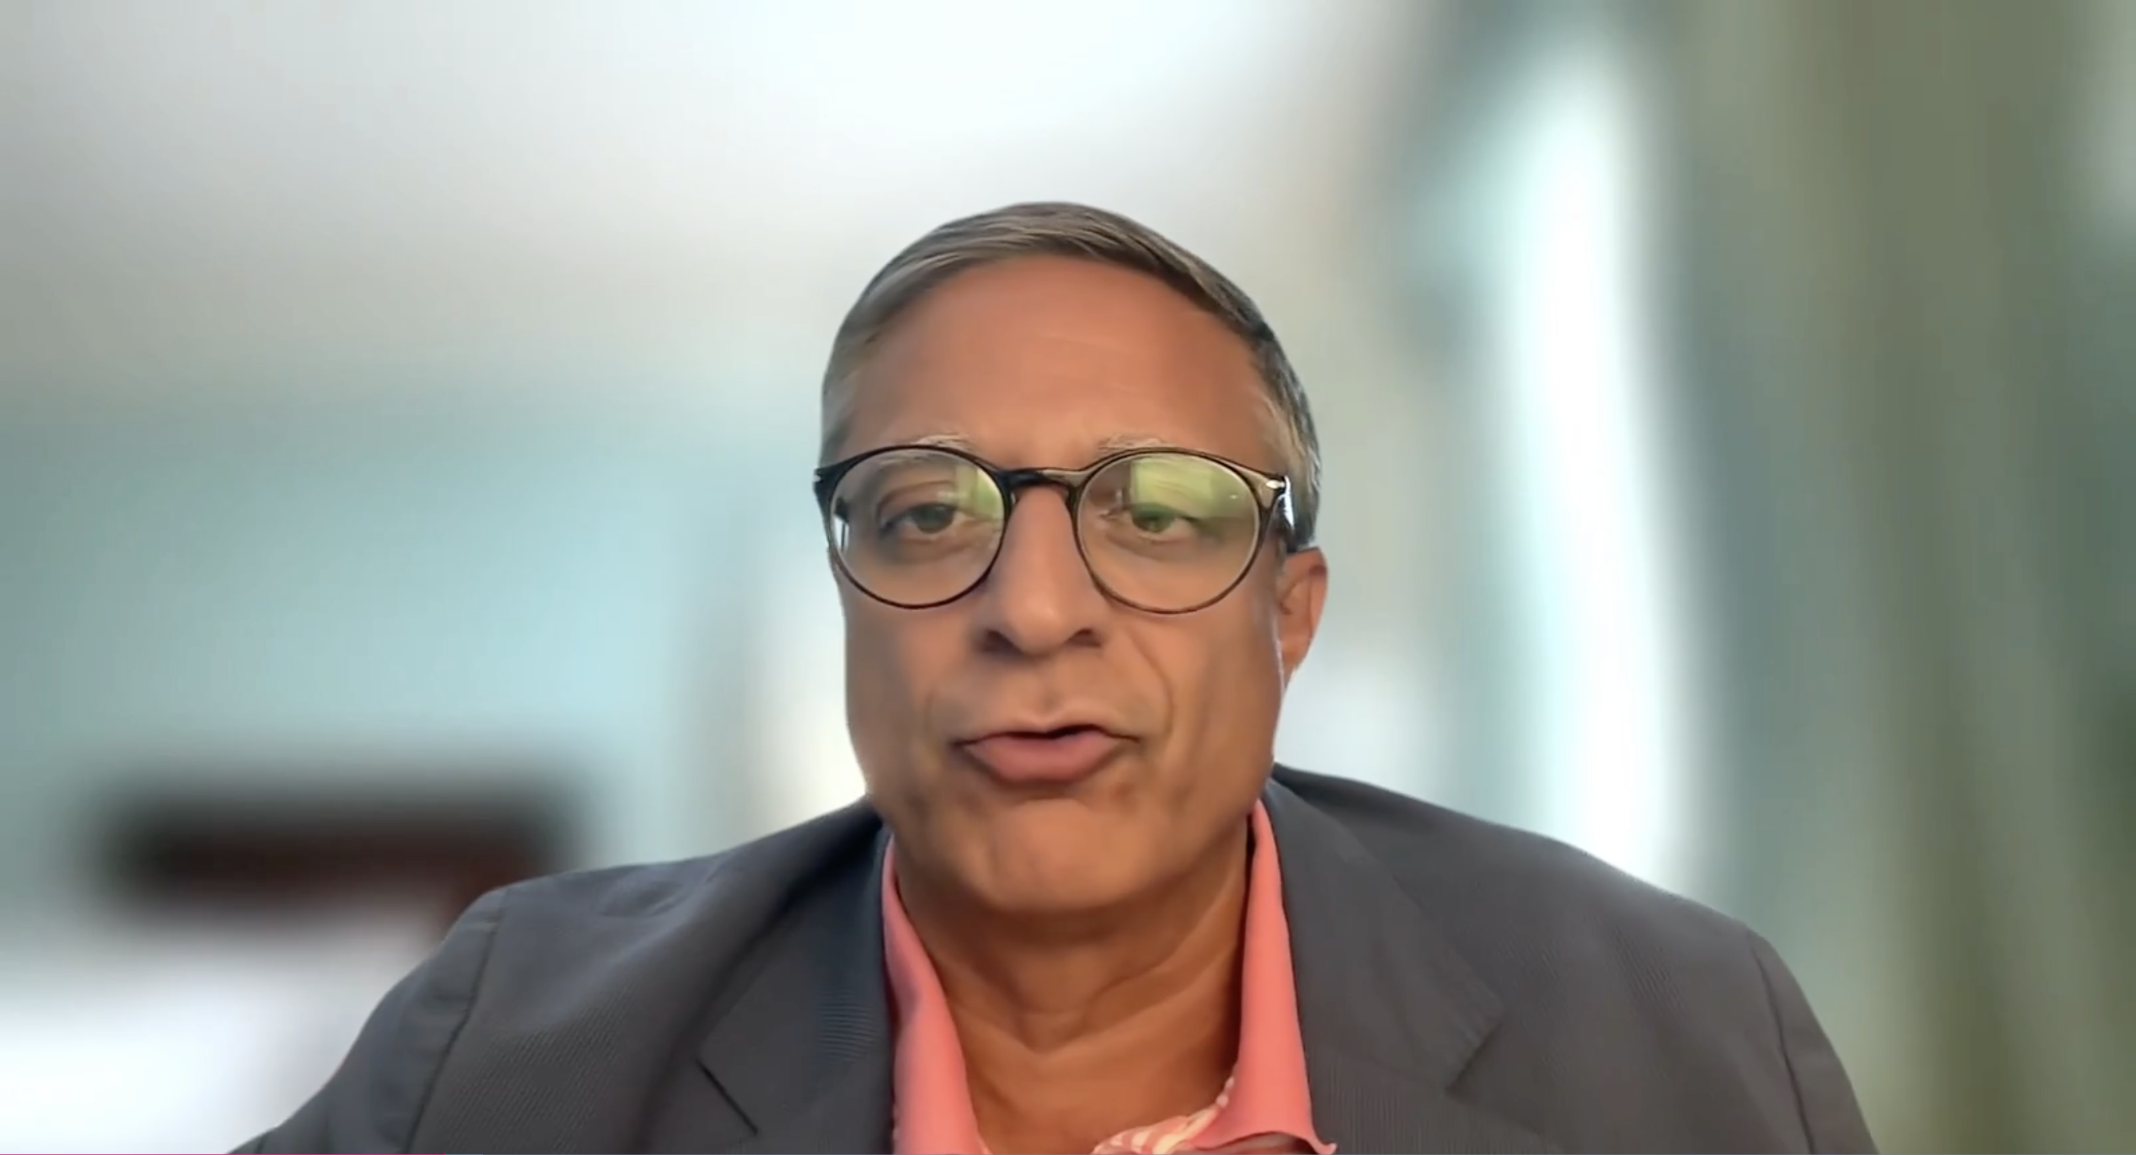
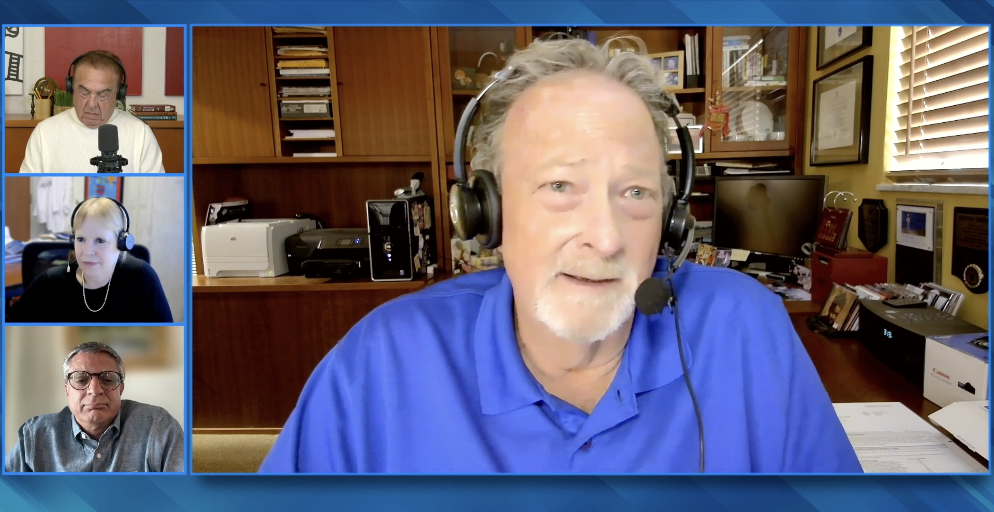
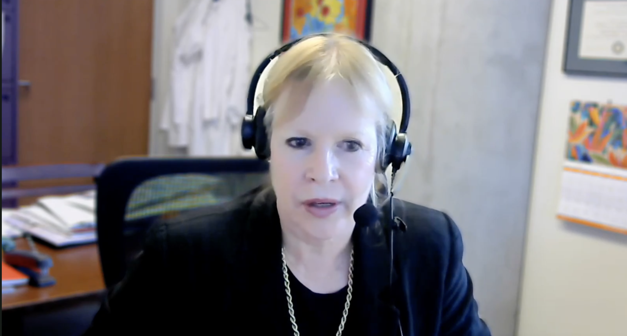
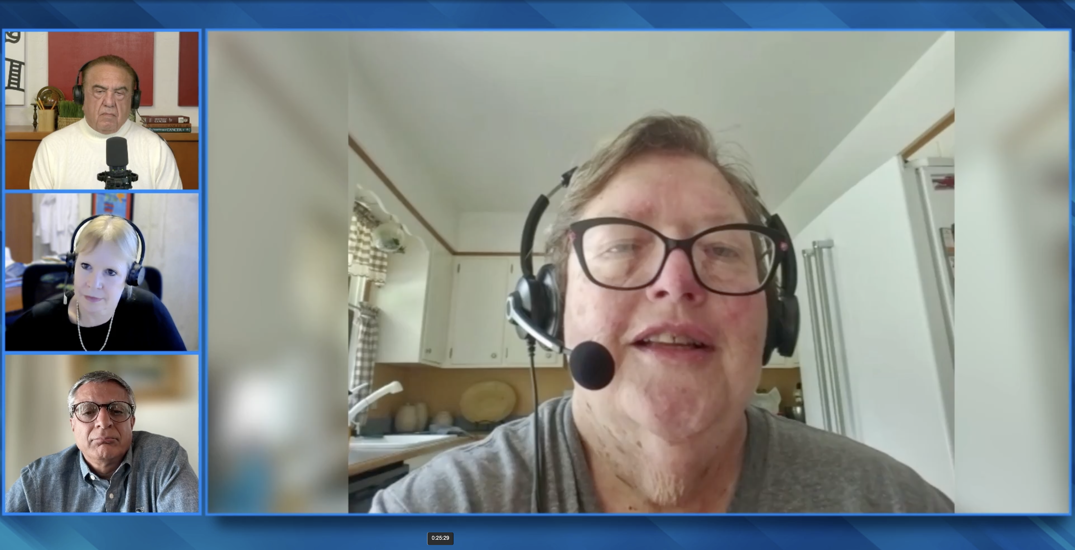

Slide 41
Cancer Q&A
CAR T-Cell Therapy for Non-Hodgkin Lymphoma
Introduction: About This Program
Module 1: Overview of CAR T-Cell Therapy
Module 2: Potential Treatment Benefits of CAR T-Cell Therapy
Module 3: CRS (Cytokine Release Syndrome) and ICANS (Immune Effector Cell-Associated Neurotoxicity Syndrome)
Module 4: Finding Information About CAR T; Clinical Trials
Module 5: Financial Issues; Risk of Infection
Module 6: Coping with Anxiety; Healing and Moving On

Slide 42
Overview of CAR T-cell therapy

Slide 43
Overview of CAR T-Cell Treatment
CAR T cells harness the power of your own immune system to fight the lymphoma. Both CAR T-cell products have identical efficacy.
One is less toxic but takes about a week longer to manufacture.
Cytopenias, secondary malignancy risk and infection risk are similar across constructs. Manufacturing time is different across different products.
Liso-cel is generally associated with lower rates of CRS and neurotoxicity.
The one limitation is the median manufacturing time is about 24 days.
All CAR products are derived from the patients own T cells. They are modified
to better recognize and kill cancer cells. Axi-cel/brexu-cel has a Ferrari engine; Liso-cel and tis-cel have a Corvette engine.
The approved products are very similar – we take T cells and turn them in to lymphoma-fighting weapons, which are more effective to get and stay in remission than other treatments. The main differences are logistics and side effects.
CRS = cytokine release syndrome

Slide 44
Cancer Q&A
CAR T-Cell Therapy for Non-Hodgkin Lymphoma
Introduction: About This Program
Module 1: Overview of CAR T-Cell Therapy
Module 2: Potential Treatment Benefits of CAR T-Cell Therapy
Module 3: CRS (Cytokine Release Syndrome) and ICANS (Immune Effector Cell-Associated Neurotoxicity Syndrome)
Module 4: Finding Information About CAR T; Clinical Trials
Module 5: Financial Issues; Risk of Infection
Module 6: Coping with Anxiety; Healing and Moving On

Slide 45
Potential treatment benefits of CAR T-cell therapy

Slide 46
Selecting a CAR T-Cell Product
We consider multiple factors, including efficacy, safety, manufacturing time
and ability to administer in the outpatient setting.
I consider disease subtype, efficacy data, tumour burden,
patient symptoms, time it will take to manufacture, patient age,
comorbidities, performance status, caregiver support.
Key factors are type of lymphoma, line of therapy, response to prior treatment, comorbid conditions, disease burden and tempo.
Liso-cel is appropriate alternative to axi-cel for DLBCL. For a patient
w/ high burden or aggressive disease the choice might be axi-cel.
For FL, the preference is liso-cel. For MCL the preference is brexu-cel.
I weigh the pros and cons of each product: If the disease
is progressing quickly, I choose speed and reliability of manufacturing.
If the patient is frail, I choose safety of the toxicity profile.

Slide 47
Selecting a CAR T-Cell Product
Manali Kamdar, MD, MBBS
When I choose a CAR-T product, I consider:
Disease subtype and efficacy data for that construct in that histology
Tumor burden, patient symptoms, time it will take to manufacture one construct versus the other
Patient profile: age, comorbidities, performance status, caregiver support
Logistics: inpatient versus outpatient feasibility, manufacturing time and caregiver support
The goal is to tailor the product to both disease biology and patient resilience.

Slide 48
Bridging Therapy
Bridging therapy is treatment used to control the disease and
symptoms while the CAR T cells are being manufactured.
We have both systemic options and radiation therapy.
Bridging therapy is anything we do to stabilize disease while CAR T cells are being manufactured. The goal is to keep the disease under control.
Patients are likely to have better outcomes regarding both safety and efficacy
if they proceed with CAR T with disease regressing as opposed to progressing.
Bridging therapy is needed to slow the progression of cancer long enough
to allow for collection, manufacture and return of the CAR product;
especially helpful for rapidly progressive disease.
Bridging therapy is not always required, especially if the amount
of lymphoma is low and speed of disease growth is slow.

Slide 49
Key Time Points in the CAR T Journey
CAR T-cells are a multi-step process, but the actual treatment is given
as a single infusion, not multiple cycles like many other therapies.
I map out the process clearly. I reassure them that if the
first 2 weeks go smoothly, they can often transition home
or local lodging, continuing close follow-up.
Patients are monitored at the treating center until they are deemed safe
to return home. Patients are followed closely for the first 90 days.
The first step is insurance approval. This can vary from patient to patient.
Next step after approval is obtaining an apheresis slot,
for which thereafter we will collect cells.
The key time points are the decision, the approval, the collection,
the manufacturing, the delivery, and the follow-up. For follow-up, patients
have testing like PET/CT scans and blood work, and to work with their local oncologist on recovering from any leftover side effects.

Slide 50
Key Time Points in the CAR T Journey
Manali Kamdar, MD, MBBS
I map out the process clearly:
Initial consult and eligibility review
Apheresis (cell collection)
Bridging therapy (if needed)
Manufacturing period (usually 3-5 weeks)
Lymphodepleting chemotherapy
Cell infusion (day 0)
Monitoring phase (days 0-14) for CRS or ICANS
Response assessment at day 30 or 90, depending on institutional programmatic approach
Follow-up phase: infection prophylaxis, labs and clinic visits for at least 6 months
I reassure them that if the first 2 weeks go smoothly, they can often transition home or to local lodging, continuing close follow-up.

Slide 51
Follicular Lymphoma
Responses to CAR T last about 5 years on average, but far longer responses
are possible. Some patients will never relapse after this treatment.
My preferred CAR T is lisocabtagene maraleucel (liso-cel),
which offers an attractive balance of efficacy and tolerability.
Remission can be long-lasting — and possibly curative.
I recommend liso-cel primarily because it is associated
with a manageable safety profile.
My preference is liso-cel; the hope is that w/ time we might identify a subset
of patients that could potentially achieve a cure or a “functional” cure.
Axi-cel. We choose this treatment because more than half of patients
are alive and did not require additional lymphoma therapy with more
than 5 years of follow up – hopefully some of those patients are cured.

Slide 52
Diffuse Large B-Cell Lymphoma
The majority of patients will respond; about half
will go into complete remission. Close to 40% will be cured.
I generally prefer liso-cel for DLBCL. The 5-year follow-up data
across all constructs suggest a roughly 40% chance of long-term
remission or cure, but liso-cel has a more favorable safety profile.
I generally favor liso-cel for older or frailer patients given
the favorable toxicity profile. For young, fit patients,
I prefer axi-cel with the favorable manufacturing time.
Preference would be based on age/fitness; for younger/fit patients axi-cel and for older patients liso-cel. This would be administered w/ the intent to cure. Patients in remission at day 90 have a great chance of long-term cure.
Axi-cel. For your relapsed DLBCL, we have one chance to provide
a curative intent therapy and thus reliability of manufacturing is key.
Axi-cel cures about 40% of patients with this otherwise fatal disease.

Slide 53
Mantle Cell Lymphoma
The vast majority of patients in this situation will respond, and most
will go into complete remission. Remissions last 1-2 years on average, but remission may last much longer. Pirtobrutinib may be used as bridging therapy.
For younger, fit patients, brexucabtagene autoleucel (brexu-cel)
remains my preferred choice. For older or frail patients,
I favor liso-cel due to its lower toxicity and outpatient feasibility.
I would prefer liso-cel for multiply-relapsed MCL. I would favor brexu-cel
for a young, fit patient with high-risk disease in first relapse.
Preference is brexu-cel. Treatment is not curative and the disease will relapse. For those unable to receive brexu-cel we use liso-cel.
Liso-cel. For your relapsed MCL, we want to balance concerns
for effective treatment and risk of side effects. The other options
are impressive, but have a higher risk of severe side effects.

Slide 54
Cancer Q&A
CAR T-Cell Therapy for Non-Hodgkin Lymphoma
Introduction: About This Program
Module 1: Overview of CAR T-Cell Therapy
Module 2: Potential Treatment Benefits of CAR T-Cell Therapy
Module 3: CRS (Cytokine Release Syndrome) and ICANS (Immune Effector Cell-Associated Neurotoxicity Syndrome)
Module 4: Finding Information About CAR T; Clinical Trials
Module 5: Financial Issues; Risk of Infection
Module 6: Coping with Anxiety; Healing and Moving On

Slide 55
CRS (cytokine release syndrome) and ICANS (immune effector cell-associated neurotoxicity syndrome)

Slide 56
CRS
The most common symptom is fever, but it can uncommonly get worse.
We give an antidote called tocilizumab with or without steroids which rapidly improves the CRS and usually prevents if from becoming severe.
I describe CRS as the “immune storm” that tells us the
CARs are expanding — fever, chills, low blood pressure,
shortness of breath — ranging from mild to severe.
The spectrum of CRS is dependent on the product regarding the likelihood
of experiencing it at all and how serious it might be. Nearly all patients
will have fever. Generally, the course of CRS is relatively short.
CRS is manifested by fever but this is generally preceded by tachycardia.
Some patients require ICU.
I describe CRS as similar to having an infection like the flu —
sometimes you can have fever and body aches and that’s it,
other times you can see low blood pressure and a trip to the ICU.

Slide 57
ICANS
The most common symptoms are confusion,
sleepiness or word-finding difficulties.
ICANS often follows or overlaps with CRS, most commonly
within 8-14 days post infusion. Early recognition is key,
and we maintain daily neurologic checks during the acute phase.
ICANS is variable and unpredictable. It generally will occur after
a patient has experienced CRS. It can be rapid in onset and resolution.
Initial management is w/ steroids and depends on severity and
duration of symptoms. For most patients this is reversible.
ICANS is brain dysfunction, which is nearly always reversible.
There are no effective preventative strategies, and treatments
can prevent ICANS from worsening.

Slide 58
Cancer Q&A
CAR T-Cell Therapy for Non-Hodgkin Lymphoma
Introduction: About This Program
Module 1: Overview of CAR T-Cell Therapy
Module 2: Potential Treatment Benefits of CAR T-Cell Therapy
Module 3: CRS (Cytokine Release Syndrome) and ICANS (Immune Effector Cell-Associated Neurotoxicity Syndrome)
Module 4: Finding Information About CAR T; Clinical Trials
Module 5: Financial Issues; Risk of Infection
Module 6: Coping with Anxiety; Healing and Moving On

Slide 59
Finding information about CAR T; clinical trials

Slide 60
Cancer Q&A
CAR T-Cell Therapy for Non-Hodgkin Lymphoma
Introduction: About This Program
Module 1: Overview of CAR T-Cell Therapy
Module 2: Potential Treatment Benefits of CAR T-Cell Therapy
Module 3: CRS (Cytokine Release Syndrome) and ICANS (Immune Effector Cell-Associated Neurotoxicity Syndrome)
Module 4: Finding Information About CAR T; Clinical Trials
Module 5: Financial Issues; Risk of Infection
Module 6: Coping with Anxiety; Healing and Moving On

Slide 61
Financial issues; risk of infection

Slide 62
Financial Issues
Insurance covers the CAR T cells and associated care.
Costs may be associated with needing to stay near our center for 2-4 weeks,
but support and reimbursement programs are available.
I emphasize the importance of caregiver support, possible work or income disruption, and the option of FMLA for caregivers.
Financial counselors and social workers assist.
Insurance coverage may impact which centers are available and this can
result in long travel. Patients have several visits to the treating center and
are generally not able to work and this too can be a financial stressor.
Work can be an important issue. Also, there is need for a caregiver,
which requires another person to be off work for an extended period,
which for some is not financially feasible.
As anything complicated, CAR T treatment can have financial
challenges, like needing to be away from home for monitoring
and needing to have a caregiver(s) to take off work.

Slide 63
Potential Long-Term Complications
Prophylactic antibiotics are used until healthy lymphocytes
have recovered. We also monitor antibody levels, and may use IVIG.
We will also consider vaccines to help prevent infections.
The primary concern is immunosuppression and infection risk due
to prolonged B-cell aplasia and hypogammaglobulinemia.
I keep patients on antiviral and PJP prophylaxis for at least 6 months.
B-cell depletion can increase the risk of infection, particularly
viral infections. Monitoring IgG levels and IVIG replacement
is also a consideration to reduce the risk of infection.
We continue anti-infection prophylaxis until blood count recovery.
CAR T cells kill B cells, both good and bad ones, and not having good
B cells for months afterwards can open you up to unsual infections.
IVIG = intravenous immunoglobulin; PJP = Pneumocystis jirovecii pneumonia

Slide 64
Cancer Q&A
CAR T-Cell Therapy for Non-Hodgkin Lymphoma
Introduction: About This Program
Module 1: Overview of CAR T-Cell Therapy
Module 2: Potential Treatment Benefits of CAR T-Cell Therapy
Module 3: CRS (Cytokine Release Syndrome) and ICANS (Immune Effector Cell-Associated Neurotoxicity Syndrome)
Module 4: Finding Information About CAR T; Clinical Trials
Module 5: Financial Issues; Risk of Infection
Module 6: Coping with Anxiety; Healing and Moving On

Slide 65
Coping with anxiety; healing and moving on

Slide 67
Thank you for joining us!
Please take a moment to complete the survey currently up on Zoom. Your feedback is very important to us. The survey will remain open for 5 minutes after the meeting ends.

