Slide 1
Treatment Intensification for Locally Advanced and BCR Prostate Cancer Patients
Neal Shore, MD, FACS

Slide 2
ADT Is a Key Component of Treatment
for High-Risk Prostate Cancer
Androgen deprivation therapy improves survival for men with high-risk prostate cancer when added to EBRT
ADT Potentiates Radiation Damage by Blocking DNA Damage Repair
EBRT + ADT
Bolla Lancet 2002. Goodwin JF Polkinghorn WR Cancer Discovery 2013.

Slide 3
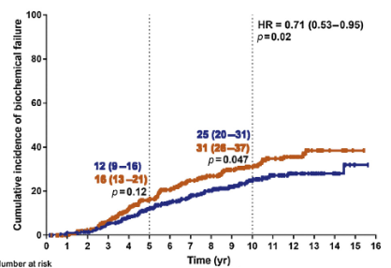
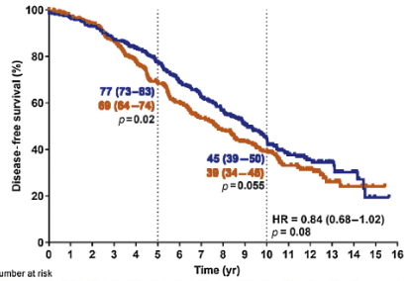
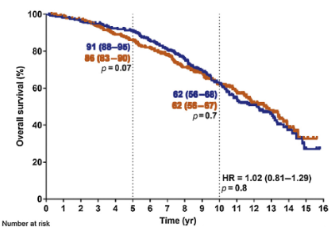
18 Months of ADT Provides Better Quality of Life Than 36 months of ADT
PCS IV, 2000-2008
More Frequent Biochemical Failure | No Difference Disease-specific survival | No Difference in OS BUT not a non-inferiority trial
Nabid A European Urology 2018; 74:432.

Slide 4
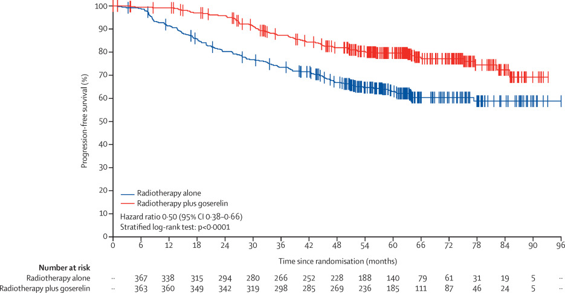
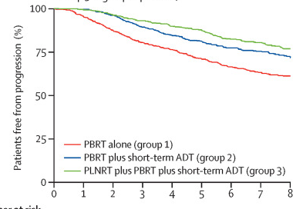
We Don’t Know The Optimal Choice
ADT is not required for all patients & may not be enough for some patients
RT + ADT
RT + ADT
RT Alone
RT Alone
GETUG 16 6 mo ADT improved freedom from progression 50% no recurrence @10yrs w/ RT alone 29% recurred @ 10 yrs w/ RT + ADT | SPPORT 4-6 mo ADT improved freedom from progression 70% no recurrence @5yrs w/ RT alone 20% recurred @ 5 yrs w/ prostate bed RT + ADT

Slide 5

PEACE-2: Phase III Trial of Cabazitaxel and Pelvic Irradiation in Patients With High-risk Localized Prostate Cancer
Androgen deprivation therapy (ADT) x 3 y
+ RXT (prostate)
Primary endpoint:
cRFS (HR: 070)
Secondary endpoints:
PSA response at 3 mos
bPFS
Metastases-free survival
CaP-specific survival
OS
Acute/Lg term tolerance
QoL
Biomarkers (biopsy)
R
A
N
D
O
M
I
Z
E
D
Pts with high-risk localized CaP:
at least 2 of the following criteria:
Gleason≥8
≥ T3
PSA>20 ng/mL
ADT
+ RXT (Prostate + Pelvis)
ADT
+ Cabazitaxel x 4 cycles
+ RXT (prostate)
ADT
+ Cabazitaxel x 4 cycles
+ RXT (Prostate + Pelvis)
n= 750 pts (completed)
Study sponsor: Unicancer
NCT01952223
Notes:
5

Slide 6





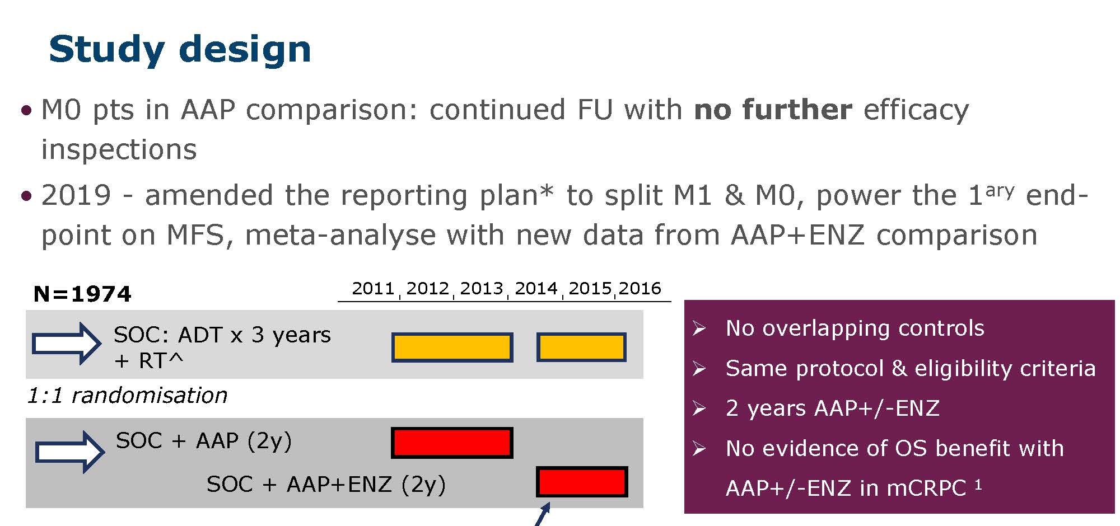
STAMPEDE: Abiraterone ± Enzalutamide in nmCSPC
Attard, et al. Lancet, 2022

Slide 7
STAMPEDE: Abiraterone ± Enzalutamide in nmCSPC
Baseline characteristics well balanced
Median age = 68
Median PSA = 34
39% N1
79% Gleason 8-10
97% patients newly diagnosed
  85% receiving radiation
  15% receiving primary ADT
Median follow-up = 72 months
No benefit to abi + enza vs. abi alone
– arms combined
Attard, et al. Lancet, 2022

Slide 8
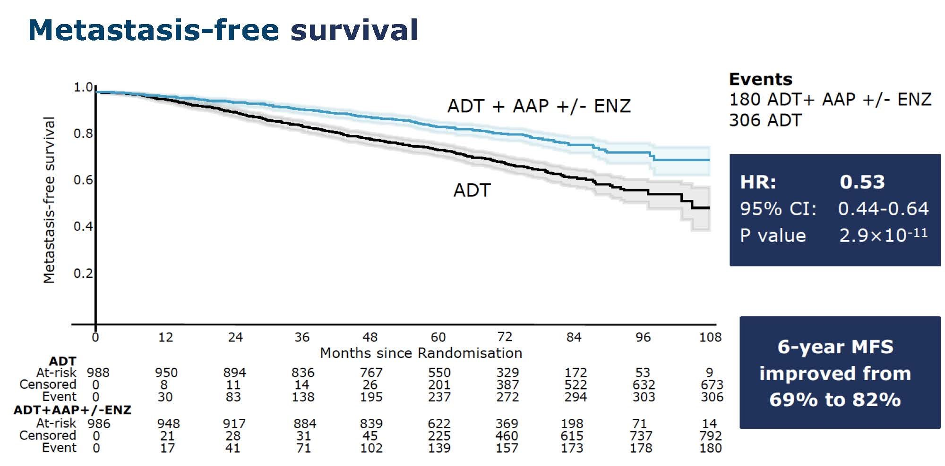
STAMPEDE: Abiraterone ± Enzalutamide in nmCSPC
Attard, et al. Lancet, 2022

Slide 9
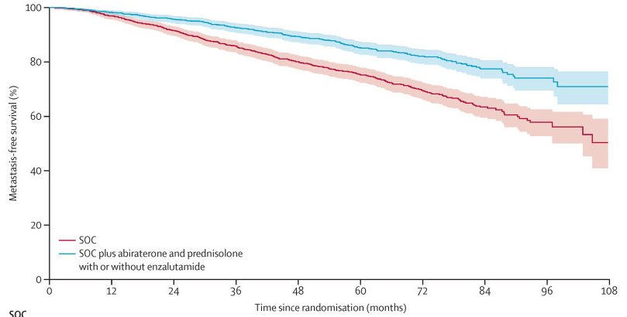
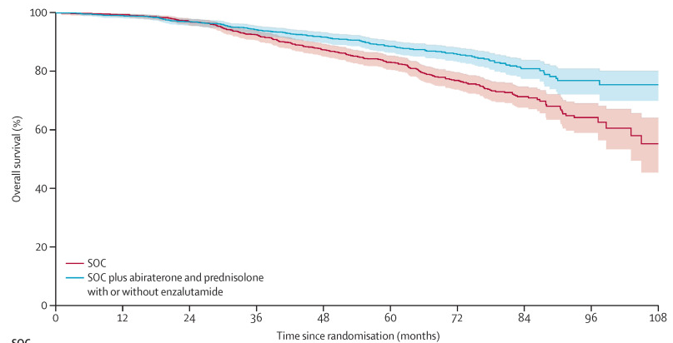
Improvement in PFS, MFS, and OS with the Addition of Abiraterone and Prednisolone to ADT – Very High Risk
STAMPEDE 1,974 PTS. Median 6-year follow up.
  Node positive or 2 of the following: T3/4, Gleason 8-10, PSA >40, high-risk relapse
6 yr MFS: 69% vs. 82%
6 yr OS: 77% vs. 86%
HR 0.53, p<0.001
HR 0.60, p<0.001
Metastasis-free survival | Overall survival
Median age 68. 73% T3/4. 79% Gl8-10. Median PSA 34. 39% Node-positive
No additional benefit to enzalutamide in addition to abiraterone.
Attard G Lancet 2021; 399:447.

Slide 10
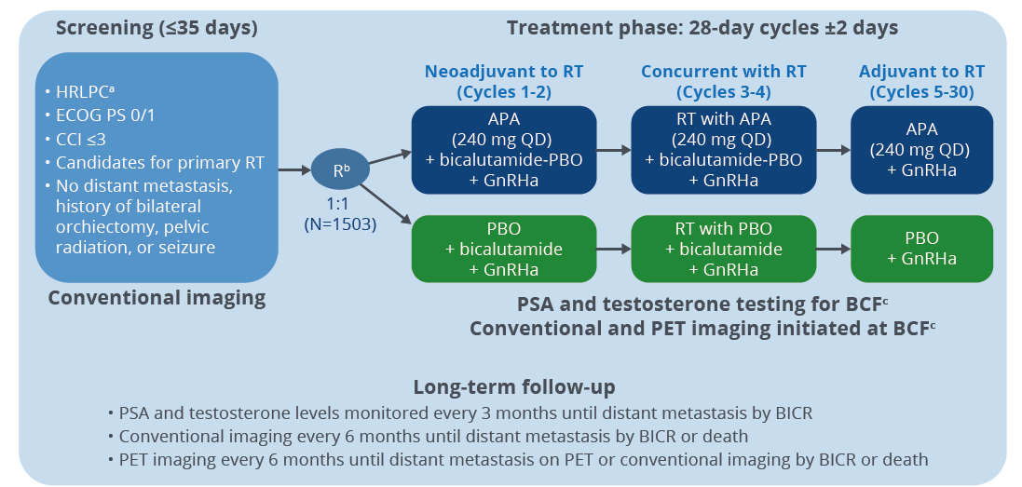
ATLAS trial design
N1=13%
High-risk +/- N1
MFS

Slide 11
ENZARAD (ANZUP 1303)
STUDY SCHEMA
Study Chairs:
Scott Williams & Paul Nguyen
n= 802 participants
Eligibility
Localized prostate cancer
High risk of recurrence
Suitable for EBRT
Stratification
Gleason score 8-10
T3-4 disease
N1 disease
PSA ≥20 ng/mL
Brachytherapy boost
Pelvic nodal RT
Study Site
Endpoints
Metastasis-free survival (primary)
Overall survival
Cause specific survival
PSA progression free survival
Clinical progression free survival
Castration-resistance
Health related quality of life
Adverse events
Incremental cost-effectiveness
Enzalutamide 160mg daily for 24 months
+ LHRHA for 24 months
+ RT starting after 16 weeks ± brachy ± nodal
®
1:1
Conventional NSAA for 6 months
+ LHRHA for 24 months
+ RT starting after 16 weeks ± brachy ± nodal
*Conventional Non-Steroidal Anti-Androgens: bicalutamide 50mg daily, nilutamide 150mg daily, or flutamide 250mg tid

Slide 12
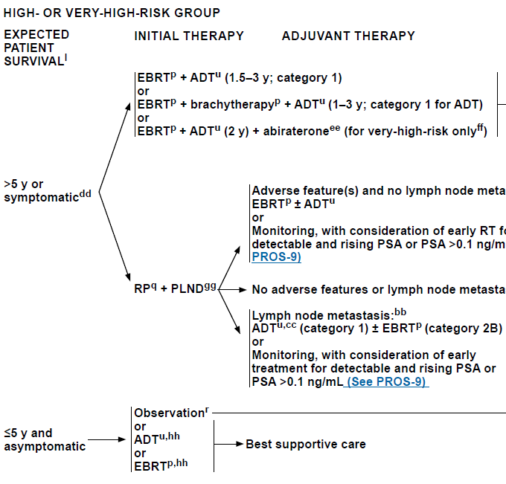

Treatment Options For High-Risk Prostate Cancer
High-Risk
No very high-risk features and exactly one high-risk feature:
cT3a OR
Grade Group 4 or 5 OR
PSA > 20 ng/ml
Very High-Risk
Has at least one of the following:
cT3b to T4 OR
Primary pattern 5 OR
2 to 3 high-risk features
>4 cores with Grade Group 4 or 5
Notes:
PSMA PET

Slide 13
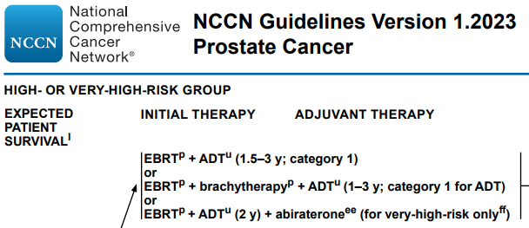
ADT with External Beam Radiation
For Very High-Risk Prostate Cancer
24 months of ADT with abiraterone
Very High-Risk
Has at least one of the following:
cT3b to T4 OR
Primary pattern 5 OR
2 to 3 high-risk features
>4 cores with Grade Group 4 or 5

Slide 14
Clinical case (Scenario 1)
65 years old with rising PSA 3.2 to 6.1 over 2 years. Testosterone 320 ng/dL. Normal DRE.
MRI prostate: 26 mL prostate. Extracapsular extension and seminal vesicle invasion. PIRADS 5
Biopsy demonstrated Gleason 4+3=7 in 6 of 12 cores

Slide 15
Case (Scenario 2)
MRI shows 1.4 cm left pelvic sidewall lymph node.
CT abd/pelvis with left sided hydronephrosis from bladder thickening at left ureteral junction. Left pelvic lymphadenopathy. Bone scan negative. PSMA PET confirms cT4N1 disease.
DRE cT4
No significant comorbidities.

Slide 16
Which therapy would you recommend with EBRT?
1. ADT alone
2. ADT with bicalutamide
3. ADT with abiraterone/prednisone
Notes:
Briefly remind audience that patients needs ADT + radiation
Move to data on AR targeting; ADT + abiraterone, ATLAS and ENZARAD trials
Discuss duration of ADT – 5 yrs vs 3yrs so message is clear as to duration

Slide 17
PRESTO: A Phase 3 Open-Label Study of Androgen Annihilation in Patients with High-Risk Biochemically Relapsed Prostate Cancer (AFT-19)
Rahul Aggarwal, on behalf of the Alliance AFT-19 Study Investigators
Paris, France
11 SEP 2022

Slide 18
Biochemically recurrent prostate cancer
Men with biochemically recurrent prostate cancer following radical prostatectomy and a short PSA doubling time are at high risk for the development of distant metastases and prostate cancer related mortality¹
Intermittent androgen deprivation therapy (ADT) is a standard treatment approach for biochemically recurrent prostate cancer²
A prior phase 3 study demonstrated non-inferiority of intermittent versus continuous ADT with respect to overall survival, with improvement in several key QOL parameters³
1. Pound CR, et al. JAMA 1999; 2. NCCN Guidelines version 4.2022; 3. Crook JM, et al. NEJM 2012

Slide 19
Study Schema
Prior radical prostatectomy
Biochemical recurrence with PSA > 0.5 ng/mL
PSA-DT ≤ 9 months
No metastases on conventional imaging
Last dose of ADT > 9 months prior to study entry
Serum T > 150 ng/dL
Arm A:
LHRH Analog
Arm B:
LHRH Analog + Apalutamide
Follow up for PSA Progression
Treatment per Investigator Discretion
Randomize 1:1:1
Long Term Follow Up
Arm C:
LHRH Analog + Apalutamide + Abiraterone Acetate + Prednisone
Stratified by PSA doubling time
(< 3 months vs. 3 – 9 months)
52 Weeks
Aggarwal R et al. ESMO 2022;Abstract LBA63.

Slide 20
Study Objectives
To compare each experimental arm versus control with respect to:
Primary Objective: PSA progression-free survival, with PSA progression defined as nadir + 2 ng/mL during treatment or > 0.2 ng/mL following treatment confirmed by repeat measurement (> 2 wks)
Secondary Objectives:
  PSA progression-free survival in testosterone-evaluable population (T > 50 ng/dL)
  Time to recovery of serum testosterone (T > 50 ng/dL)
  Safety profile
  36-month PSA progression-free survival rate
  Metastasis-free survival
  Time to castration resistance
  Short- and long-term patient reported quality of life
Aggarwal R et al. ESMO 2022;Abstract LBA63.

Slide 21
Baseline Characteristics
 | Arm A (N = 166) | Arm B (N = 168) | Arm C (N = 169) | Overall Study Cohort (N =503)
Median Age (Q1, Q3) | 67.0 (60.3, 71.1) | 66.0 (60.7, 70.3) | 67.3 (62.4, 71.3) | 66.7 (61.2, 70.9)
Race (%) American Indian/Alaska Native Asian Black or African-American Native Hawaiian/Pacific Islander Other White Unknown/Not Reported/Missing | 1 (0.6) 3 (1.8) 7 (4.2) 1 (0.6) 2 (1.2) 142 (85.5) 10 (6.0) | 0 (0.0) 0 (0.0) 13 (7.7) 0 (0.0) 1 (0.6) 144 (85.7) 10 (6.0) | 2 (1.2) 10 (5.9) 12 (7.1) 1 (0.6) 2 (1.2) 135 (79.9) 7 (4.1) | 3 (0.6) 13 (2.6) 32 (6.4) 2 (0.4) 5 (1.0) 421 (83.7) 27 (5.4)
Ethnicity (%) Hispanic Non-Hispanic Unknown/Not Reported/Missing | 10 (6.0) 151 (91.0) 5 (3.0) | 10 (6.0) 152 (90.5) 6 (3.6) | 7 (4.1) 155 (91.7) 7 (4.1) | 27 (5.4) 458 (91.1) 18 (3.6)
Rahul Aggarwal, MD
Aggarwal R et al. ESMO 2022;Abstract LBA63.

Slide 22
Baseline Characteristics, cont.
 | Arm A (n = 166) | Arm B (n = 168) | Arm C (n = 169) | Overall Study Cohort (N = 503)
Median PSA at study entry, ng/mL (Q1, Q3) | 1.73 (1.01, 3.20) | 1.80 (0.97, 3.58) | 1.77 (0.95, 4.21) | 1.77 (0.97,3.57)
PSA doubling time strata (%) < 3 months 3 – 9 months | 43 (25.9) 123 (74.1) | 43 (25.6) 125 (74.4) | 44 (26.0) 125 (74.0) | 130 (25.8) 373 (74.2)
Median time interval between radical prostatectomy and study entry, years (Q1, Q3) | 4.6 (2.8, 7.3) | 4.7 (2.8, 6.5) | 4.0 (2.8, 6.8) | 4.4 (2.8, 6.8)
Prior radiation, N (%) | 147 (88.6) | 142 (84.5) | 137 (81.1) | 426 (84.7)
Prior androgen deprivation therapy, N (%) | 71 (42.8) | 75 (44.6) | 67 (39.6) | 213 (42.35)
Aggarwal R et al. ESMO 2022;Abstract LBA63.

Slide 23
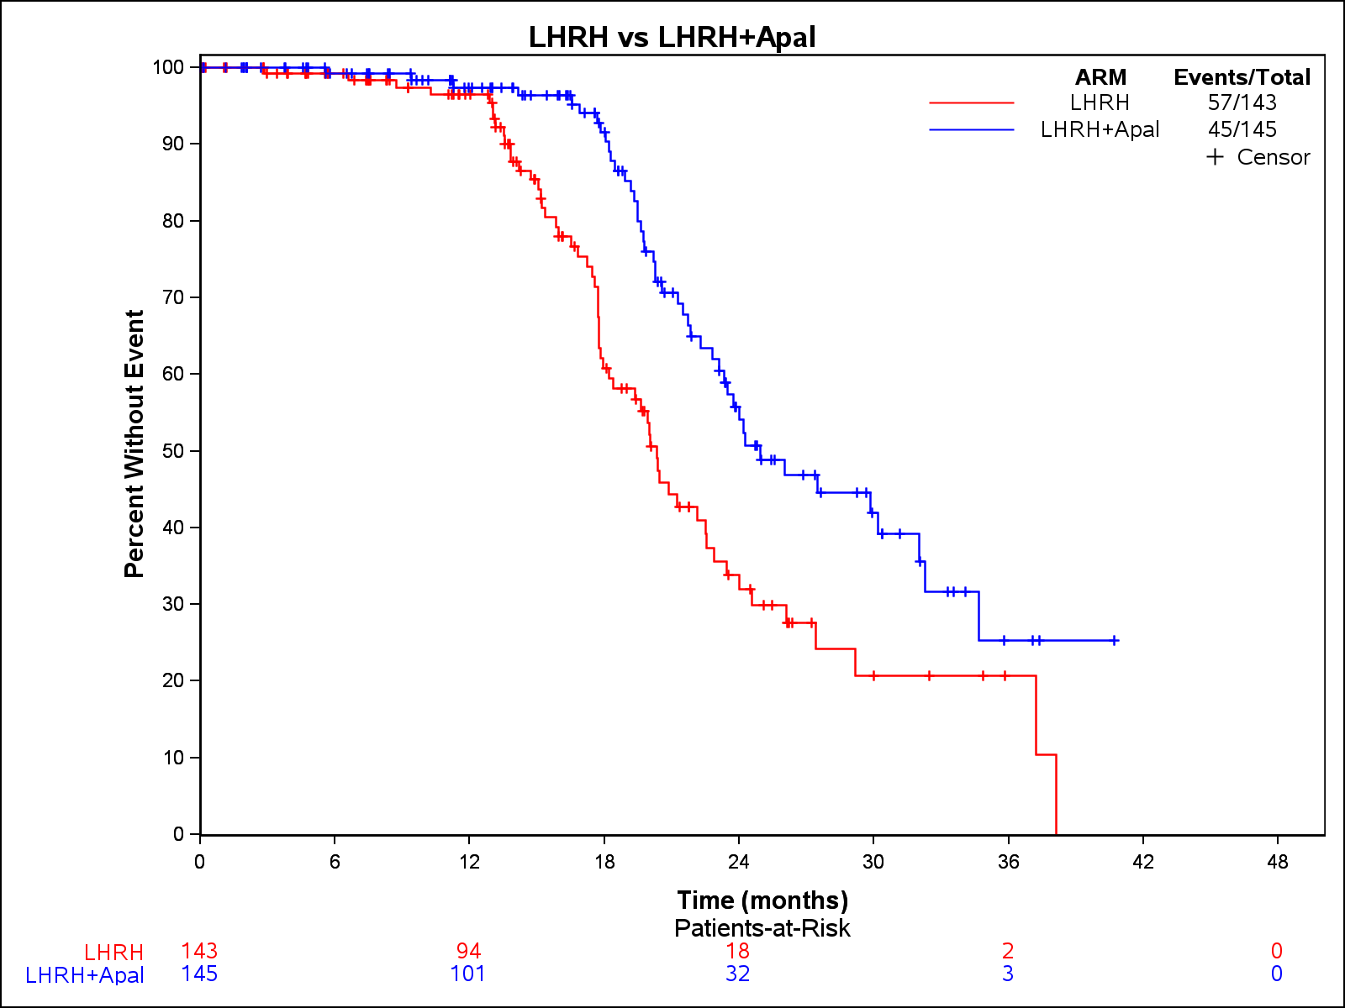
Arm B: ADT + apalutamide vs. ADT monotherapy
Median follow up 21.5 months
102 PSA PFS events
Median PSA progression-free survival
  ADT + APA = 24.9 months (95% CI: 23.3 – 32.3)
  ADT alone = 20.3 months (95% CI: 18.2 – 22.9)
  Hazard ratio 0.52 (95% CI: 0.35 – 0.77)
  One-sided p-value = 0.00047)
LHRH
LHRH + APA
LHRH
LHRH + APA
Aggarwal R et al. ESMO 2022;Abstract LBA63.

Slide 24
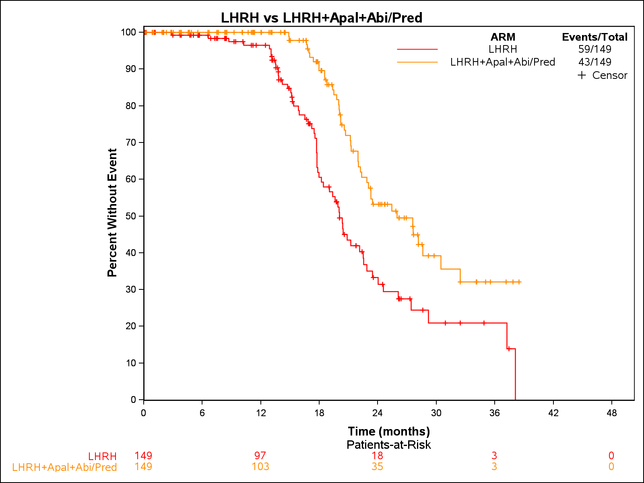
Arm C: ADT + apalutamide + abiraterone acetate + prednisone vs. ADT monotherapy
Median follow up 21.3 months
102 PSA PFS events
Median PSA progression-free survival
  ADT + APA + AAP = 26.0 months (95% CI: 22.9 – 32.5)
  ADT alone = 20.0 months (95% CI: 18.2 – 22.5)
  Hazard ratio = 0.48 (95% CI: 0.32 – 0.71)
  One-sided p-value = 0.00008
LHRH
LHRH + APA + AAP
LHRH
LHRH + APA + AAP
Aggarwal R et al. ESMO 2022;Abstract LBA63.

Slide 25
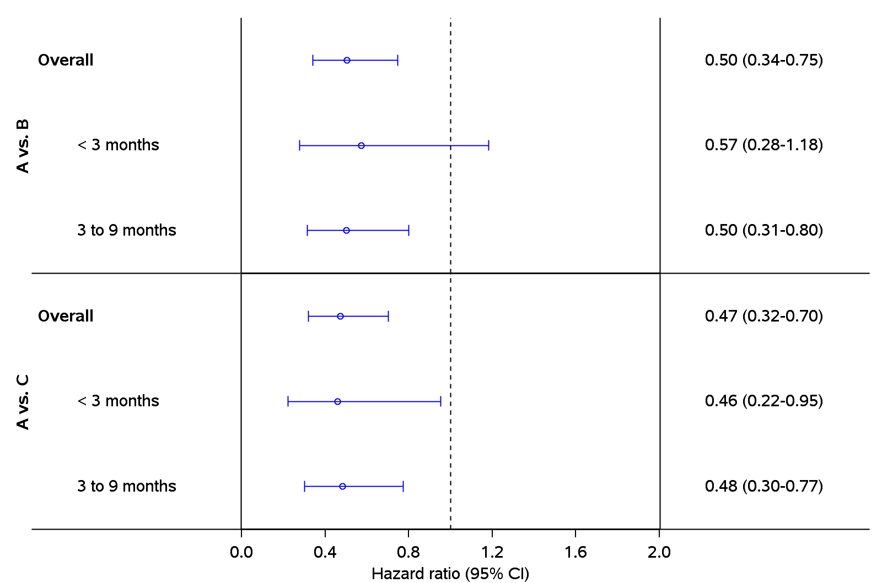
PSA Progression-Free Survival by PSA Doubling Time
Hazard Ratio for PSA Progression-Free Survival
Arm A: n = 38
Arm B: n = 39
Arm B vs. Arm A
Arm A: n = 105
Arm B: n = 106
Arm C vs. Arm A
Arm A: n = 40
Arm C: n = 41
Arm A: n =109
Arm C: n = 108
Favors experimental arm
Favors control arm
Aggarwal R et al. ESMO 2022;Abstract LBA63.

Slide 26
Most Common Grade ≥ 2 Adverse Events (N = 484)
 | Arm A (n = 160) |  | Arm B (n = 163) |  | Arm C (n = 161)
Adverse Events (AE) | Grade 2 | Grade ≥ 3 | Grade 2 | Grade ≥ 3 | Grade 2 | Grade ≥ 3
 | n (%) |  | n (%) |  | n (%)
Hypertension | 19 (12) | 12 (8) | 25 (15) | 12 (7) | 18 (11) | 31 (19)
Hot flashes | 19 (12) | 1 (1) | 8 (5) | 0 | 23 (14) | 0
Fatigue | 14 (9) | 0 | 8 (5) | 3 (2) | 16 (10) | 2 (1)
Injection site reaction | 9 (6) | 0 | 10 (6) | 0 | 11 (7) | 0
Insomnia | 9 (6) | 0 | 5 (3) | 0 | 8 (5) | 0
Hyperglycemia | 0 | 3 (2) | 6 (4) | 2 (1) | 6 (4) | 5 (3)
Rash | 2 (1) | 1 (1) | 7 (4) | 3 (2) | 3 (2) | 5 (3)
Erectile dysfunction | 10 (6) | 1 (1) | 6 (4) | 1 (1) | 2 (1) | 0
Arthralgia | 4 (3) | 1 (1) | 6 (4) | 1 (1) | 3 (2) | 2 (1)
Elevated ALT | 1 (1) | 0 | 1 (1) | 0 | 2 (1) | 0
Aggarwal R et al. ESMO 2022;Abstract LBA63.

Slide 27
Summary of Adverse Events (N = 484)
 | Arm A (n=160) | Arm B (n=163) | Arm C (n=161)
Adverse Events (AE) | n (%) | n (%) | n (%)
Any AE | 145 (90.6) | 148 (90.8) | 155 (96.3)
Grade 3 or 4 AE | 30 (18.8) | 41 (25.2) | 61 (37.9)
Any Serious AE | 13 (8.1) | 14 (8.6) | 28 (17.4)
AE leading to treatment discontinuation | 0 (0.0) | 3 (1.8) | 5 (3.1)
Aggarwal R et al. ESMO 2022;Abstract LBA63.

Slide 28
Limitations
PSA-based rather than metastasis-free survival primary endpoint
  Follow up is ongoing to estimate median metastasis-free survival in each study arm
Metabolic imaging (e.g. fluciclovine or PSMA PET) not required at screening
  Truly M0 biochemically recurrent CSPC population shrinking with stage migration
  Role of metastasis-directed therapy in oligometastatic CSPC in conjunction with ADT remains to be defined
Aggarwal R et al. ESMO 2022;Abstract LBA63.

Slide 29
Conclusions
PRESTO is the first phase 3 study to report results of ADT plus AR pathway inhibition in biochemically recurrent, non-metastatic, castration-sensitive prostate cancer
The addition of apalutamide to androgen deprivation for a finite duration of treatment leads to a statistically significant prolongation of PSA progression-free survival
  No adverse impact on time to testosterone recovery
  Safety profile consistent with prior studies
There does not appear to be further benefit with addition of abiraterone acetate + prednisone to apalutamide
Aggarwal R et al. ESMO 2022;Abstract LBA63.

Slide 30
Conclusions (continued)
Follow up is ongoing to estimate the impact of ADT plus AR pathway inhibition on patient-reported outcomes, time to subsequent therapy, and metastasis-free survival
Given that treatment decisions in biochemically recurrent prostate cancer are often predicated on PSA kinetics alone, ADT plus apalutamide for a finite treatment period could be considered for high-risk patients with a short PSA doubling time
Aggarwal R et al. ESMO 2022;Abstract LBA63.

Slide 31
EMBARK: A Phase 3 Randomized Study of Enzalutamide or Placebo Plus Leuprolide Acetate and Enzalutamide Monotherapy in High-Risk Biochemically Recurrent Prostate Cancer
Neal D. Shore,¹ Murilo de Almeida Luz,² Ugo De Giorgi,³ Martin Gleave,⁴ Geoffrey T. Gotto,⁵ Gabriel P. Haas,⁶ Miguel Ramirez-Backhaus,⁷ Antti Rannikko,⁸ Jamal Tarazi,⁹ Swetha Sridharan,¹⁰ Jennifer Sugg,⁶ Yiyun Tang,¹¹ Ronald F. Tutrone, Jr.,¹² Balaji Venugopal,¹³ Arnauld Villers,¹⁴ Henry H. Woo,¹⁵ Fabian Zohren,¹⁶ Stephen J. Freedland¹⁷
¹Carolina Urologic Research Center/GenesisCare US, Myrtle Beach, SC, USA; ²Erasto Gaertner Hospital, Curitiba, Brazil; ³IRCCS Istituto Romagnolo per lo Studio dei Tumori (IRST) Dino Amadori, Meldola, Italy; ⁴University of British Columbia, Vancouver, BC, Canada; ⁵University of Calgary, Calgary, AB, Canada; ⁶Astellas Pharma Inc., Northbrook, IL, USA; ⁷Servicio de Urología, Fundación Instituto Valenciano de Oncología, Valencia, Spain; ⁸University of Helsinki and Helsinki University Hospital, Helsinki, Finland; ⁹Pfizer Inc., Collegeville, PA, USA; ¹⁰Calvary Mater, Newcastle, NSW, Australia; ¹¹Pfizer Inc., San Francisco, CA, USA; ¹²Chesapeake Urology Research Associates, Towson, MD, USA; ¹³Beatson West of Scotland Cancer Centre, University of Glasgow, Glasgow, UK; ¹⁴University of Lille, Department of Urology, Claude Huriez Hospital, CHU LILLE, Lille, France; ¹⁵Sydney Adventist Hospital, Sydney, NSW, Australia; ¹⁶Pfizer Inc., Cambridge, MA, USA; ¹⁷Samuel Oschin Comprehensive Cancer Institute,
Cedars-Sinai Medical Center, Los Angeles, CA, USA

Slide 32
Introduction
Within 10 years following definitive therapy, between 20–50% of patients experience disease recurrence characterized by rising PSA levels.¹⁻³
Limited level 1 clinical data exist for the treatment of patients with BCR.
Patients with high-risk BCR are at increased risk of prostate cancer-specific mortality.³⁻⁵
Evidence from phase 3 clinical trials demonstrates that treatment intensification with ARSI, such as enzalutamide, consistently improves patient outcomes across the prostate cancer continuum.⁶⁻¹⁰
The objective of EMBARK was to evaluate enzalutamide in combination with leuprolide acetate
and enzalutamide monotherapy in patients with high-risk BCR.
1. Kupelian PA, et al. Cancer. 2002;95:2302–7. 2. Kupelian PA et al. Urology. 2006;68;593–8. 3. Freedland SJ et al. JAMA. 2005;294:433–9. 4. Freedland SJ, et al. J Clin Oncol. 2007; 25:1765–71. 5. Markowski MC, et al. Clin Genitourin Cancer. 2019;17:470–1. 6. Scher HI, et al. N Engl J Med. 2012;367:1187–97. 7. Beer TM, et al. N Engl J Med. 2014;371:424–33. 8. Hussain M, et al. N Engl J Med. 2018;378:2465–74. 9. Armstrong AJ, et al. J Clin Oncol. 2019;37:2974–86. 10. Davis ID, et al. N Engl J Med. 2019;381:121–31. ARSI, androgen receptor signaling inhibitor; BCR, biochemical recurrence; PSA, prostate-specific antigen.
Shore N et al. AUA 2023;Abstract LBA02-09.
Notes:
Kupelian_2002/p2305A (XRT, 47%; RP 42%)
Kupelian_2006/p593A/p594A/p595A (32%)
Freedland_2005/p434A (RP, 19%)
Freedland JAMA 2005 p437AB
Freedland_2007/p1767A/p1769A/p1770A
Markowski_2019/p471A/p474A (also include absolute PSA)
Scher HI_2012/p1190D/p1191A
Beer TM_2014/p427BD
Hussain M_2018/p2468C/p2470ABC
Armstrong AJ_2019/p2976BC
Davis ID_2019/p125C

Slide 33
EMBARK study design
    Patient population:
    Screening PSA ≥1 ng/mL after RP and at least 2 ng/mL above the nadir for primary EBRT
    PSADT ≤9 mo
    No metastases on bone scan or CT/MRI per central read
    Testosterone ≥150 ng/dL
    Prior hormonal therapy ≥9 mo prior to R (neoadjuvant/adjuvant for ≤36 mo OR ≤6 mo for rising PSA)
    Stratification factors:
    Screening PSA (≤10 ng/mL vs. >10 ng/mL)
    PSADT (≤3 mo vs. >3 to ≤9 mo)
    Prior hormonal therapy (yes vs. no)
Enzalutamide (160 mg oral qd) + leuprolide acetate
(22.5 mg IM/q12w)
n = 355
Blinded
Primary endpoint^{b}:
MFS by BICR, enzalutamide + leuprolide acetate vs. leuprolide acetate alone
Week 37
Suspend treatment at week 37 Monitor PSA (reinitiate if PSA rises)ª
Yes
Key secondary endpoints^{b,c}:
    MFS by BICR, enzalutamide monotherapy vs. leuprolide acetate alone
    Time to PSA progression
    Time to first use of new antineoplastic therapy
    OS^{c}
    Other secondary endpoints:
    Safety^{d}
R
1:1:1
Placebo + leuprolide acetate (22.5 mg IM/q12w)
n = 358
Blinded
PSA <0.2 ng/mL at week 36
N = 1068
No
Remain on treatment
Enzalutamide monotherapy (160 mg oral qd)
n = 355
Unblinded
ªStudy treatment was suspended once at week 37 if PSA was <0.2 ng/mL and restarted when PSA was ≥5.0 ng/mL (without prior RP) and ≥2 ng/mL (prior RP). ^{b}Intent-to-treat population. ^{c}Primary endpoint and key secondary endpoints for enzalutamide combination and enzalutamide monotherapy are alpha-protected. P-value to determine significance for OS of combination and monotherapy treatment comparisons was dependent on outcomes of primary endpoint and key secondary endpoints. ^{d}Safety population. BICR, blinded independent central review; CT, computed tomography; d, day; EBRT, external beam radiotherapy; IM, intramuscular; MFS, metastasis-free survival; mo, month; MRI, magnetic resonance imaging; OS, overall survival; PSA, prostate-specific antigen; PSADT, PSA doubling time; q, every; R, randomization; RP, radical prostatectomy; w, weeks.
Shore N et al. AUA 2023;Abstract LBA02-09.
Notes:
MDV3100 protocol 2021/p34A/p35AFG/p36AB
MDV3100 protocol 2021/p31ACD/p85B
MDV3100 protocol 2021/p31B
MDV3100 protocol 2021/p31E
MDV3100 protocol 2021/p79D
MDV3100 protocol 2021/p30BC

Slide 34
Demographics
Characteristic | Enzalutamide combination (n = 355) | Leuprolide acetate (n = 358) | Enzalutamide monotherapy (n = 355)
Age, median (range), yr | 69 (51–87) | 70 (50–92) | 69 (49–93)
Race, n (%)ª White | 293 (82.5) | 301 (84.1) | 295 (83.1)
Asian | 26 (7.3) | 26 (7.3) | 26 (7.3)
Black | 16 (4.5) | 16 (4.5) | 15 (4.2)
Other^{b} | 10 (2.8) | 10 (2.8) | 5 (1.4)
PSADT, n (%)^{c} ≤3 mo | 69 (19.4) | 80 (22.3) | 76 (21.4)
>3 to ≤9 mo | 285 (80.3) | 277 (77.4) | 278 (78.3)
PSADT, median, mo | 4.6 | 5.0 | 5.0
Serum PSA, median, n (%), ng/mL^{d} | 5.0 | 5.5 | 5.3
≤10 | 278 (78.3) | 273 (76.3) | 272 (76.6)
>10 | 77 (21.7) | 83 (23.2) | 82 (23.1)
Prior hormonal therapy, n (%) | 107 (30.1) | 113 (31.6) | 112 (31.5)
RP alone, n (%) | 90 (25.4) | 75 (20.9) | 99 (27.9)
RT alone, n (%) | 86 (24.2) | 104 (29.1) | 90 (25.4)
RP and RT, n (%) | 179 (50.4) | 179 (50.0) | 166 (46.8)
ªNot reported included: enzalutamide combination, n = 10 (2.8%); leuprolide acetate, n = 5 (1.4%); enzalutamide monotherapy, n = 14 (3.9%). ^{b}Includes patients who identified as multiple races (enzalutamide combination, n = 5; leuprolide acetate, n = 9; enzalutamide monotherapy, n = 5), American Indian or Alaskan Native (enzalutamide combination, n = 4; leuprolide acetate, n = 1; enzalutamide monotherapy, n = 0), Native Hawaiian or other Pacific Islander (enzalutamide combination, n = 1; leuprolide acetate and enzalutamide monotherapy, n = 0). ^{c}Missing included n = 1 (0.3%) for each treatment group. ^{d}Missing included: leuprolide acetate, n = 2; enzalutamide monotherapy, n = 1. RT, radiation therapy; yr, year.
Notes:
EMBARK TLR TLF/p40BD/p42C/p43ABDE
Ytang email 24APR could not PDF
EMBARK AUA ad hoc analysis/p2A

Slide 35
Primary endpoint — MFS for enzalutamide combination vs. leuprolide acetate
3-yr rate
92.9%
83.5%
5-yr rate
87.3%
71.4%
100
 | Enzalutamide combination (n = 355) | Leuprolide acetate (n = 358)
Median follow-up, mo | 60.7 | 60.6
Events, n (%) | 45 (13) | 92 (26)
Per BICR, median MFS (95% CI), mo | NR (NR) | NR (85.1–NR)
80
Enzalutamide combination
Leuprolide acetate
60
Metastasis-free survival (%)
40
HR (95% CI):
0.42 (0.31–0.61); P<0.0001ª
20
0
0
6
12
18
24
30
36
42
48
54
60
66
72
78
84
90
96
Metastasis-free survival (mo)
355 | 331 | 324 | 318 | 304 | 292 | 281 | 265 | 251 | 234 | 180 | 116 | 60 | 24 | 6 | 0 | 0
358 | 335 | 321 | 303 | 280 | 259 | 238 | 221 | 203 | 183 | 138 | 88 | 32 | 15 | 6 | 1 | 0
Patients at risk
Enzalutamide combination
Leuprolide acetate
A consistent treatment effect was seen for investigator-assessed MFS: HR (95% CI): 0.47 (0.37–0.67); P<0.0001
Data cutoff: January 31, 2023. Symbols indicate censored data. ªHR was based on a Cox regression model with treatment as the only covariate stratified by screening PSA, PSADT, and prior hormonal therapy as reported in the IWRS; relative to leuprolide acetate <1 favoring enzalutamide combination; the two-sided P-value was based on a stratified log-rank. CI, confidence interval; HR, hazard ratio; IWRS, interactive web response system; NR, not reached.
Notes:
EMBARK TLR TLF/p137A
EMBARK AUA Additional ad hoc/p1A

Slide 36
Subgroup analysis of MFS for enzalutamide combination vs. leuprolide acetate
 |  | Enzalutamide combination | Leuprolide acetate
Subgroup |  | Events, n /patients, n |  |  | MFS HR (95% CI)
All patients |  | 45/355 | 92/358 |  | 0.42 (0.30–0.61)
PSADT | ≤3 mo | 14/69 | 30/80 |  | 0.46 (0.24–0.88)
 | >3 to ≤6 mo | 18/187 | 35/142 |  | 0.33 (0.19–0.59)
 | >6 to ≤9 mo | 13/98 | 27/135 |  | 0.63 (0.32–1.22)
Baseline age | ≤65 years | 11/81 | 28/91 |  | 0.40 (0.20–0.81)
 | ≥65 years | 34/274 | 64/267 |  | 0.44 (0.29–0.67)
Geographic region | North America | 22/144 | 32/137 |  | 0.62 (0.36–1.06)
 | Europe | 14/130 | 33/128 |  | 0.35 (0.19–0.66)
 | ROW | 9/81 | 27/93 |  | 0.32 (0.15–0.68)
Baseline PSA | ≤10 ng/mL | 31/278 | 64/273 |  | 0.42 (0.27–0.64)
 | >10 ng/mL | 14/77 | 28/83 |  | 0.45 (0.24–0.85)
Prior hormonal therapy | Yes | 19/107 | 34/113 |  | 0.48 (0.28–0.85)
 | No | 26/248 | 58/245 |  | 0.39 (0.25–0.62)
Prior RP | Yes | 26/269 | 61/254 |  | 0.36 (0.23–0.58)
 | No | 19/86 | 31/104 |  | 0.57 (0.32–1.00)
Favors enzalutamide combination
Favors leuprolide acetate
Data cutoff: January 31, 2023. For all patients, HR and 95% CI are based on stratified Cox regression model stratified by randomization stratification factors; for subgroups, HR and 95% CI are based on unstratified Cox regression model.
Shore N et al. AUA 2023;Abstract LBA02-09.
Notes:
EMBARK TLF/p139AC
EMBARK TLF/p139AB

Slide 37
Key secondary endpoint — Time to PSA progression for enzalutamide combination vs. leuprolide acetate
100
 | Enzalutamide combination (n = 355) | Leuprolide acetate (n = 358)
Events, n (%) | 8 (2) | 93 (26)
Median time to PSA progression (95% CI), mo | NR (NR) | NR (NR)
80
Enzalutamide combination
Leuprolide acetate
60
PSA progression free (%)
HR (95% CI):
0.07 (0.03–0.14); P<0.0001ª
40
20
0
0
6
12
18
24
30
36
42
48
54
60
66
72
78
84
90
Time to PSA progression (mo)
355 | 337 | 326 | 319 | 302 | 286 | 270 | 260 | 247 | 230 | 175 | 119 | 75 | 37 | 12 | 0
358 | 341 | 314 | 293 | 268 | 253 | 223 | 201 | 182 | 168 | 128 | 83 | 42 | 20 | 7 | 3
Patients at risk
Enzalutamide combination
Leuprolide acetate
Data cutoff: January 31, 2023. Symbols indicate censored data. ªThe HR was based on a Cox regression model with treatment as the only covariate stratified by screening PSA, PSADT, and prior hormonal therapy as reported in the IWRS; relative to leuprolide acetate <1 favoring enzalutamide combination; the two-sided P-value is based on a stratified log-rank test.
Shore N et al. AUA 2023;Abstract LBA02-09.
Notes:
EMBARK TLF/p141A
EMBARK TLF/p141B

Slide 38
Key secondary endpoint — Time to first use of new antineoplastic therapy for enzalutamide combination vs. leuprolide acetate
100
 | Enzalutamide combination (n = 355) | Leuprolide acetate (n = 358)
Events, n (%) | 58 (16) | 140 (39)
Median time to first use of new antineoplastic therapy (95% CI), mo | NR (NR) | 76.2 (71.3–NR)
80
Enzalutamide combination
Leuprolide acetate
60
Antineoplastic therapy free (%)
HR (95% CI):
0.36 (0.26–0.49); P<0.0001ª
40
20
0
0
6
12
18
24
30
36
42
48
54
60
66
72
78
84
90
96
Time to first use of new antineoplastic therapy (mo)
355 | 342 | 335 | 328 | 318 | 302 | 292 | 284 | 273 | 255 | 195 | 135 | 87 | 43 | 16 | 3 | 0
358 | 342 | 332 | 322 | 304 | 281 | 262 | 240 | 218 | 202 | 149 | 100 | 56 | 25 | 9 | 3 | 0
Patients at risk
Enzalutamide combination
Leuprolide acetate
Data cutoff: January 31, 2023. Symbols indicate censored data. ªThe HR was based on a Cox regression model with treatment as the only covariate stratified by screening PSA, PSADT, and prior hormonal therapy as reported in the IWRS; relative to leuprolide acetate <1 favoring enzalutamide combination; the two-sided P-value is based on a stratified log-rank test.
Shore N et al. AUA 2023;Abstract LBA02-09.
Notes:
EMBARK TLF/p143A
EMBARK TLF/p143AB

Slide 39
Key secondary endpoint — MFS for enzalutamide monotherapy vs. leuprolide acetate
100
 | Enzalutamide monotherapy (n = 355) | Leuprolide acetate (n = 358)
Median follow-up, mo | 60.7 | 60.6
Events, n (%) | 63 (18) | 92 (26)
Per BICR, median MFS (95% CI), mo | NR (NR) | NR (85.1–NR)
80
Enzalutamide monotherapy
Leuprolide acetate
60
Metastasis-free survival (%)
HR (95% CI):
0.63 (0.46–0.87); P=0.0049ª
40
20
0
0
6
12
18
24
30
36
42
48
54
60
66
72
78
84
90
96
Metastasis-free survival (mo)
355 | 342 | 328 | 309 | 287 | 273 | 260 | 247 | 228 | 209 | 171 | 108 | 52 | 26 | 5 | 0 | 0
358 | 335 | 321 | 303 | 280 | 259 | 238 | 221 | 203 | 183 | 138 | 88 | 32 | 15 | 6 | 1 | 0
Patients at risk
Enzalutamide monotherapy
Leuprolide acetate
A consistent treatment effect was seen for investigator-assessed MFS: HR (95% CI): 0.56 (0.40–0.78); P=0.0006
Data cutoff: January 31, 2023. Symbols indicate censored data. ªThe HR was based on a Cox regression model with treatment as the only covariate stratified by screening PSA, PSADT, and prior hormonal therapy as reported in the IWRS; relative to leuprolide acetate <1 favoring enzalutamide monotherapy; the two-sided P-value was based on a stratified log-rank test.
Shore N et al. AUA 2023;Abstract LBA02-09.

Slide 40
Key secondary endpoints — Enzalutamide monotherapy vs. leuprolide acetate
Time to PSA progression
Time to first use of new antineoplastic therapy
100
100
80
Enzalutamide monotherapy
Leuprolide acetate
80
Enzalutamide monotherapy
Leuprolide acetate
60
60
PSA progression free (%)
Antineoplastic therapy free (%)
40
40
20
20
0
0
0
6
12
18
24
30
36
42
48
54
60
66
72
78
84
90
96
0
6
12
18
24
30
36
42
48
54
60
66
72
78
84
90
96
Months
Months
355 | 346 | 328 | 311 | 291 | 279 | 262 | 246 | 228 | 213 | 168 | 108 | 63 | 37 | 8 | 3 | 0
358 | 341 | 314 | 293 | 268 | 253 | 223 | 201 | 182 | 168 | 128 | 83 | 42 | 20 | 7 | 3 | 0
355 | 352 | 341 | 327 | 312 | 297 | 279 | 268 | 252 | 240 | 192 | 124 | 80 | 40 | 12 | 3 | 0
358 | 342 | 332 | 322 | 304 | 281 | 262 | 240 | 218 | 202 | 149 | 100 | 56 | 25 | 9 | 3 | 0
Patients at risk
Enzalutamide monotherapy
Leuprolide acetate
Patients at risk
Enzalutamide monotherapy
Leuprolide acetate
 | Enzalutamide monotherapy (n = 355) | Leuprolide acetate (n = 358)
Events, n (%) | 37 (10) | 93 (26)
Median time to PSA progression (95% CI), mo | NR (NR) | NR (NR)
 | Enzalutamide monotherapy (n = 355) | Leuprolide acetate (n = 358)
Events, n (%) | 84 (24) | 140 (39)
Median time to first use of new antineoplastic therapy (95% CI), mo | NR (NR) | 76.2 (71.3–NR)
HR (95% CI):
0.33 (0.23–0.49); P<0.0001ª
HR (95% CI):
0.54 (0.41–0.71); P<0.0001ª
Data cutoff: January 31, 2023. Symbols indicate censored data. ªThe HR was based on a Cox regression model with treatment as the only covariate stratified by screening PSA, PSADT, and prior hormonal therapy as reported in the IWRS; relative to leuprolide acetate <1 favoring enzalutamide monotherapy; the two-sided P-value was based on a stratified log-rank test.
Shore N et al. AUA 2023;Abstract LBA02-09.

Slide 41
Safety profile
Event, n (%)ª | Enzalutamide combination (n = 353) |  | Leuprolide acetate (n = 354) |  | Enzalutamide monotherapy (n = 354)
Event — no. (%) | All grades | Grade ≥3 | All grades | Grade ≥3 | All grades | Grade ≥3
Any AE | 343 (97.2) | 164 (46.5) | 345 (97.5) | 151 (42.7) | 347 (98.0) | 177 (50.0)
Treatment-related AE | 305 (86.4) | 62 (17.6) | 283 (79.9) | 31 (8.8) | 312 (88.1) | 57 (16.1)
Serious AE | 123 (34.8) | 110 (31.2) | 112 (31.6) | 100 (28.2) | 131 (37.0) | 116 (32.8)
Treatment-related serious AE | 26 (7.4) | 22 (6.2) | 8 (2.3) | 7 (2.0) | 17 (4.8) | 17 (4.8)
AE leading to dose reduction | 25 (7.1) | 11 (3.1) | 16 (4.5) | 5 (1.4) | 56 (15.8) | 14 (4.0)
AE leading to permanent discontinuation | 73 (20.7) | 31 (8.8) | 36 (10.2) | 19 (5.4) | 63 (17.8) | 34 (9.6)
AE leading to death | 6 (1.7)^{b} | – | 3 (0.8)^{b} | – | 8 (2.3)^{b} | –
Median treatment duration excluding treatment suspension was 32.4 mo (range, 0.1–83.4 mo) for enzalutamide combination, 35.4 mo (range, 0.7–85.7 mo) for leuprolide acetate, and 45.9 mo (0.4–88.9 mo) for enzalutamide monotherapy.
The most common AE leading to study drug discontinuation was fatigue (enzalutamide combination, 3.4% [n = 12]; leuprolide acetate, 1.1% [n = 4]; enzalutamide monotherapy, 2.3% [n = 8]).
Data cutoff: January 31, 2023. ªPercentages may not total 100 because of rounding. Shown are AE that occurred from the time of first dose of study treatment through 30 days after permanent discontinuation. AE were graded according to the National Cancer Institute Common Terminology Criteria for Adverse Events version 4.03. ^{b}Grade 5 AE; none were considered treatment-related. AE, adverse event.
Shore N et al. AUA 2023;Abstract LBA02-09.
Notes:
EMBARK TLR_TLF/p47AB/p84ABC
EMBARK data 20MAR23/p1AB

Slide 42
Most common TEAEs
Most common TEAEs (>15% of patients), n (%)ª | Enzalutamide combination (n = 353) |  | Leuprolide acetate (n = 354) |  | Enzalutamide monotherapy (n = 354)
Most common adverse events (>15% of patients), n (%) | All grades | Grade ≥3 | All grades | Grade ≥3 | All grades | Grade ≥3
Hot flash | 243 (68.8) | 2 (0.6) | 203 (57.3) | 3 (0.8) | 77 (21.8) | 1 (0.3)
Fatigue | 151 (42.8) | 12 (3.4) | 116 (32.8) | 5 (1.4) | 165 (46.6) | 14 (4.0)
Arthralgia | 97 (27.5) | 5 (1.4) | 75 (21.2) | 1 (0.3) | 81 (22.9) | 1 (0.3)
Hypertension | 82 (23.2) | 2 (0.6) | 69 (19.5) | 0 | 67 (18.9) | 0
Fall | 74 (21.0) | 3 (0.8) | 51 (14.4) | 2 (0.6) | 56 (15.8) | 5 (1.4)
Back pain | 60 (17.0) | 1 (0.3) | 54 (15.3) | 0 | 62 (17.5) | 1 (0.3)
Nausea | 42 (11.9) | 0 | 29 (8.2) | 0 | 54 (15.3) | 1 (0.3)
Gynecomastia | 29 (8.2) | 0 | 32 (9.0) | 0 | 159 (44.9) | 1 (0.3)
Nipple pain | 11 (3.1) | 0 | 4 (1.1) | 0 | 54 (15.3) | 0
The most common AEs (>15% of patients) for all treatment cohorts were hot flash, fatigue; plus gynecomastia in the enzalutamide monotherapy cohort; most were grade <3.
Data cutoff: January 31, 2023. ªPercentages may not total 100 because of rounding. Shown are AEs that occurred from the time of first dose of study treatment through 30 days after permanent discontinuation. AEs were graded according to the National Cancer Institute Common Terminology Criteria for Adverse Events version 4.03. TEAE, treatment-emergent AE.
Shore N et al. AUA 2023;Abstract LBA02-09.
Notes:
EMBARK TLR_TLF/p87AB/p88AB/p90AB
EMBARK data 20MAR23/p8AB/p14AB/p20AB/p21AB/p35AB/p37AB/p94AB/p164AB
YTang 21MAR23 email/p1A

Slide 43
Selected TEAEs of special interest
Clustered TEAEs of special interest, n (%)ª | Enzalutamide combination (n = 353) |  | Leuprolide acetate (n = 354) |  | Enzalutamide monotherapy (n = 354)
Most common adverse events (>15% of patients), n (%) | All grades | Grade ≥3 | All grades | Grade ≥3 | All grades | Grade ≥3
Fatigue^{b} | 178 (50.4)^{c} | 14 (4.0) | 134 (37.9)^{c} | 6 (1.7) | 191 (54.0)^{c} | 17 (4.8)
Musculoskeletal events^{d} | 163 (46.2)^{c} | 13 (3.7) | 148 (41.8)^{c} | 4 (1.1) | 158 (44.6)^{c} | 6 (1.7)
Hypertension | 89 (25.2)^{c} | 27 (7.6) | 74 (20.9) | 21 (5.9) | 77 (21.8)^{c} | 20 (5.6)
Fall | 74 (21.0) | 4 (1.1) | 51 (14.4) | 4 (1.1) | 56 (15.8) | 7 (2.0)
Fracture^{e} | 65 (18.4) | 14 (4.0) | 48 (13.6) | 9 (2.5) | 39 (11.0) | 7 (2.0)
Cognitive and memory impairment | 53 (15.0)^{c} | 2 (0.6) | 23 (6.5) | 2 (0.6) | 50 (14.1)^{c} | 0
Loss of consciousness^{f} | 20 (5.7) | 17 (4.8) | 12 (3.4) | 6 (1.7) | 12 (3.4) | 8 (2.3)
Ischemic heart disease | 19 (5.4) | 14 (4.0) | 20 (5.6) | 11 (3.1) | 32 (9.0) | 21 (5.9)
Other selected CV events^{g} | 18 (5.1) | 13 (3.7) | 17 (4.8) | 10 (2.8) | 13 (3.7) | 8 (2.3)
Convulsion (seizure) | 4 (1.1) | 2 (0.6) | 0 | 0 | 3 (0.8) | 2 (0.6)
The most common AEs of special interest for all treatment cohorts (≥10% of patients) were fatigue, fall, fracture, hypertension, and musculoskeletal events.
Data cutoff: January 31, 2023. ªPercentages may not total 100 because of rounding. Shown are AEs that occurred from the time of first dose of study treatment through 30 days after permanent discontinuation. AEs were graded according to the National Cancer Institute Common Terminology Criteria for Adverse Events version 4.03. ^{b}Fatigue events included asthenia. ^{c}The most common (≥10% of patients) TEAEs. ^{d}Musculoskeletal events included back pain, arthralgia, myalgia, musculoskeletal pain, pain in extremity, musculoskeletal stiffness, muscular weakness, and muscle spasms. ^{e}Fractures excluded tooth fracture and fracture of the penis. ^{f} Loss of consciousness included syncope and presyncope. ^{g}Other selected CV events included hemorrhagic central nervous system vascular conditions, ischemic central nervous system vascular conditions, and cardiac failure. CV, cardiovascular.
Shore N et al. AUA 2023;Abstract LBA02-09.
Notes:
EMBARK TLR_TLF/p85AB/p86AB
EMBARK Data 21MAR23/p9AB/p10AB
Ytang safety labels/p2A

Slide 44

EMBARK: Conclusions
aPLS
In patients with high-risk BCR, compared with leuprolide acetate, enzalutamide combination demonstrated a statistically significant and clinically meaningful improvement in MFS (HR 0.42; 95% CI, 0.30–0.61; P<0.0001).
    A consistent treatment effect in pre-specified subgroups
    Significant delays in time to PSA progression and time to first new antineoplastic therapy
    A trend toward improved survival in interim analysis (HR 0.59; 95% CI, 0.38–0.90; P=0.0142); study ongoing for final analysis
Enzalutamide monotherapy also demonstrated statistically significant and clinically meaningful improvements in MFS (HR 0.63; 95% CI 0.46–0.87; P=0.0049), time to PSA progression, and time to first new antineoplastic therapy.
  A trend toward improved survival in interim analysis
No new safety signals observed to date with enzalutamide treatment
Enzalutamide in combination with ADT, if approved in this setting, has the potential
to become a new standard of care for patients with high-risk BCR.
.
Shore N et al. AUA 2023;Abstract LBA02-09.
Notes:
EMBARK TLR/p2ABCD/p3AC
Password, EMBARKTLRonxy

Slide 45
Clinical Case: BCR
70 yo WM 18 months post RP
PSA 5.0, PSADT 6 months
Conventional Imaging (CT/BS) negative
MedHx: ECOG 0; +HTN/elevated lipids
Genomic profiling not done

Slide 46
Clinical Case: BCR, continued
Initiate therapy:
ADT alone
ADT + APA
ADT + Enza
Monotx Enza
Wait till conventional imaging positive

Slide 47
Clinical Case: BCR, continued
Questions:
1: Role genomic molecular markers (Decipher®, Prolaris®, Oncotype DX®)
2: Role genetic alteration testing (germline, somatic)
3: Role PSMA PET
4: Role metastasis directed therapy (RT vs excision), +/- T suppression

Slide 48
THANK YOU

